Slide 1
Nuclear Terrorism
James Zino, Tye Johnson,
Jeffery Terrillion, Steven McIlveen

Slide 2
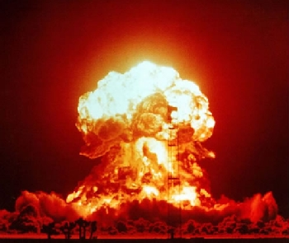
The History of Nuclear Terrorism
Since the mid 1900s, nuclear warfare and terrorism have become a universal fear around the world
Although the only nuclear bombs that have ever been dropped were detonated over 4 decades ago, the fear of nuclear war remains

Slide 3
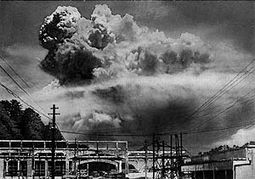
Hiroshima & Nagasaki
In early August 1945 the United States dropped the worlds first nuclear bombs on the Japanese cities Hiroshima and Nagasaki
Over 70,000 people died immediately from the blasts
Nearly everything within a half mile from the points of detonation was leveled
Flammable materials such as paper burst into flames as far as 10, 000 ft away from the blasts
The bombs were each equivalent to 20,000 tons of dynamite

Slide 4
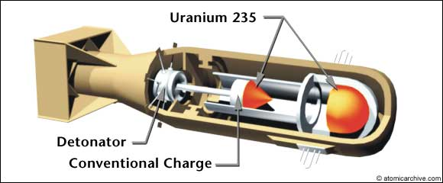
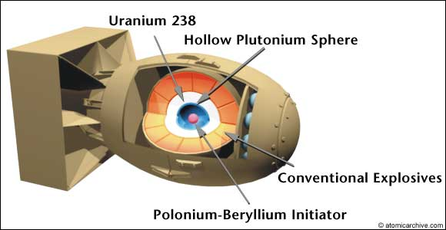
The Bombs Themselves
“Little Boy”
“Fat Man”
“Little Boy” was built using an Uranium 235, a rare and radioactive isotope
This bomb was detonated over Hiroshima and caused massive amounts of damage
“Fat Man” was built using Plutonium 239
After the Japanese did not surrender following the bombing of Hiroshima, “Fat Man” was detonated over Nagasaki

Slide 5
Many of the people who survived the blasts died from severe burns, radiation poisoning, and cancer
Thousands of others died due to drinking “black rain”
Many of the survivors’ children were born with terrible birth defects as well as cancer and leukemia
The official death toll from the bombings is over 200,000 , meaning the radiation afterwards killed more people than the initial blasts

Slide 6
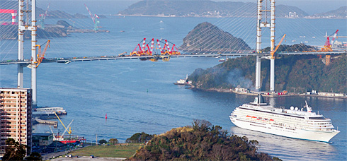
Today…
Hiroshima & Nagasaki
Today both Hiroshima and Nagasaki are thriving
The level of radiation is completely safe
Nagasaki alone has a population of over 440,000

Slide 7
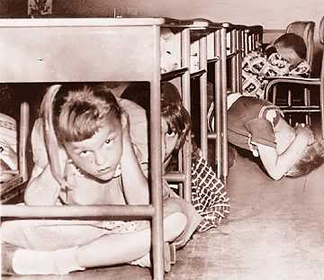
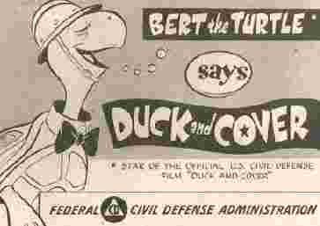
Although nuclear weapons are generally viewed negatively, the fear of these weapons has had positive affects
The fear of nuclear warfare may well have kept the United States and Soviet Union from open war
Many argue that nuclear weapons although they are never used, protect countries from attacks by hostile nations. This is called deterrence.

Slide 8
Could Terrorists Do It?
Seizing a Bomb
Although it has never happened, one way in which a terrorist group could obtain a nuclear bomb is by stealing one from one of the nine nations that currently report having nuclear weapons. With 20,000 weapons spread throughout the world amongst those nations it is a possibility that one could be stolen.
However, such an action, would be extremely unlikely with the amount of security and fail-safe devices with each nuclear weapon. That being said, accidents do happen. The Pentagon has reported to losing 11 Hydrogen bombs from 1945 to Present.
Seizing Bomb Fuel
With 1700 tons of weapons-grade uranium and 500 tons of weapons-grade plutonium spread throughout the world, which is enough to create 60,000 bombs of each kind.

Slide 9
Making a Bomb
A terrorist group could potentially make a fission or fusion bomb, but the chances are unlikely due to the expensive and intricate enrichment process.
90% of Manhattan Project budget spent on enrichment
Gun-Type – Little Boy –easier
Implosion Type- Fat Man - harder
Nuclear dirty bomb is relatively easy to make, but ineffective.
1995 Chechen Rebels

Slide 10
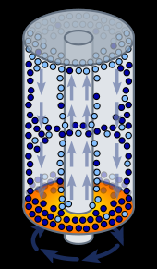
Why is Enrichment so Hard?
Enrichment requires expensive equipment and time
Need to separate isotopes
Thermal Diffusion - Outdated
Gaseous Diffusion - Outdated
Centrifugal Enrichment
Atomic vapor laser isotope separation
(AVLIS) – Ionization of U-235
Zippe Centrifuge

Slide 11
The Electromagnetic Pulse (EMP)
Outside of the nuclear effects of a weapon, another side effect is the creation of an EMP.
First known occurrence: Starfish Prime Test – 1962
400KM above Mid-Pacific Ocean

Slide 12
How Does an EMP Work? What controls how effective it is?
The altitude of the weapon when detonated;
The yield and construction details of the weapon;
The distance from the weapon when detonated;
Geographical depth or intervening geographical features
The local strength of the Earth's magnetic field.
Theory is based on the Compton Effect
Unrepairable
Also degausses

Slide 13
What would this mean?
If a terrorist group managed to use a 1 – 10 megaton bomb, an EMP would most likely occur.
No electricity, no phone, radio signals disrupted.
Start from scratch, or dig up old technology.

Slide 14
Incidents in Pakistan
“There is a greater possibility of a nuclear meltdown in Pakistan than anywhere else in the world” - Rolf Mowatt-Larssen
In the past 2 years, terrorists have attacked 3 Pakistani nuclear military facilities
Wah Cantonment Ordinance Complex
Sargodha nuclear missile storage facility
Kamra nuclear airbase
Pakistan is estimated to have between 70-90 nuclear warheads
Two senior Pakistan Atomic Energy Commission scientists, met with Osama Bin Laden twice in 2000 and 2001

Slide 15
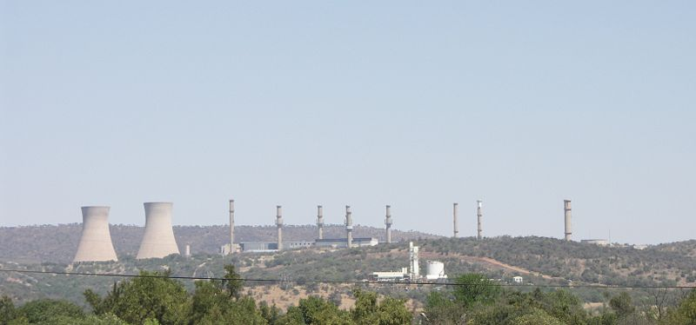
Incidents Elsewhere
In 2007 4 armed men broke into the Pelindaba Nuclear facility in South Africa, but escaped without acquiring any uranium
Between 1993 and 2006 the IAEA confirmed 1080 illicit trafficking incidents reported by participating countries

Slide 16
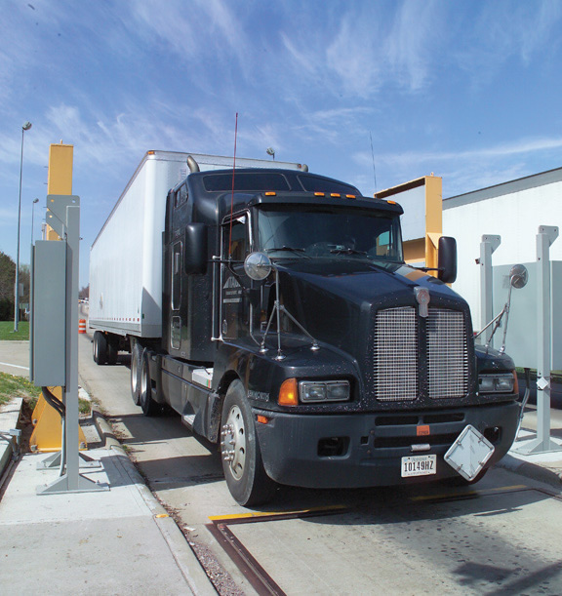
Nuclear Weapon Detection
Radiation Portal Monitors (RPM) are passive radiation detectors, most commonly used on vehicles or other cross border vectors such as trains, mail, and planes
RPMs are also used at nuclear facilities to prevent theft of radioactive material

Slide 17
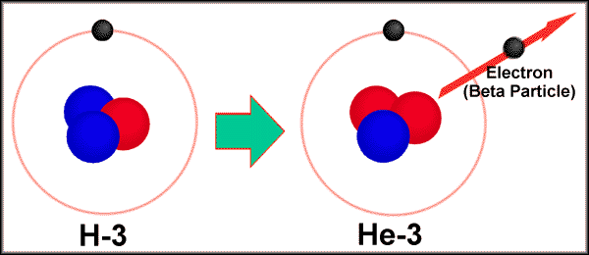
Nuclear Weapon Detection
The newest and best performing RPM are He-3 RPMs which are used to detect thermal neutrons
He-3 RPMs consist of He-3 tubes surrounded by neutron moderators, such as graphite or heavy water
He-3 is produced when the tritium (H-3) in Hydrogen bombs decays into He-3. Because of tritium’s half life of 12.33, every few years the tritium in these bombs has to be removed, purified by removing the He-3, and replenished

Slide 18
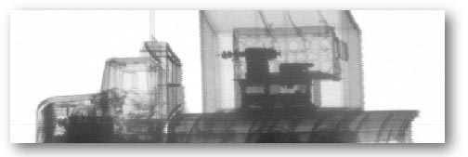
Nuclear Weapon Detection
Gamma-ray radiography
These systems usually use Cobalt-60 or Caesium-137 in one tower, and gamma detectors in another
X-ray radiography
These systems use a high energy Bremsstrahung spectrum with an energy of 5-10 MeV created by a linear particle accelerator.

Slide 19
Nuclear-Weapon Detection
Geiger Counter – Usually detect Beta, Gamma particles.
Tube of H – conducts electricity when nuclear particle or proton comes in contact

