Slide 1
The life and discoveries
Of Galileo Galilei
By: Daniel Rosenstein, Lauren Dougherty, Michael Wexler, Monique Mottler and Nicholas Cacciola

Slide 2
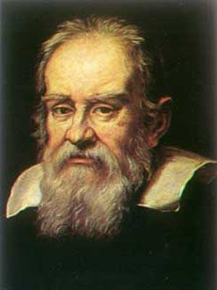
Early Life
Galileo was born in February 15th in Pisa, Italy
First became educated at the Camaldolese Monastery at Vallombrosa in Florence, Italy at the age of 8.
After studying mathematics at the University of Pisa until 1592, he moved to the University of Padua to teach geometry, mechanics and astronomy until 1610

Slide 3
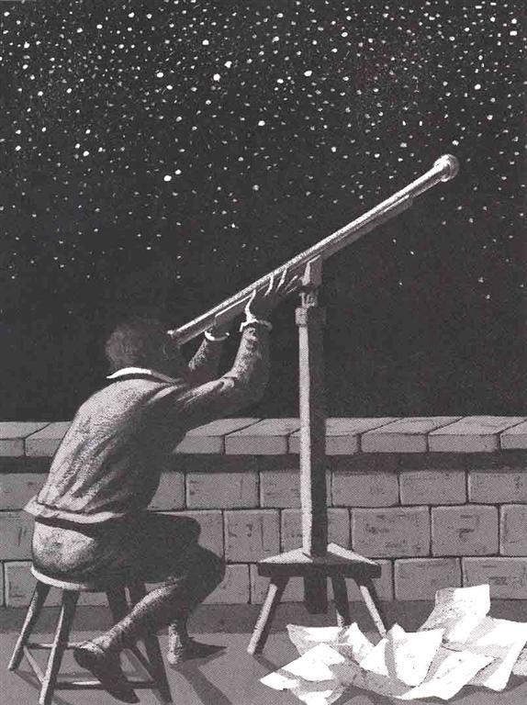
Methods
This method of problem solving set the path for modern mathematical and experimental physics.
Among his many accomplishments, Galileo’s scientific successes and originality as a scientist lay in his method of inquiry. He first reduced scientific problems to simple everyday terms that could be understood with regular experiences and common sense logic. He then analyzed and resolved them according to simple mathematical descriptions.

Slide 4
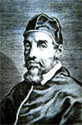
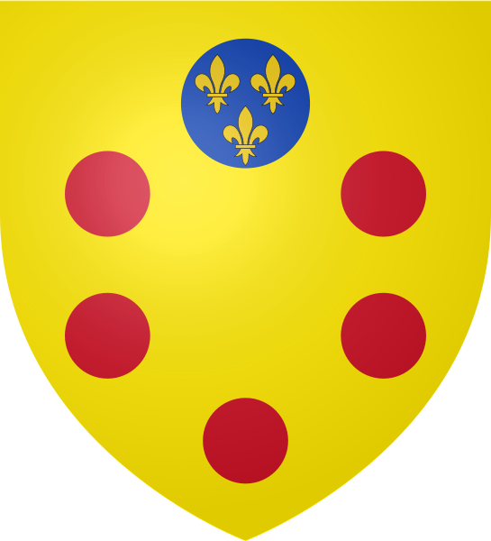
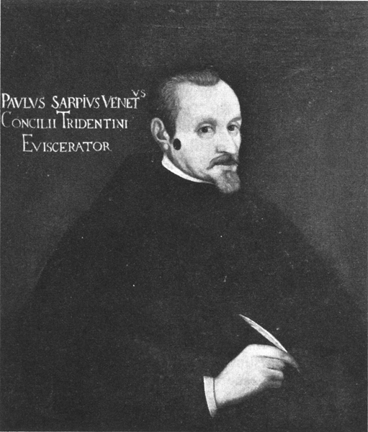
Patrons
Throughout his life, Galileo had a number of patrons who shared similar beliefs as he and supported his ideas and experiments.
1.Pope Urban VIII, Maffeo Barberini
2. The Medici Family
3. Paolo Sarpi
Pope Urban VIII, Maffeo Barberini
Medici Family Coat of Arms
Paolo Sarpi

Slide 5
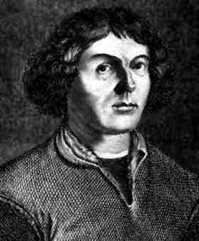
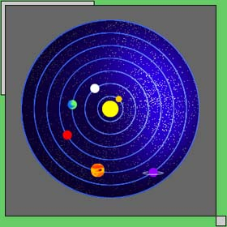
Copernicus
One of the biggest influences on Galileo’s studies and experiments was Copernicus and his ideas about the world.
The Copernican Theory, which Galileo studied were the first speculations that the Sun may be the center of the cosmos and the Earth is just one the planets traveling around it.
Copernicus created a new geocentric model that settled the order of the planets definitively.
One flaw of Copernicus’ was that he relied on circular motion, and thus his was not as great an improvement from his predecessors as we thought.
*His planetary model, with the Sun at the center.

Slide 6
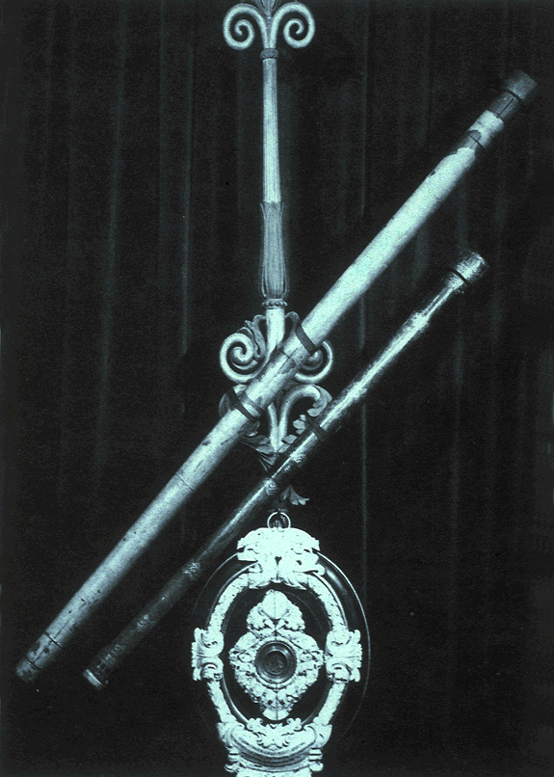
The Telescope
Galileo was fascinated with the invention of the Telescope in approx. 1608. The invention of the Telescope is credited to Hans Lipperhey ( of Belgium).
In 1609, having heard of this invention that “made distant objects appear visible” he improved the design using the law of optics and two lenses.
* Galileo’s telescopes

Slide 7
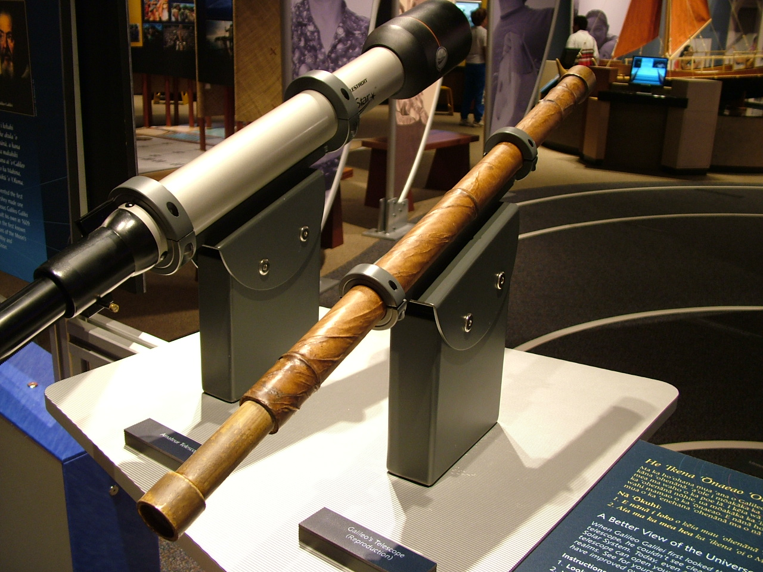
Telescope Cont.
*Galileo’s refractor-scope next to the modern day equivalent.
Galileo created a refractor-type telescope.
Galileo used convergent objective lens, and a divergent eyepiece lens.
These two lenses allow the scope to gather more light than the eye would.

Slide 8
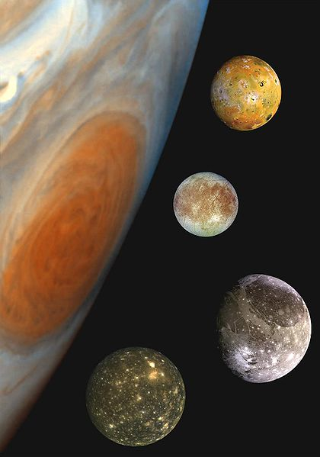
Discoveries With the Telescope
Galileo was the first person to observe the moons of Jupiter.
He initially thought them to be stars located close to Jupiter.
After studying that they orbited around Jupiter, he named the moons:
1. Io
2.Europe
3.Callisto
4.Ganymede

Slide 9
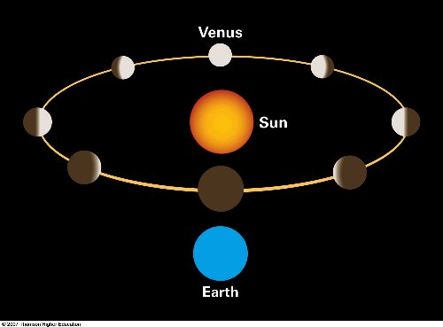
The Phases of Venus
In 1610, Galileo began to study the phases of Venus as it passed around the sun.
He observed that Venus moved in similar ways to the phases of the moon.

Slide 10
The Rings of Saturn
Galileo was also the first person to discover the rings around Saturn.
First he mistook them to be two planets rotating amongst themselves, but seeing their different patterns confused him.
*Galileo’s Sketches of the Rings of Saturn.

Slide 11
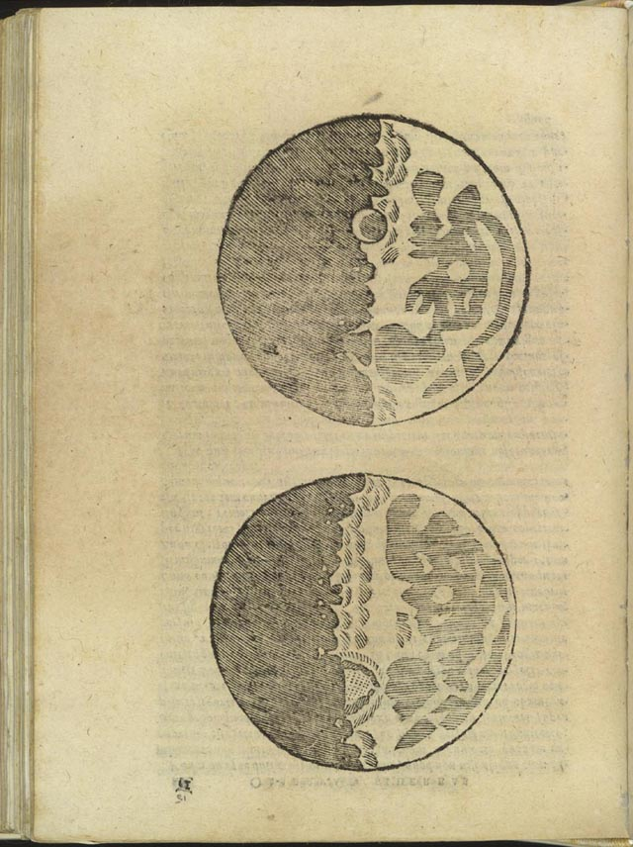
Observations of the Moon
Galileo observed sun spots, lunar mountains, and craters on both the Sun and the Moon.
These observations conflicted with the previous notions of Aristotle that the Sun, Moon and other ‘heavenly bodies’ were perfect – they were rough like Earth.
Galileo’s Drawings of the Moon

Slide 12
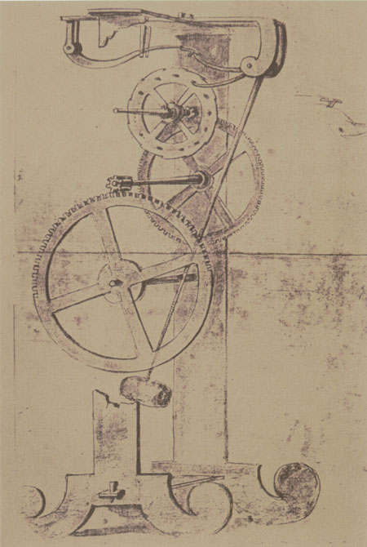
The Pendulum
What is a Pendulum?
A Pendulum is something hanging from a fixed point which, when pulled back and released, is free to swing down by force of gravity and then out and up because of its inertia.
Inertia: means that bodies in motion, will stay in motion; bodies at rest, will stay at rest, unless acted on by an outside force.
How does a Pendulum Clock Work?
(http://videos.howstuffworks.com/howstuffworks/15-how-pendulum-clocks-work-video.htm)

Slide 13
Pendulum Experiments
Galileo observed the motions of a chandelier in a cathedral and noticed that it had a constant period even when moving at different angles.
In 1602 Galileo began conducting experiments with pendulums in order to examine if their periods are indeed constant
To figure this out, he had to count the number of oscillations within a specified time
Galileo and his students recorded the number of oscillations in one entire day
Galileo examined a variety of pendulums and claimed that the period of each is totally independent of the size of the arc through which it passes.
In Conclusion, A pendulum with an angle of 80 degrees has an identical period to that of a pendulum with an angle of 2 degrees

Slide 14
Pendulum Conclusions
While Galileo’s Pendulum Experiments were insightful, they were not 100% correct.
Galileo did not consider Friction
For example: If you move a pendulum to an angle of 60 degrees, within a short number of cycles the pendulum will not extend beyond an angle of 20 degrees because of the friction. Because Galileo measured a large number of cycles, he thought that this law held true for larger angles too
Galileo discovered that the periods of smaller angles were constant and assumed that this was correct for every angle, an assumption which we now know to be wrong.
For small angles, the straight line is almost identical to the circle, so that the descent period is constant for the circle too. For this reason, the period of the pendulum at small angles is constant
*AIR = FRICTION

Slide 15
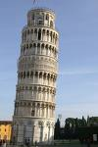
Galileo and Gravity
Galileo is alleged to have dropped objects from the top of the Leaning Tower of Pisa, to disprove Aristotle’s theories about Gravity.
Aristotle claimed that the speed at which an object falls is related to it’s weight.
Galileo held that the rate of speed of a falling object was related to it’s mass, not it’s weight.
As the legend has it, Galileo brought his students to the top of the tower to drop different objects with different masses to observe how they fall.

Slide 16
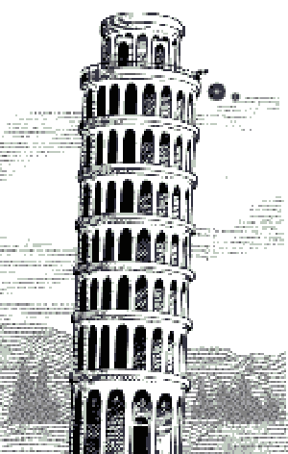
Galileo’s Experiment
With this experiment came Galileo’s ‘Law of Fall’:
All freefalling objects fall with the same acceleration towards the Earth’s surface, in the absence of air resistance
Whether it be 1lb or 10lbs does not affect the rate of speed as it falls toward the Earth
Feather vs. Hammer - http://video.google.com/videoplay?docid=6926891572259784994#

Slide 17
The Inclined Plane Experiments
The Inclined Plane Experiments
Does rate of acceleration depend on:
Mass and size of the ball?
Or the angle at which the plane is inclined?
Helped formulate an idea that led to Newton’s Second Law, inertia.
Newton writes in the Scholium appended to the Laws of Motion,
“By the first two Laws … Galileo discovered that the descent of bodies observed the duplicate ratio of the time …”

Slide 18
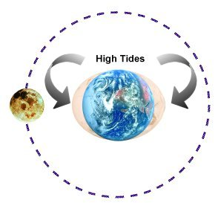
Tides
Galileo thought tides were caused by the Earth speeding up and slowing down as it rotated on it’s axis and revolved around the Sun.
He hoped to use tides to prove that the Earth was in motion.
This theory turned out to be false, but it was the first that took into account water basin shape when predicting the size and timing of tides.

Slide 19
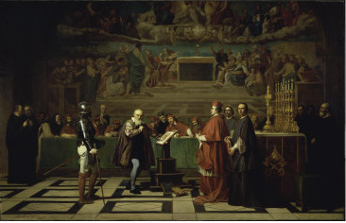
Galileo and the Inquisition
All of Galileo’s Experiments and findings, finally put him in some trouble with the Church.
A committee declared to the Inquisition that the Copernican proposition that the Sun is the center of the universe was a heresy.
. However, with the printing of Galileo's book, Dialogue Concerning the Two Chief World Systems, Galileo was called to Rome in 1633 to face the Inquisition again. Galileo was found guilty of heresy for his Dialogue, and was sent to his home near Florence where he was to be under house arrest for the remainder of his life.
In 1638, the Inquisition allowed Galileo to move to his home in Florence, so that he could be closer to his doctors. In 1642, Galileo died at his home outside Florence

Slide 20
Other Information
Some of Galileo’s published writings:
La Balancita- An accurate method of weighing objects in water or air.
-The Starry Messenger-first scientific writing on telescope observations.
-The Assayer-encouraged mathematical experimentation.
-Dialogue Concerning the Two Chief World Systems-supported Copernican view of sun-centered universe. This got him banned from releasing any further publications.
Galileo was the first to state the relationship between physical laws and mathematics.
-Improved geometrical compass.
-Among the first to use a refracting telescope.
-Thermometer using the contraction and expansion of air with varying temperature.
-Developed a microscope.
Showed a great liking for music (similar to other great physicists like Planck and Sommerfeld.) Also was fond of making things with his hands like Newton.
-"Playing the lute was a consolation throughout his life"

Slide 21
“[The universe] cannot be read until we have learnt the language and become familiar with the characters in which it is written.” -Galileo Galilei

Slide 22
Sources:
http://www.essortment.com/all/galileogalilei_rngy.htm
http://www-groups.dcs.st-and.ac.uk/~history/Biographies/Galileo.html
http://www.astronomy2009.org/resources/multimedia/images/detail/galileo_12/
http://www.juliantrubin.com/bigten/galileofallingbodies.html
http://www.endex.com/gf/buildings/ltpisa/ltpnews/physnews1.htm
http://muse.tau.ac.il/museum/galileo/galileo_low_of_fall.html
http://galileo.rice.edu/galileo.html
Galileo
E.N. Da C. Andrade
Galileo, Copernicanism and the origins of the new science of motion.
http://csep10.phys.utk.edu/astr161/lect/history/galileo.html
http://outreach.atnf.csiro.au/education/senior/astrophysics/galileo.html

