Slide 1
Efficient Parallelization for AMR MHD Multiphysics Calculations
Implementation in AstroBEAR
Collaborators:
Adam Frank
Brandon Shroyer
Chen Ding
Shule Li
Martin Huárte-Espinoza
Kris Yirak
Jonathan Carroll-Nellenback

Slide 2
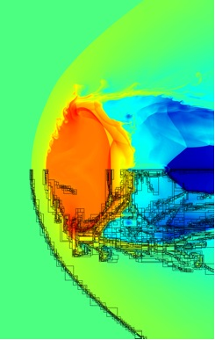
Actively developed at the University of Rochester
Written primarily using Fortran
Parallelized with MPI
Grid-based AMR with arbitrary sized grids.
Conserves mass, momentum, energy and ∇⋅B
Implements various Riemann solvers, reconstruction methods, etc…
Supports thermal conduction, self-gravity, sink particles, and various cooling functions.

Slide 3
Outline
Motivation
Distributed tree
Level threading
Dynamic load balancing
Sweep Method for Unsplit Stencils
Results & Conclusions
Notes:
Use outline format here and slide for motivation, results

Slide 4
Cpu clock speeds have not kept pace with Moore’s law.
Motivation
Notes:
Use outline format here and slide for motivation, results

Slide 5
Cpu clock speeds have not kept pace with Moore’s law.
Instead programs have been required to be more extensively parallelized.
Motivation
Notes:
Use outline format here and slide for motivation, results

Slide 6
Cpu clock speeds have not kept pace with Moore’s law.
Instead programs have been required to be more extensively parallelized.
While computational domains can be spatially divided over many processors, the time steps required to advance the simulation must be done sequentially.
Motivation
Notes:
Use outline format here and slide for motivation, results

Slide 7
Cpu clock speeds have not kept pace with Moore’s law.
Instead programs have been required to be more extensively parallelized.
While computational domains can be spatially divided over many processors, the time steps required to advance the simulation must be done sequentially.
Increasing the resolution for a given problem will result in more cells to distribute, but will also require more time steps to complete.
Motivation
Notes:
Use outline format here and slide for motivation, results

Slide 8
Cpu clock speeds have not kept pace with Moore’s law.
Instead programs have been required to be more extensively parallelized.
While computational domains can be spatially divided over many processors, the time steps required to advance the simulation must be done sequentially.
Increasing the resolution for a given problem will result in more cells to distribute, but will also require more time steps to complete.
If the number of processors is increased to keep the number of cells per processor fixed (ie weak scaling), the wall-time per step will remain constant. However, the increase in the number of time steps will result in the wall-time being proportional to the resolution.
Motivation
Notes:
Use outline format here and slide for motivation, results

Slide 9
Cpu clock speeds have not kept pace with Moore’s law.
Instead programs have been required to be more extensively parallelized.
While computational domains can be spatially divided over many processors, the time steps required to advance the simulation must be done sequentially.
Increasing the resolution for a given problem will result in more cells to distribute, but will also require more time steps to complete.
If the number of processors is increased to keep the number of cells per processor fixed (ie weak scaling), the wall-time per step will remain constant. However, the increase in the number of time steps will result in the wall-time being proportional to the resolution.
Strong scaling requires a reduction in the number of calculations done by each processing unit per time step. This is however often accompanied by greater overhead in communication and computation.
Motivation
Notes:
Use outline format here and slide for motivation, results

Slide 10
Cpu clock speeds have not kept pace with Moore’s law.
Instead programs have been required to be more extensively parallelized.
While computational domains can be spatially divided over many processors, the time steps required to advance the simulation must be done sequentially.
Increasing the resolution for a given problem will result in more cells to distribute, but will also require more time steps to complete.
If the number of processors is increased to keep the number of cells per processor fixed (ie weak scaling), the wall-time per step will remain constant. However, the increase in the number of time steps will result in the wall-time being proportional to the resolution.
Strong scaling requires a reduction in the number of calculations done by each processing unit per time step. This is however often accompanied by greater overhead in communication and computation.
As the reduction in workload per processing unit continues, the memory required for each processing unit should also reduce, allowing for closer packing of processing units. This requires algorithms that utilize memory efficiently.
Motivation
Notes:
Use outline format here and slide for motivation, results

Slide 11
Motivation
Distributed tree
Level threading
Dynamic load balancing
Sweep Method for Unsplit Stencils
Results & Conclusions
Outline
Notes:
Use outline format here and slide for motivation, results

Slide 12
Level 0 base grid
Level 0 node
Grids store fluid quantities in a regular array of cells on a single processor. Nodes contain the meta-data that includes the physical location of the grid, and the processor containing the grids data.
Distributed Tree
Notes:
Define nodes vs grids

Slide 13
Mesh
Tree
Parent-Child
Level 1 nodes are children of level 0 node
Level 1 grids nested within parent level 0 grid
Physical relationships between grids in the mesh are reflected in connections between their corresponding nodes in the AMR tree
Distributed Tree

Slide 14
Mesh
Tree
Neighbor
Neighbor
Conservative methods require synchronization of fluxes between neighboring grids as well as the exchanging of ghost zones
Distributed Tree
Notes:
Show ghost zones

Slide 15
Mesh
Tree
Level 2 nodes are children of level 1 nodes
The AMR tree contains all of the parent-child relationships between grids on different levels as well as neighbor relationships between grids on the same level.
Level 2 grids nested within parent level 1 grids
Distributed Tree

Slide 16
Since the mesh is adaptive there are successive iterations of grids and nodes
Current iteration
Time
Previous iteration
Distributed Tree

Slide 17
Current iteration
Current grids need access to data from the previous iteration of grids that physically overlap.
Previous iteration
Note that while the mesh has changed, the tree happens to have the same structure. This is only for simplicity and is not true in general.
Distributed Tree

Slide 18
Current iteration
Level 1 Overlaps
Previous iteration
This overlapping of grids between iterations is also stored in the AMR tree in overlap relationships.
Note that the location of the level 1 grids has not changed between iterations for simplicity, but they still correspond to separate grids and nodes
Distributed Tree
Notes:
Remove thin lines and level 2 grids

Slide 19
Current generation
Level 2 Overlaps
Previous generation
One of the useful features of nested AMR is that neighboring grids will either have the same parent or will have neighboring parents. The same is true for overlaps as well. This can be exploited for establishing neighbor and overlap connections for each iteration of nodes.
Distributed Tree

Slide 20
Current generation
AMR Tree
Previous generation
While all patch-based AMR codes distribute the grids that comprise the mesh and the associated computations across multiple processors, few distribute the tree.
Distributed Tree
Notes:
Amr grids in most codes…

Slide 21
While the memory and communication required for each node is small to that required for each grid, the memory required for the entire AMR tree can overwhelm that required for the local grids when the number of processors becomes large.
Consider a mesh in which each grid is 8x8x8 where each cell contains 4 fluid variables for a total of 2048 bytes per grid. Lets also assume that each node requires 7 bytes to store values describing its physical location and the host processor. The memory requirement for the local grids would be comparable to the AMR tree when there were of order 300 processors.
Even if each processor prunes its local tree by discarding nodes not directly connected to its local nodes, the communication required to globally share each new iteration of nodes may eventually prevent the simulation from effectively scaling.
Distributed Tree
Notes:
Break this up and do sub calculations

Slide 22
Current iteration
Processor 1
Processor 2
Processor 3
Previous iteration
Consider this mesh distributed across 3 processors. Each processor has the data for a set of local grids and needs information about all of the nodes that connect with its local nodes.
For simplicity we have also kept the distribution of grids similar between the two iterations
Distributed Tree
Notes:
Label processors and discuss distribution first… Then mention sub tree… local nodes relatives

Slide 23
Current iteration
Processor 1
Previous iteration
For example processor 1 only needs to know about the following section of the tree or “sub-tree”
Distributed Tree
Notes:
Use same coloring as prev slide

Slide 24
Current iteration
Processor 2
Previous iteration
And the sub-tree for processor 2
Distributed Tree

Slide 25
Current iteration
Processor 3
Previous iteration
And the sub-tree for processor 3
Distributed Tree

Slide 26
The tree changes each time new grids are created by their parent grids.
The nodes corresponding to these new grids have to be added to the tree and connected to overlaps, neighbors, and parents.
Before these connections can be established, processors must share these new nodes with each other.
However, instead of sharing every new child node with every other processor, each processor only sends the necessary child nodes to the necessary processors.
Distributed Tree
Notes:
Simplify language here… child grids instead of children – and grids instead of nodes

Slide 27
Tree starts at a single root node that persists from generation to generation
Processor 1
Processor 2
Processor 3
Distributed Tree

Slide 28
Root node creates next generation of level 1 nodes
And exchanges child info with its overlap
Processor 1
Processor 2
Processor 3
Distributed Tree

Slide 29
Root node creates next generation of level 1 nodes
And exchanges child info with its overlap
It next identifies overlaps between new and old children
Processor 1
Processor 2
Processor 3
Distributed Tree

Slide 30
Root node creates next generation of level 1 nodes
And exchanges child info with its overlap
It next identifies overlaps between new and old children
As well as neighbors among new children
Processor 1
Processor 2
Processor 3
Distributed Tree
Notes:
Make this animated

Slide 31
New nodes along with their connections are then communicated to the assigned child processor.
Processor 1
Processor 2
Processor 3
Distributed Tree
Notes:
Animate this

Slide 32
Processor 1
Processor 2
Processor 3
Distributed Tree

Slide 33
Level 1 nodes then locally create new generation of level 2 nodes
Processor 1
Processor 2
Processor 3
Distributed Tree

Slide 34
Level 1 nodes then locally create new generation of level 2 nodes
Processor 1
Processor 2
Processor 3
Distributed Tree

Slide 35
Processor 1
Processor 2
Processor 3
Level 1 grids communicate new children to their overlaps so that new overlap connections on level 2 can be determined
Distributed Tree

Slide 36
Processor 1
Processor 2
Processor 3
Level 1 grids communicate new children to their neighbors so that new neighbor connections on level 2 can be determined
Distributed Tree

Slide 37
Processor 1
Processor 2
Processor 3
New grids along with their connections are then sent to their assigned processors.
Distributed Tree

Slide 38
Processor 1
Processor 2
Processor 3
Each processor now has the necessary tree information to update their local grids.
Distributed Tree

Slide 39
Motivation
Distributed tree
Level threading
Dynamic load balancing
Sweep Method for Unsplit Stencils
Results & Conclusions
Level Threading
Notes:
Use outline format here and slide for motivation, results

Slide 40
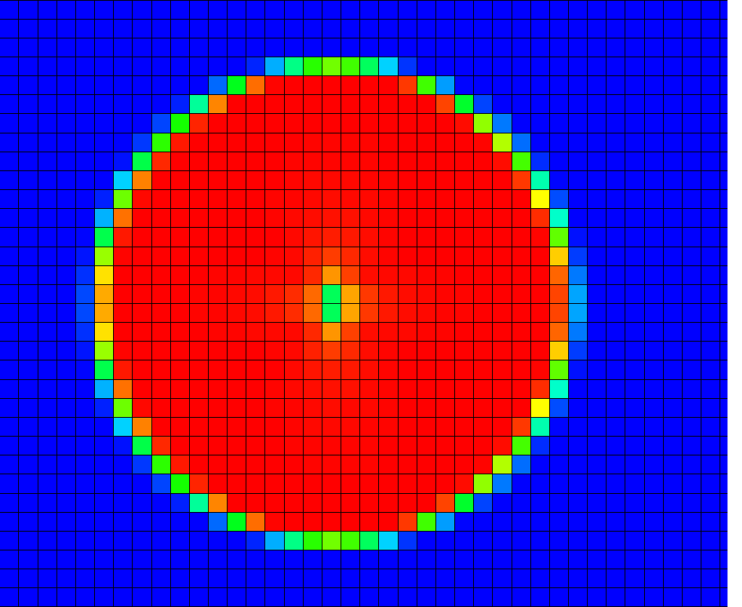
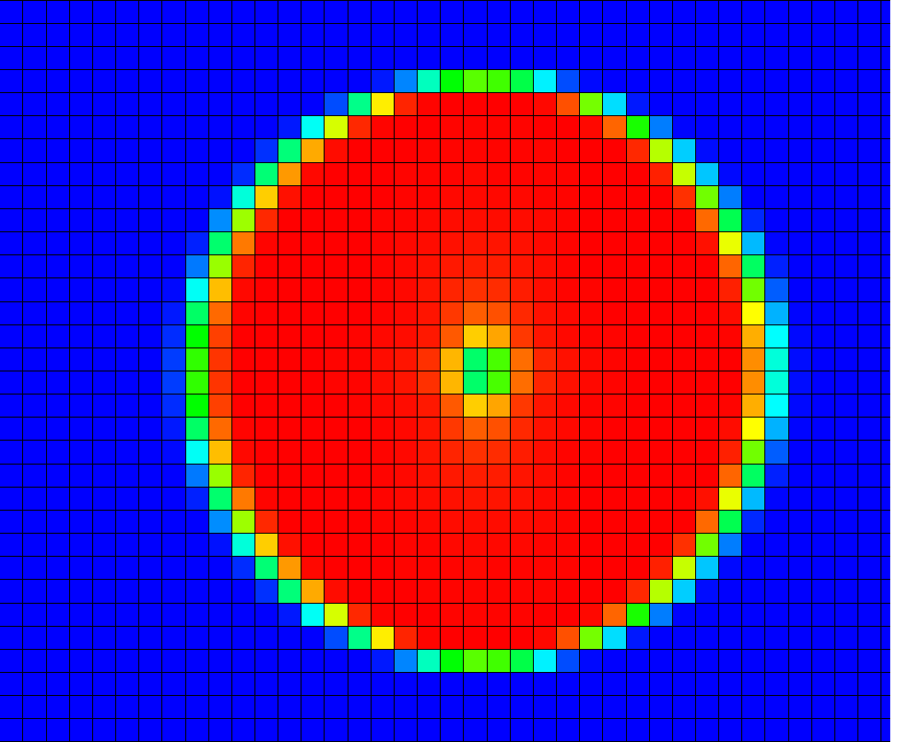
O
A
S
Level Threading

Slide 41
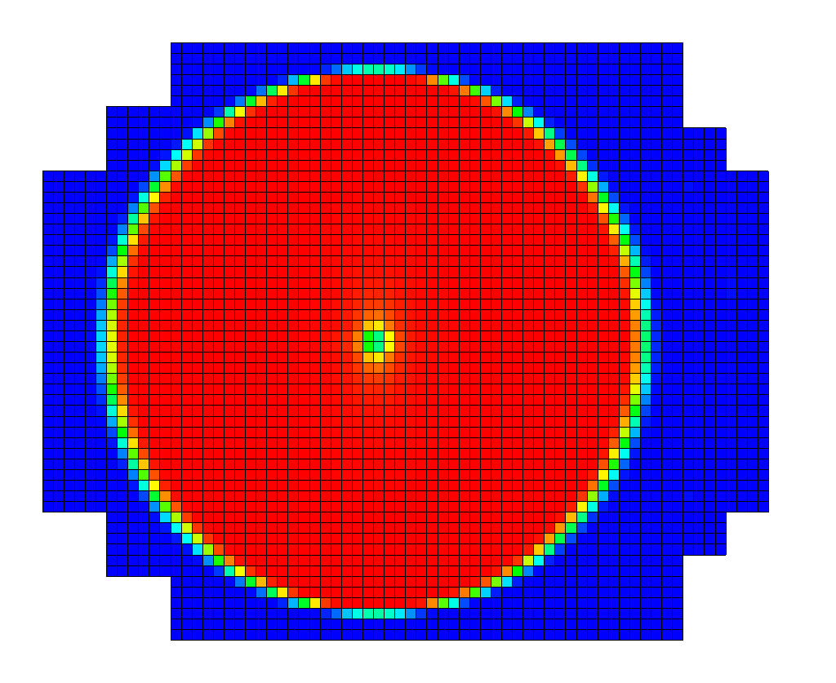
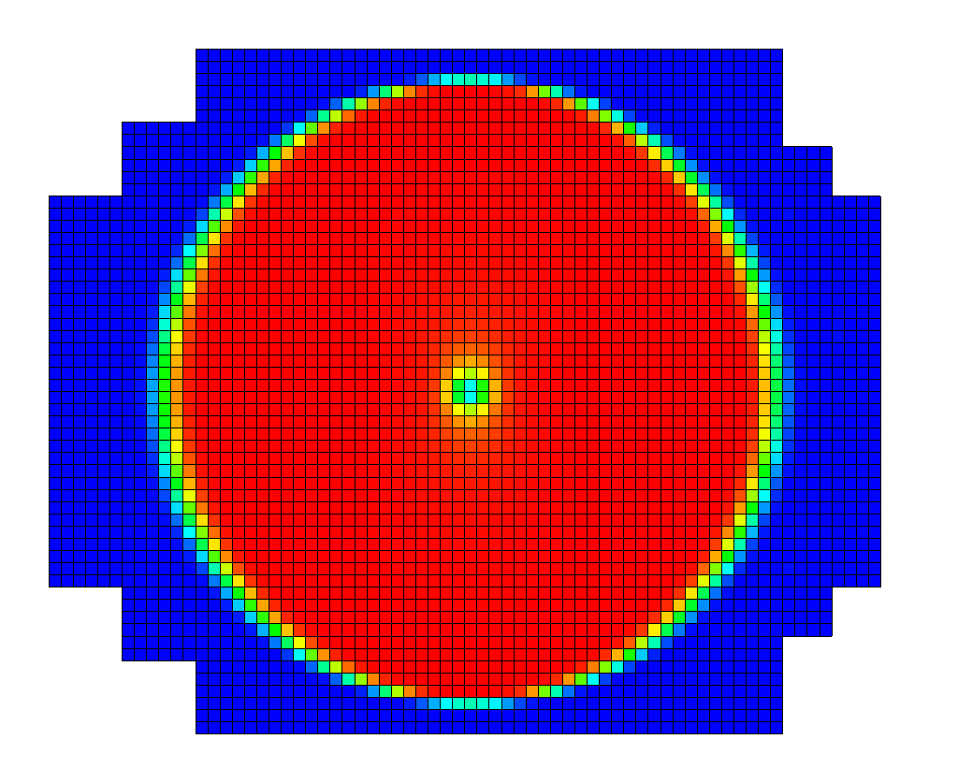
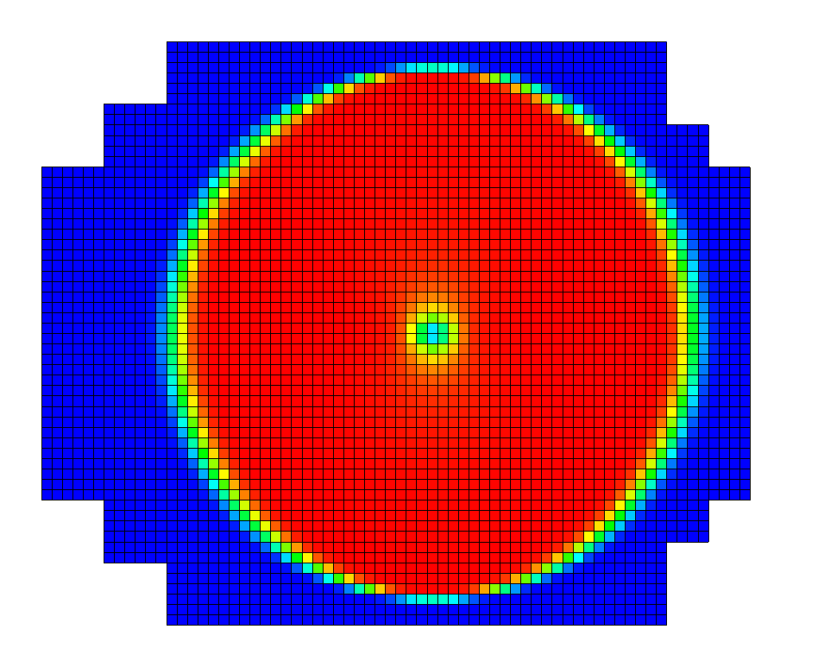
O
A
S
P
R
O
A
S
A
S
Level Threading

Slide 42
O
A
S
A
S
O
A
S
P
R
P
R
P
R
O
A
S
A
S
O
A
S
A
S
O
A
A
S
S
A
A
S
S
P
P
R
R
P
P
R
R
O
O
A
A
S
S
A
A
S
S
O
O
A
A
S
S
A
A
S
S
Level Threading

Slide 43
O
A
A
S
S
P
P
R
R
O
O
A
A
A
A
S
S
S
S
A
A
A
A
S
S
S
S
P
P
P
P
R
R
R
R
P
P
P
P
R
R
R
R
O
O
O
O
A
A
A
A
S
S
S
S
A
A
A
A
S
S
S
S
O
O
O
O
A
A
A
A
S
S
S
S
A
A
A
A
S
S
S
S
O
A
S
P
R
Level Threading

Slide 44
Level 0 Threads
O
A
S
P
Level 1 Threads
R
O
A
S
A
S
P
Level 2 Threads
R
P
Level 2 Threads
R
O
A
S
A
S
O
A
S
A
S
P
R
P
R
P
R
P
R
O
A
S
A
S
O
A
S
A
S
O
A
S
A
S
O
A
S
A
S
Control Thread
Level Threading

Slide 45
O
A
S
P
R
O
A
S
A
S
P
R
P
R
O
A
S
A
S
O
A
S
A
S
P
R
P
R
P
R
P
R
O
A
S
A
S
O
A
S
A
S
O
A
S
A
S
O
A
S
A
S
Serial Execution
Good performance requires load balancing every step
O
A
S
P
R
O
A
S
A
S
P
R
P
R
O
A
S
A
S
O
A
S
A
S
P
R
P
R
P
R
P
R
O
A
S
A
S
O
A
S
A
S
O
A
S
A
S
O
A
S
A
S
Threaded Execution
Good performance requires global load balancing across AMR levels
Level Threading

Slide 46
Balancing each level requires having enough grids to distribute among all of the processors – or artificially fragmenting grids into smaller pieces.

Slide 47
Level Threading
Global load balancing allows for greater parallelization and allows processors to have a few larger grids instead of multiple small grids.

Slide 48
2.3 x faster
Linear grid size

Slide 49
Motivation
Distributed tree
Level threading
Dynamic load balancing
Sweep Method for Unsplit Stencils
Results & Conclusions
Dynamic Load Balancing
Notes:
Use outline format here and slide for motivation, results

Slide 50
0
O
A
S
P
R
1
O
A
S
A
S
P
R
P
R
2
O
A
S
A
S
O
A
S
A
S
P
R
P
R
P
R
P
R
3
O
A
S
A
S
O
A
S
A
S
O
A
S
A
S
O
A
S
A
S
Dynamic Load Balancing

Slide 51
Motivation
Distributed tree
Level threading
Dynamic load balancing
Sweep Method for Unsplit Stencils
Results & Conclusions
Sweep Method for Unsplit Stencils
Notes:
Use outline format here and slide for motivation, results

Slide 52
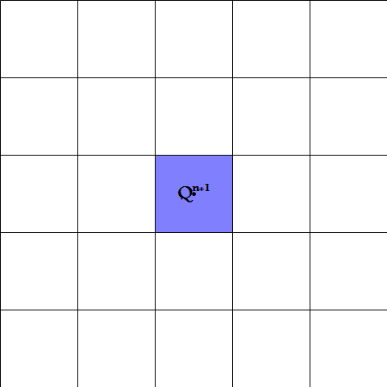
At the end of an update we need new values for the fluid quantities Q at time step n+1
Sweep Method for Unsplit Stencils

Slide 53
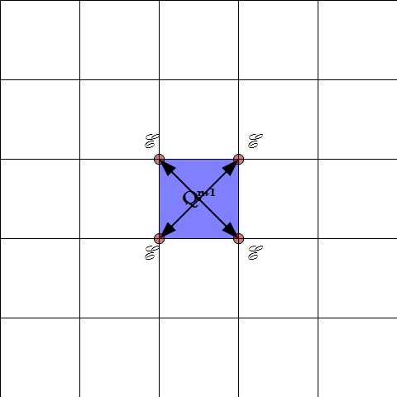
At the end of an update we need new values for the fluid quantities Q at time step n+1
The new values for Q will depend on the EMF’s calculated at the cell corners
Sweep Method for Unsplit Stencils

Slide 54
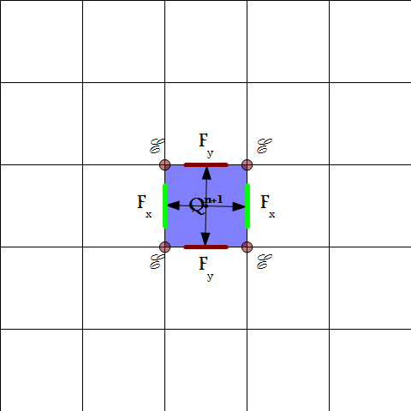
At the end of an update we need new values for the fluid quantities Q at time step n+1
The new values for Q will depend on the EMF’s calculated at the cell corners
As well as the x and y fluxes at the cell faces
Sweep Method for Unsplit Stencils

Slide 55
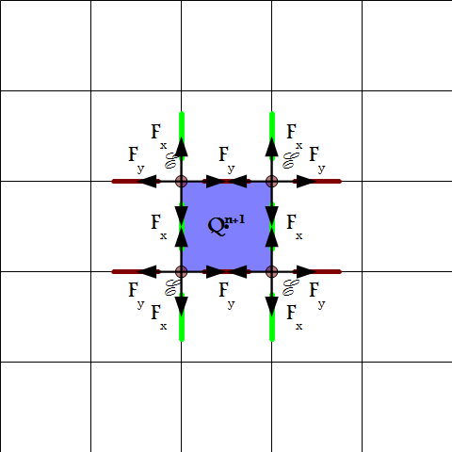
At the end of an update we need new values for the fluid quantities Q at time step n+1
The new values for Q will depend on the EMF’s calculated at the cell corners
As well as the x and y fluxes at the cell faces
The EMF’s themselves also depend on the fluxes at the faces adjacent to each corner.
Sweep Method for Unsplit Stencils

Slide 56
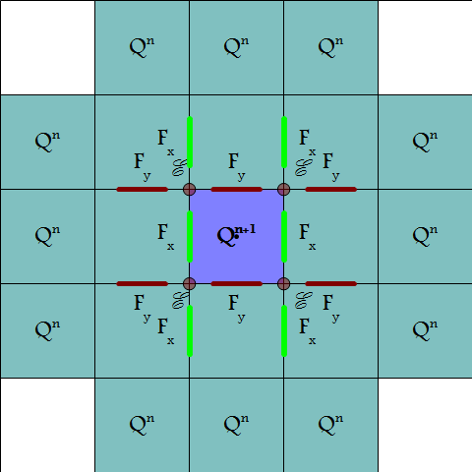
At the end of an update we need new values for the fluid quantities Q at time step n+1
The new values for Q will depend on the EMF’s calculated at the cell corners
As well as the x and y fluxes at the cell faces
The EMF’s themselves also depend on the fluxes at the faces adjacent to each corner.
Each calculation extends the stencil until we are left with the range of initial values Q at time step n needed for the update of a single cell
Sweep Method for Unsplit Stencils

Slide 57
Each stencil piece has a range where it is calculated
Sweep Method for Unsplit Stencils

Slide 58
Initial data is copied to the sweep buffer a row at a time
Sweep Method for Unsplit Stencils

Slide 59
And then held on to while the next row of data arrives
Sweep Method for Unsplit Stencils

Slide 60
Eventually enough data is arrived to calculate first column of vertical interface states and fluxes
Sweep Method for Unsplit Stencils

Slide 61
Followed by horizontal interface states and fluxes and EMF’s
Sweep Method for Unsplit Stencils

Slide 62
And finally we can fully update the first row of values
Stencil buffers are only a few cells wide
Sweep Method for Unsplit Stencils

Slide 63
As the sweep continues across the grid, intermediate values no longer needed are discarded
Sweep Method for Unsplit Stencils

Slide 64
Sweep Method for Unsplit Stencils

Slide 65
Motivation
Distributed tree
Level threading
Dynamic load balancing
Sweep Method for Unsplit Stencils
Results &Conclusions
Results and Conclusion
Notes:
Use outline format here and slide for motivation, results

Slide 66
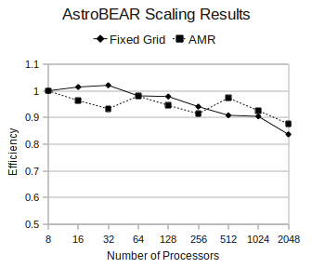
FieldLoop Advection
Fixed grid scaling results are fairly insensitive to the particular problem being studied.
When using AMR, the problem itself sets the degree and manner of refinement.
We chose the 3D field loop advection problem for our scaling tests.
The radius of the field loop was chosen to have a comparable number of refined and coarse cells (64³) on the root level as well as the 1st level of refinement.
Results

Slide 67
Conclusions
Implementing a fully distributed tree in patch-based AMR can significantly reduce the memory and communication overhead without decreasing performance.
Using inherent parallelization of AMR level advances loosens restrictions for load balancing and can allow for less artificial grid fragmentation.
Dynamical load balancing can be used to compensate for previous imbalances as well as real-time performance of processors.
Sweep method allows for a reduction in memory overhead associated with the use of un-split methods.
Conclusions

Slide 68
Thank you

Slide 69
Dynamic Load Balancing
Notes:
1 should be a 2, everthing grids, size is workload, number is hilbert order, created, loose hilbert order…

Slide 70
Calculating Child Workload Shares

Slide 71
Calculating Child Workload Shares

Slide 72
Calculating Child Workload Shares

Slide 73
Calculating Child Workload Shares

Slide 74
Calculating Child Workload Shares

Slide 75
Calculating Child Workload Shares

Slide 76
Calculating Child Workload Shares

Slide 77
Dynamic Load Balancing

Slide 78
Dynamic Load Balancing

Slide 79
Dynamic Load Balancing

