Slide 1
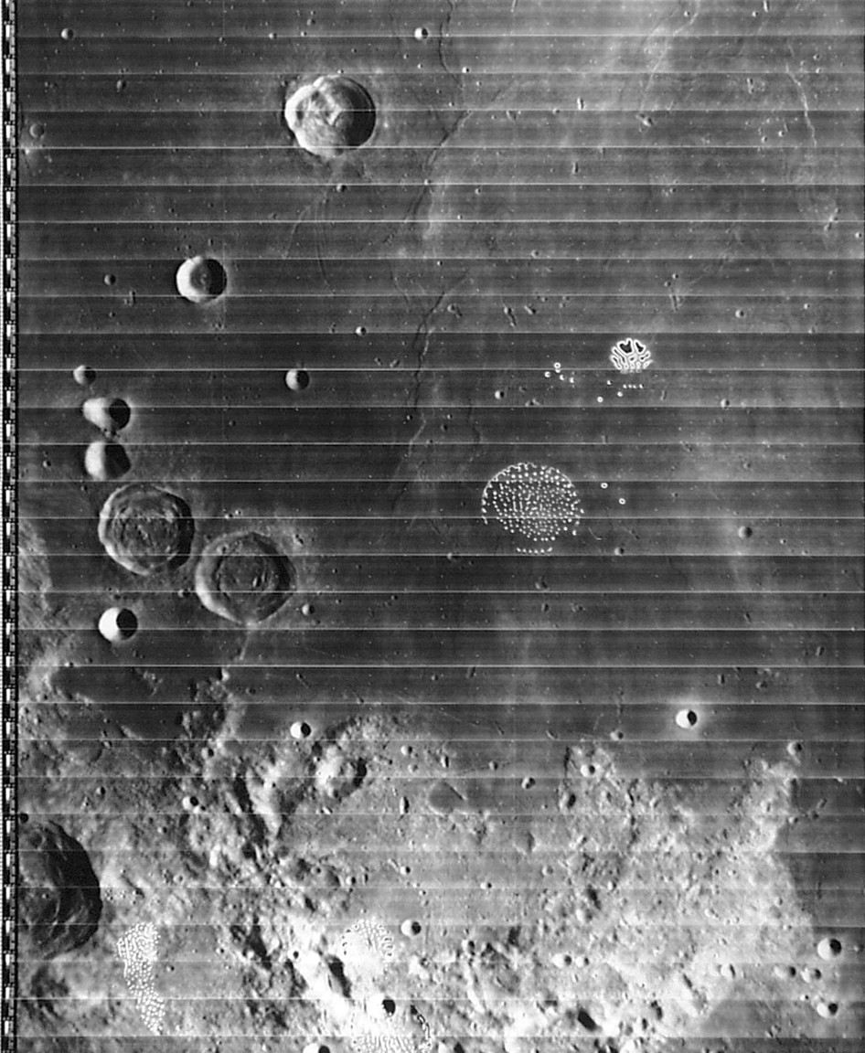
Notes:
Lunar Orbiter plate IV-085-H1

Slide 2
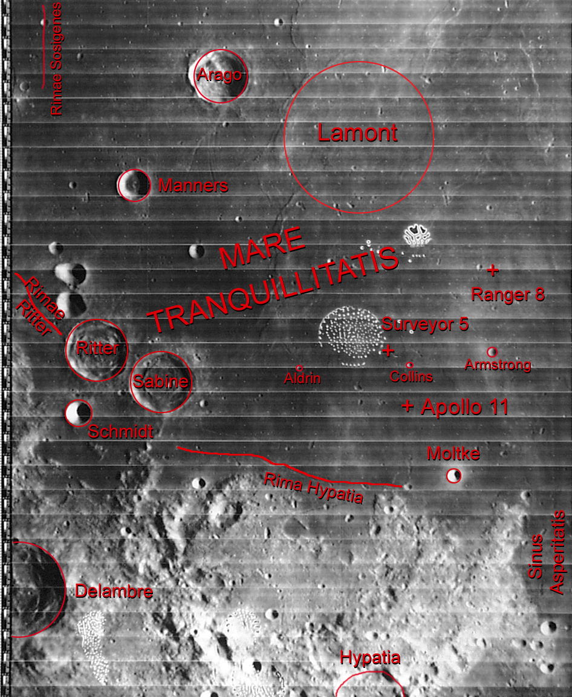
Notes:
Lunar Orbiter plate IV-085-H1: key to features
Diameters: Arago = 26 km; Sabine = 30 km; Lamont = 106 km

Slide 3
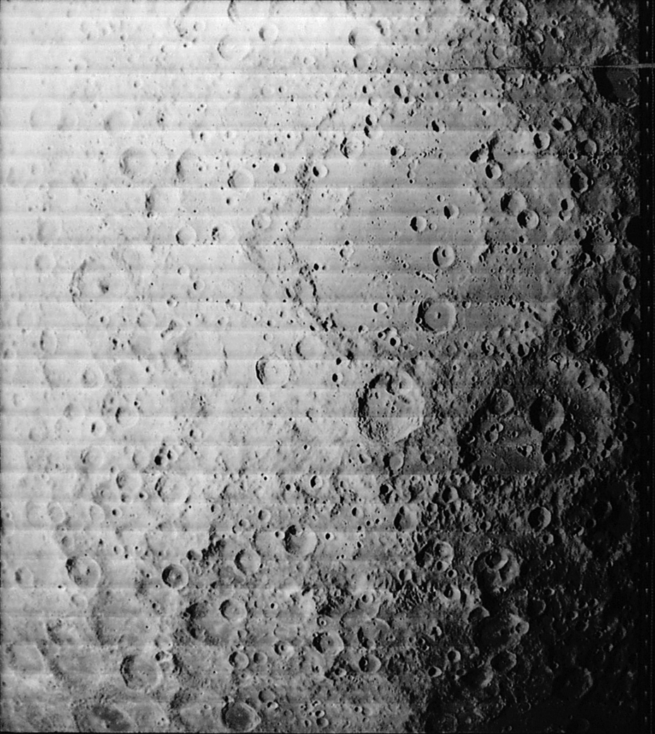
Notes:
Lunar Orbiter plate I-030-M

Slide 4
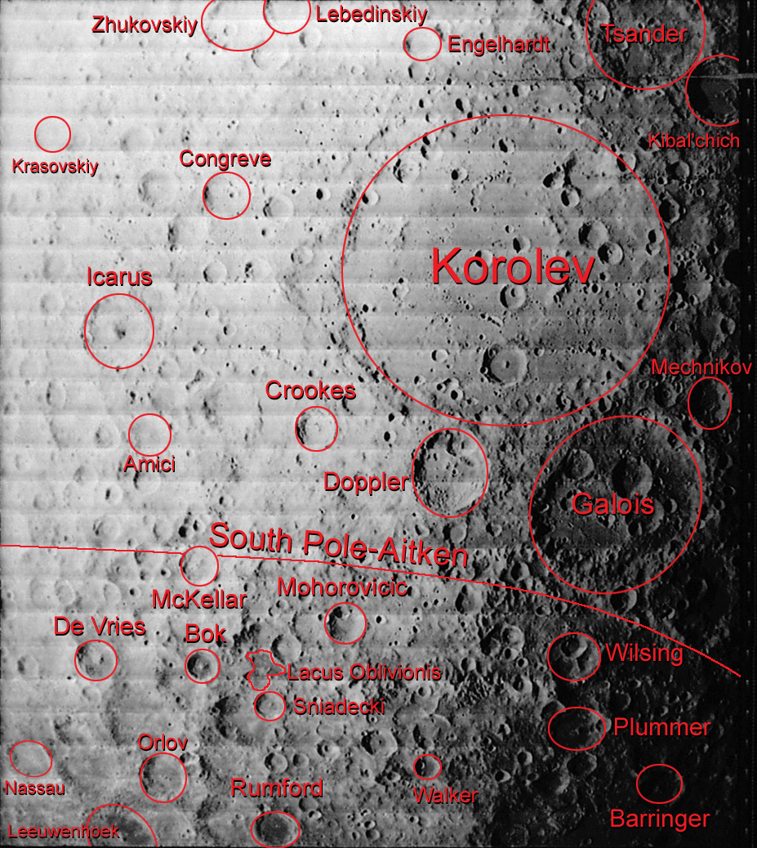
Notes:
Lunar Orbiter plate I-030-M: key to features
Diameters: Korolev = 437 km; Icarus = 96 km; Barringer = 68 km

Slide 5
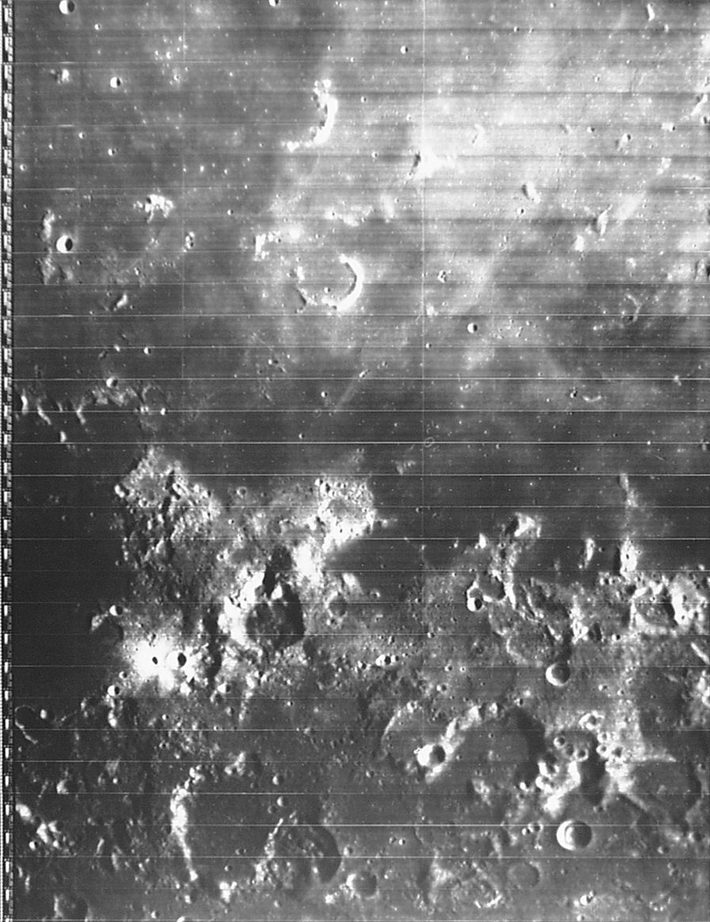
Notes:
Lunar Orbiter plate IV-073-H1

Slide 6
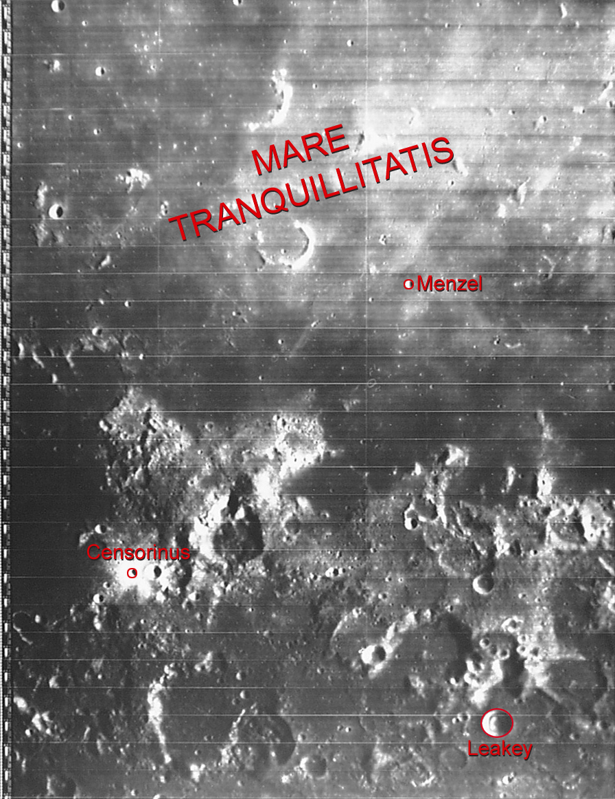
Notes:
Lunar Orbiter plate IV-073-H1: key to features
Diameters: Leakey = 12 km; Menzel = 3 km

Slide 7
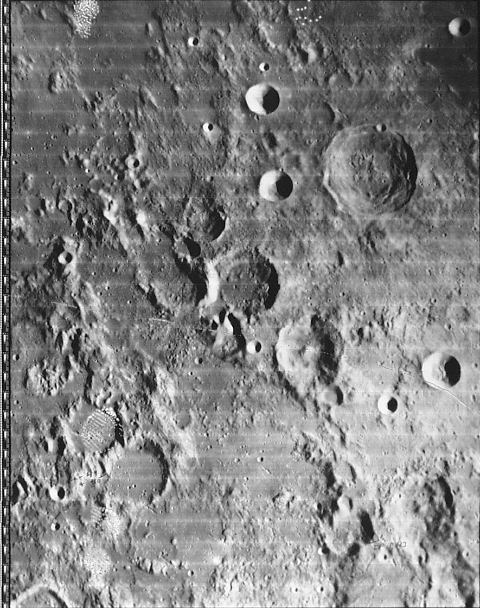
Notes:
Lunar Orbiter plate IV-089-H3

Slide 8
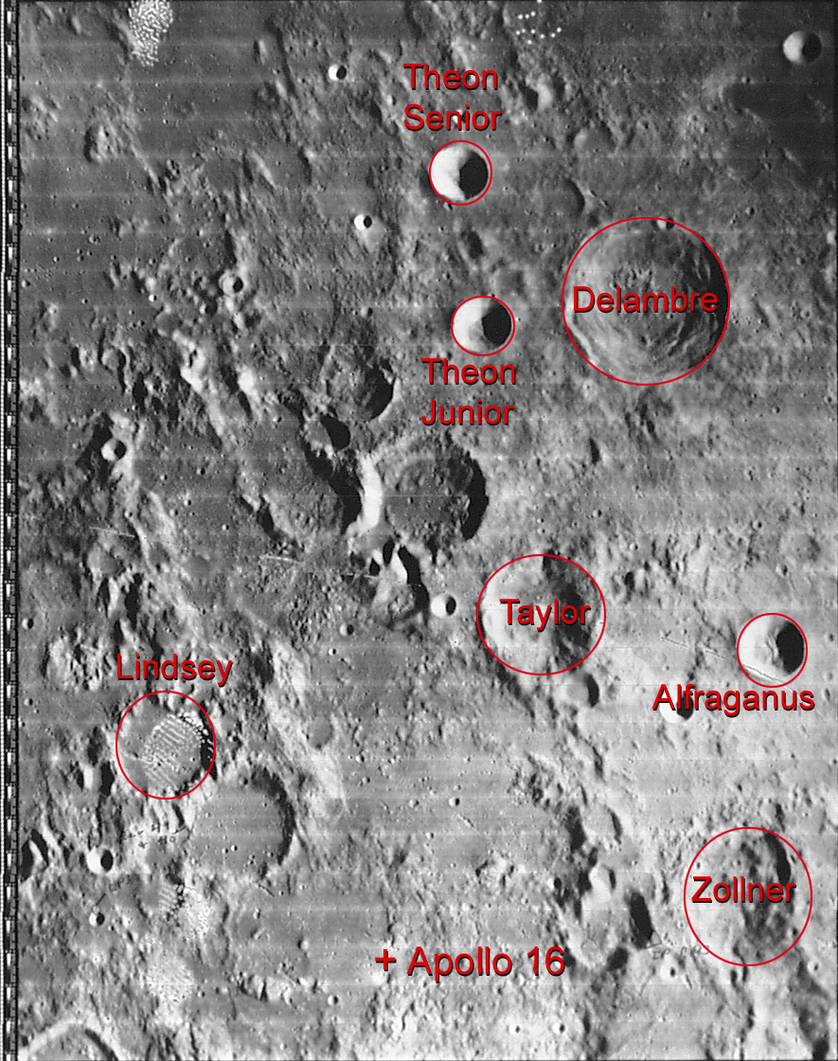
Notes:
Lunar Orbiter plate IV-089-H3: key to features
Diameters: Delambre = 51 km; Alfraganus = 20 km; Theon Senior = 18 km

