Slide 1
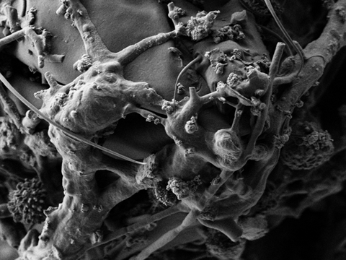
Notes:
1. Introduction slide

Slide 2
Daguerreotype Research University of Rochester and George Eastman House
Ralph Wiegandt, George Eastman House
Nicholas Bigelow, University of Rochester
Brian McIntyre, University of Rochester
Research support from the National Science Foundation
Notes:
Slide 2.
The context of this paper is to report on the emerging outcomes from the collaborative research on the daguerreotype undertaken by George Eastman House and the University of Rochester. As most of you know the National Science Foundation funded a program in 2009, with strong advocacy by the Andrew W. Mellon Foundation, to unite research universities and museums by addressing grand challenges in conservation science through a program entitled “Chemistry and Materials Research at the Interface between Science and Art” , better known by its acronym SCIART. Our award was granted in the first round of funding, and is titled “Science and Preservation of the Daguerreotype”. Our research has relied heavily on the art and science of scanning electron microscopy and associated analytical techniques to pursue existing lines of research that had been ongoing at George Eastman House at an increasing pace in the past 5 years. A series of Federal and Foundation grants has provided support for both research and implementation at Eastman House, and provided a number of inter-institutional collaborative initiatives for daguerreotype research; with the Metropolitan Museum, the Museum of Fine Arts, Boston, and now with the University of Rochester. This particular paper is presenting the research findings of the NSF award.

Slide 3
Three Themes
A daguerreotype is an artifact of nanotechnology.
A daguerreotype is archaeological . It has recorded circumstances and events in its close proximity continually since its “first light”.
Conservators should be advancing methods to preserve and protect the residual evidence of the daguerreotype’s original state at first light.
Notes:
Slide 3
We are in our third and final year of funding and have gathered a great deal of data that translate into many talks that could be delivered on the diverse aspects of our research into the daguerreotype . For this conference it is important to distill findings into essential themes that can be delivered within 20 minutes. We look forward to opportunities for collegial dialogue in this conference; and we are working on publications and Web resource to place our findings and provide a forum for discussion.
For clarification, we are using the term “First Light” in theme 2 to include both the light to which the sensitized plate was exposed to create the image, and to the light at first viewing after the daguerreotype was completed. This would constitute the daguerreotype’s original state.

Slide 4
How are daguerreotypes nanotechnology?
SEM micrograph of a period (1850) daguerreotype surface
Scale bar is 100 nm
Except for the image particle, all visible features are smaller than 100 nm in one dimension
We will return to the one that is not!
Theme I: Daguerreotype as Nanotechnology
Notes:
Slide 4
According to common usage of the term nano-technology or nano-science, it is the size threshold whereby surface physical properties dominate in discrete structures having at least one dimension between 1 and 100nm; although that appears to be somewhat arbitrary and not absolute, as research is showing for variations ranging upwards of .5 microns.
This simplified definition appears to apply since a daguerreotype surface is largely defined by features well within this size range.
[CHANGE SLIDE TO FULL SCALE VIEW]

Slide 5
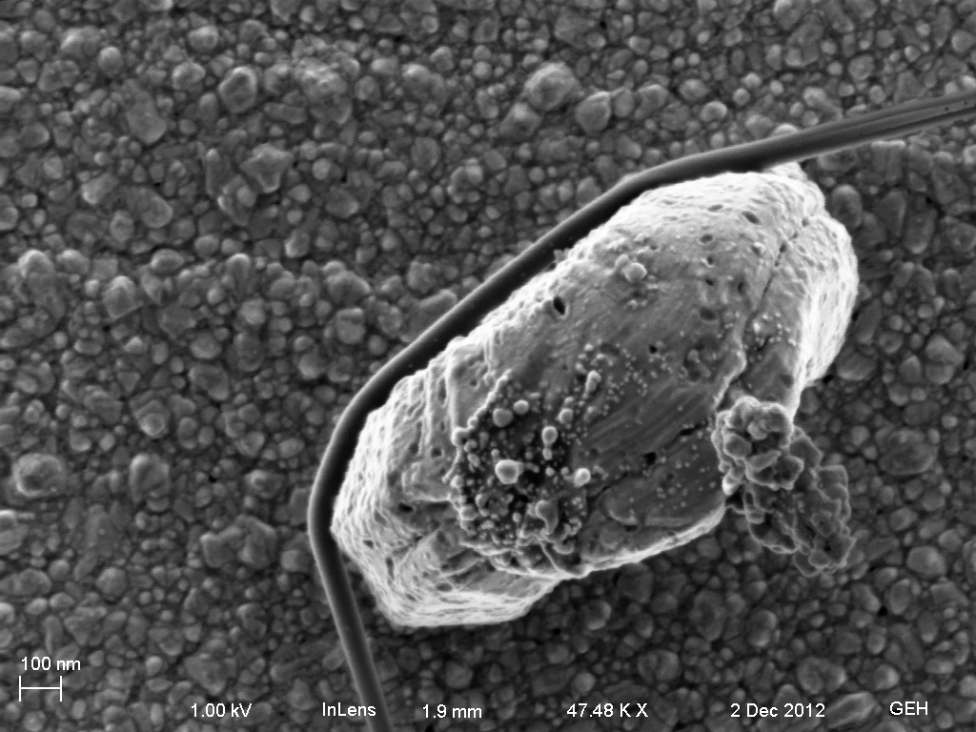
Notes:
Slide 5
Other key characteristics of nano materials that apply to the daguerreotype:
Quantum optical characteristics that are particular strong in noble and transition metal nanoparticles.
Gold, silver, copper, and mercury exhibit very different physical properties as nanoparticles from those we familiar with from their bulk metal state. For example, gold, generally considered highly unreactive, becomes a powerful catalyst and can interact vigorously with sulfur and other oxidants.
At the nano-scale we begin to understand the processes of the daguerreotype very differently. High transition metals at the qualifying dimensions can directly fuse together or into one anogher by mass transport phenomena under favorable energy conditions; which is both the mechanism of mercury development as well the forces at play in the gilding process, as we will show.
The nano-properties of all daguerreotype metals, but particularly gold and silver, have well known pathways for integrating with organic materials and can interact with life chemistry through a multitude of mechanisms . We will show the evidence and support our interpretation by drawing from the vastly growing body of research in the fields of bio-chemistry, bio-medicine, bio-engineering, green-synthesis of nanoparticles , bio-mimetics, bio-inspired, and whole new fields of study. Today’s cutting edge research is essentially rediscovering nano-scale properties of the metals that created the daguerreotype 180 years ago. And it gets more serendipitous and bizarre, as we shall see.
All of these characteristics will be shown in the research to be fundamental to a new understanding of the daguerreotype, and to marvel that what Daguerre, Niepce, Fizeau, Herschel, Draper, and others at the daguerreotype’s inception accomplished mastery of nano-technologies that if anything, worked entirely too well in some its ascribed domains.

Slide 6
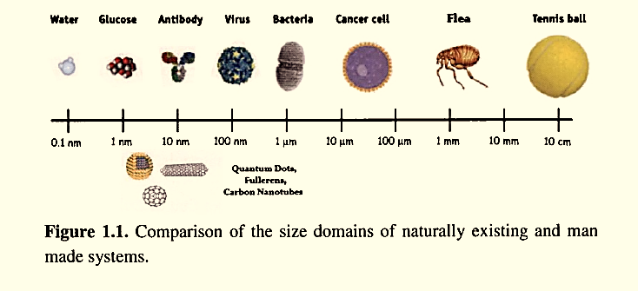
How small is nano?
Water Glucose Antibody Virus Bacteria Cancer cell Flea Tennis ball
Nanometer = 1 billionth of a meter
Theme I: Daguerreotype as Nanotechnology
Notes:
Slide 6
This Web graphic provides a frame of reference for the strict meaning of nano as ranging size from a 1nm glucose molecule through a 10 nm antibody and including a 100nm virus. Small, very small.

Slide 7
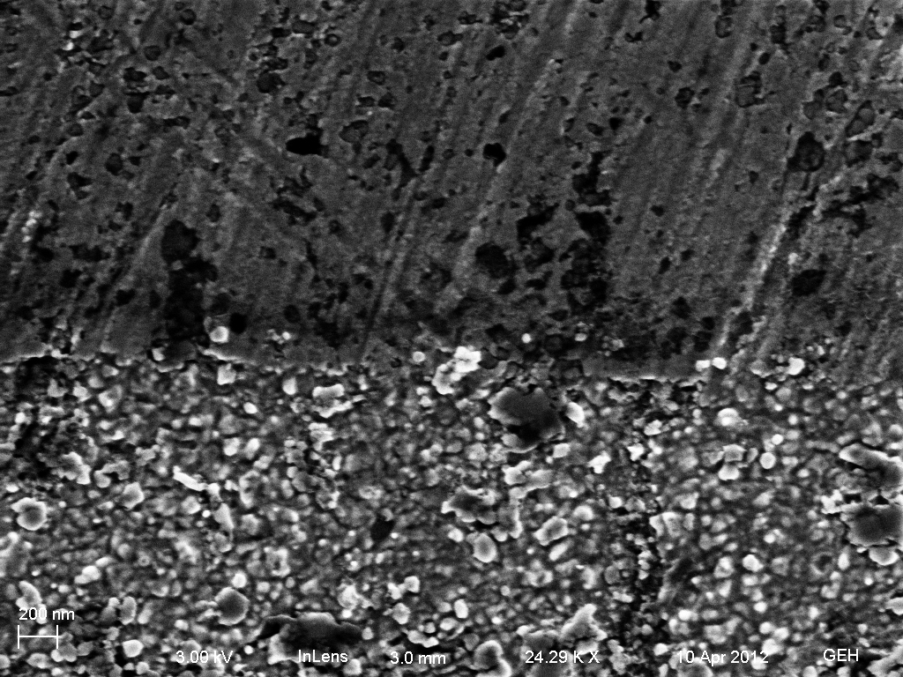
Silver etched by Iodine fuming
Non iodized (coated)
Iodized and fixed
200 nm
Theme I: Daguerreotype as Nanotechnology
Notes:
Slide 7
This is a test coupon made from modern daguerreotype stock -- silver cladding over copper. It is crudely polished, but that has no effect on the experiment. One half was coated with Acryloid (Paraloid) B-48n in toluene as a protective coating.
It was then placed in over iodine crystals in a fuming box in the standard manner. until a first order straw –magenta silver iodide layer formed as viewed at grazing incidence. It was not exposed. The coupon was fixed in sodium thiosulfate and water rinsed prior to removing the coating by solvent immersion.
[CLICK TO SHOW LABELS]
This oft repeated experiment shows a highly granular structure of silver with differentiated highly 3 dimensional features ranging from <10nm to 100 nm in at least one dimension. This establishes the daguerreotype image from the halide sensitization step onward as inherently a nano-structured object –and therefore predominately governed by the principles of nanochemistry and physics.

Slide 8
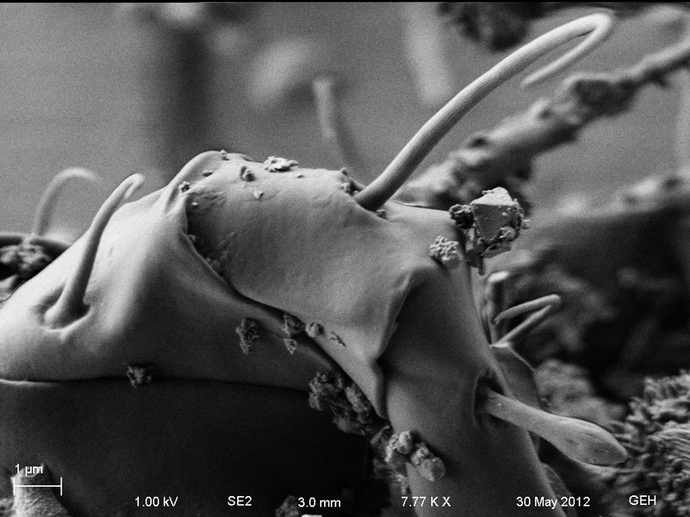
The daguerreotype surface engages readily with life forms at the cellular level
Hosts and engages with living organisms and the chemistry of life:
Fungi
Bacteria
Plants
Enzymes
Proteins
Nucleic acids
Cytoplasmic fluids
Theme I: Daguerreotype as Nanotechnology
Notes:
Slide 8
The talk will expand upon this extraordinary characteristic in detail –both for its intrinsic scientific value, and for its profound conservation implications. We would like to acknowledge the work done at Harvard by Brenda Bernier and Elena Bulat and the mycological research team that definitively identified an active fungal colony on a daguerreotype for the first time. Our work has been centered on how and why this is the case, and how pervasive and diverse this condition is. A more cogent question is what can prevent this from happening.
We are just at the beginning of developing a research framework to explain how a structure such as this came to be. What physico-chemical parameters are necessary to create this? How long did it take? What was the initial biochemical landscape that began the process?

Slide 9
The daguerreotype surface has the elemental building blocks for bottom-up self assembling nanostructures
Gold and silver nanoparticles are favored elements for nano bio- engineers in creating self-assembling structures
Biological forms and chemistry can serve as the scaffolding and mechanisms for self-assembled gold and silver complexes
Theme I: Daguerreotype as Nanotechnology
Notes:
Slide 9
The body of published research on self-assembling nano-structures incorporating gold and silver nano-particles that are mediated by a biological route is growing rapidly. The synthesis of metal nanoparticles of certain sizes and shapes that can be chemically functionalized to bond uniquely to individual cell types, and is a very active area of current medical research. The hybrid organo-metallic structures are also of great interest to bio-engineers who are using biomolecules as templates or scaffolds, and whose chemistry can induce controlled self-assembly of electrically conductive or optically active structures on nearly the atomic scale for quantum computing and photonic devices. To think what the daguerreotype achieved in 1839 –even without the mastery of quantum physics and optics.

Slide 10
Daguerreotypes exhibit quantum optical characteristics
Color in darkfield light microscopy is due to localized plasmon resonance of gold and silver nanoparticles
This may be a source for natural color effects seen in daguerreotypes –A topic of further research
Theme I: Daguerreotype as Nanotechnology
Notes:
Slide 10
A biologically mediated assembly viewed through a light microscope with extended focus imaging in darkfield illumination 500 times magnified. It shows highly unusual optical effects.

Slide 11
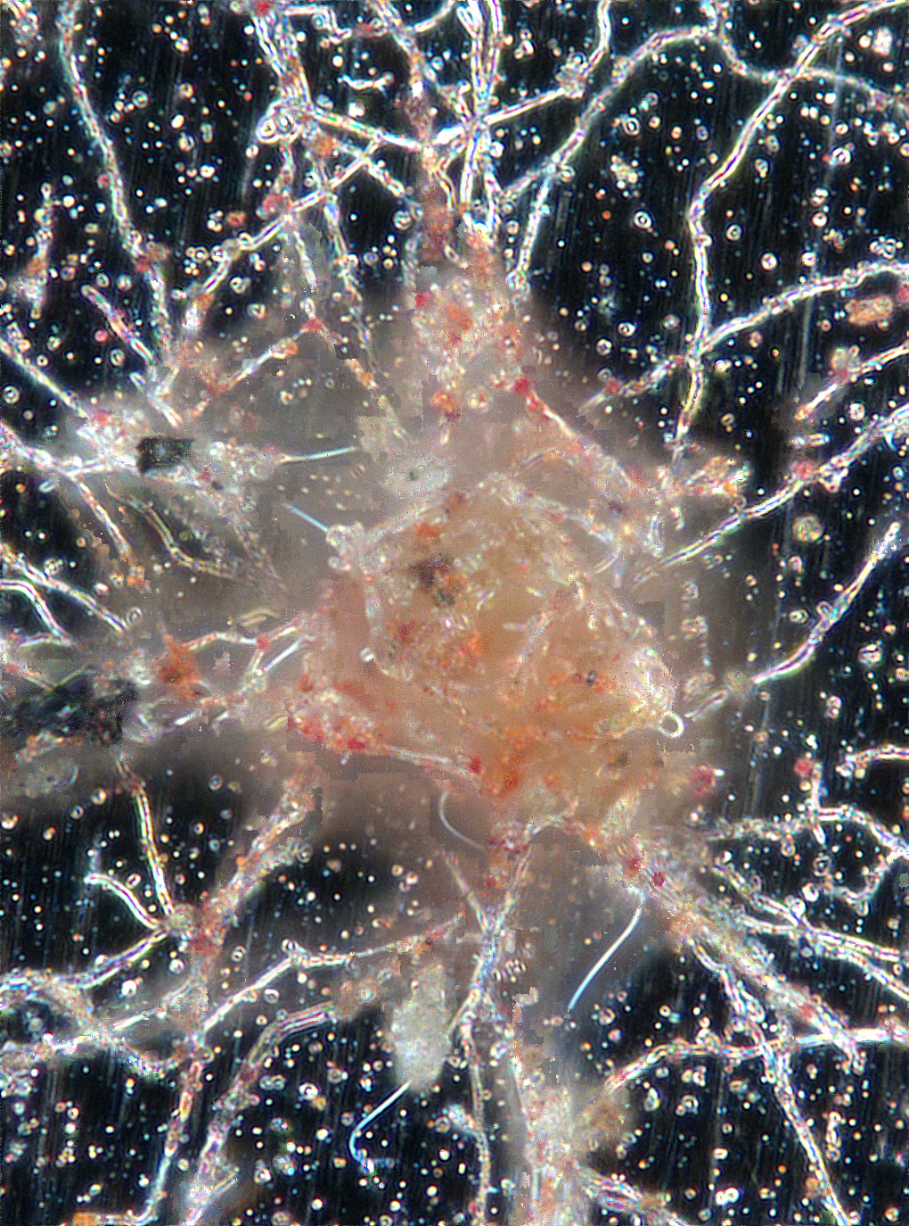
Notes:
Slide 10
A biologically mediated assembly viewed through a light microscope with extended focus imaging in darkfield illumination 500 times magnified. It shows highly unusual optical effects.

Slide 12
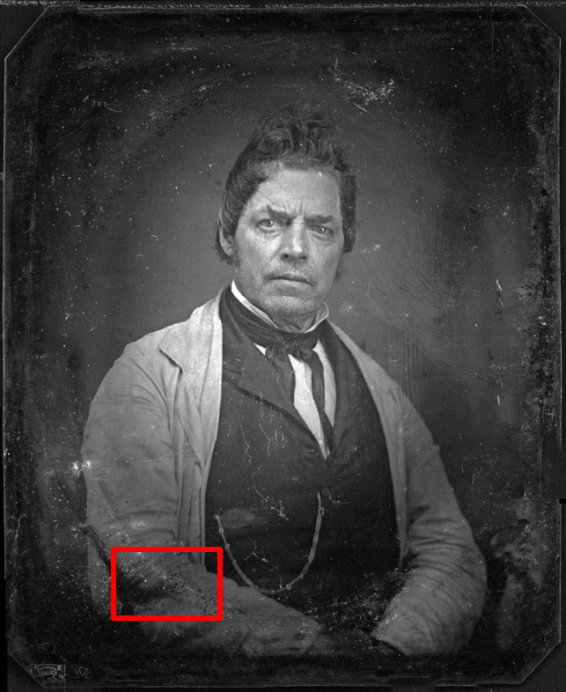
The biology of a daguerreotype
Notes:
Slide 12
We are going to investigate the biological interaction in greater depth in this study case.
This is a sixth plate from the Eastman House study collection that has undergone a comprehensive examination by LM, Scanning Electron Microscopy with Energy Dispersive X-Ray analysis, and Focused Ion Beam investigation; totaling nearly thirty hours Scanning Electron Microscopy time.
It is one of approximately 25 6th and 9th plates that have been thoroughly examined similarly It is a fine daguerreotype; it is hallmarked plate, and captures an unusual portrait of a man conveying his powerful sense of self by his steadfast gaze and the proud presentation of his metier, by wearing a well worn smock over the status symbols of his heavy watch fob, well cut waistcoat, and fine cravat.
However interesting, we are going to turn our attention to what is on him rather than what is in him. Denoting a region of interest marked in red

Slide 13
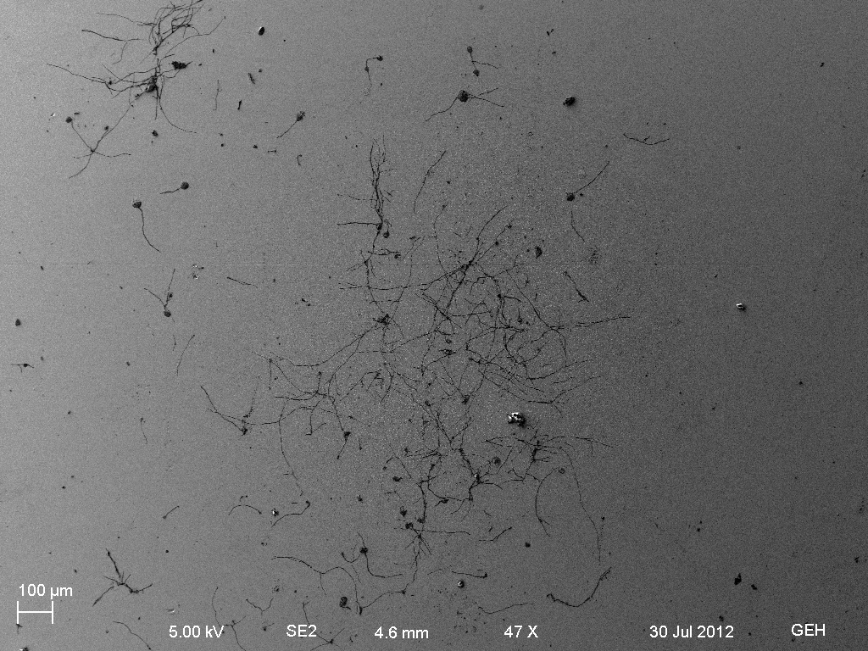
Theme I: Daguerreotype as Nanotechnology -- The biology of a daguerreotype
Notes:
Slide 13
Sub region selected for detailed examination at higher magnification and energy dispersive X-ray emission detector (EDX) for elemental identification of features

Slide 14
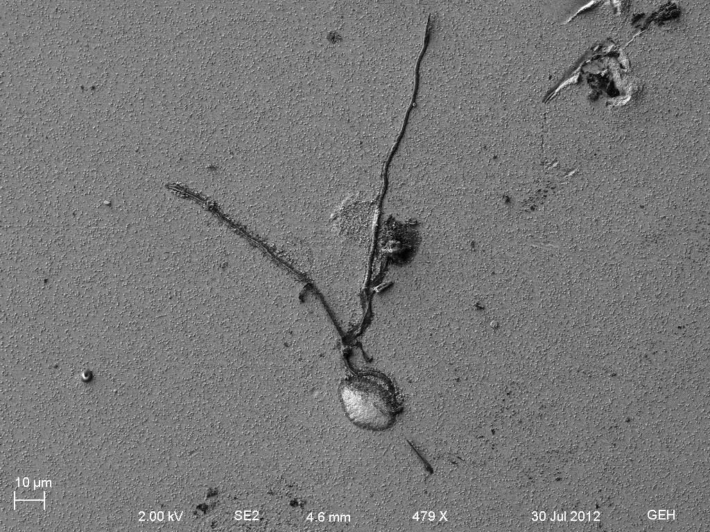
Theme I: Daguerreotype as Nanotechnology -- The biology of a daguerreotype
Notes:
Slide 14

Slide 15
1
2
3
Theme I: Daguerreotype as Nanotechnology -- The biology of a daguerreotype
Notes:
Slide 15
Sub region with low emitting fibril feature adjoined with a large mass; note the aggregations of inorganic particles along the fiber [1]–distinct from image particles [2]; and a penumbra of organic non-conducting film[3] extending out from the large mass

Slide 16
1
2
3
Theme I: Daguerreotype as Nanotechnology -- The biology of a daguerreotype
Notes:
Slide 16
Detailed view: note penumbral extension along fibers associated with small aggregate particles [1] on one side, and larger crystalline forms on the other[2]; the apparent emergence or extension of the penumbral biofilm engaged with the surface converting to a tubular form [3] connected to the large mass feature

Slide 17
2
1
Theme I: Daguerreotype as Nanotechnology -- The biology of a daguerreotype
Notes:
Slide 17

Slide 18
.
Theme I: Daguerreotype as Nanotechnology -- The biology of a daguerreotype
Notes:
Slide 18
Series of images of the left bio-fiber branch and the phenomena of particle – crystalline aggregations and interruption of the plate surface

Slide 19
Theme I: Daguerreotype as Nanotechnology -- The biology of a daguerreotype
Notes:
Slide 19
Fiber terminus; note the large aggregate particles and the extending surface bio-film , perhaps indicative of the linear propagation of the bio-fiber.

Slide 20
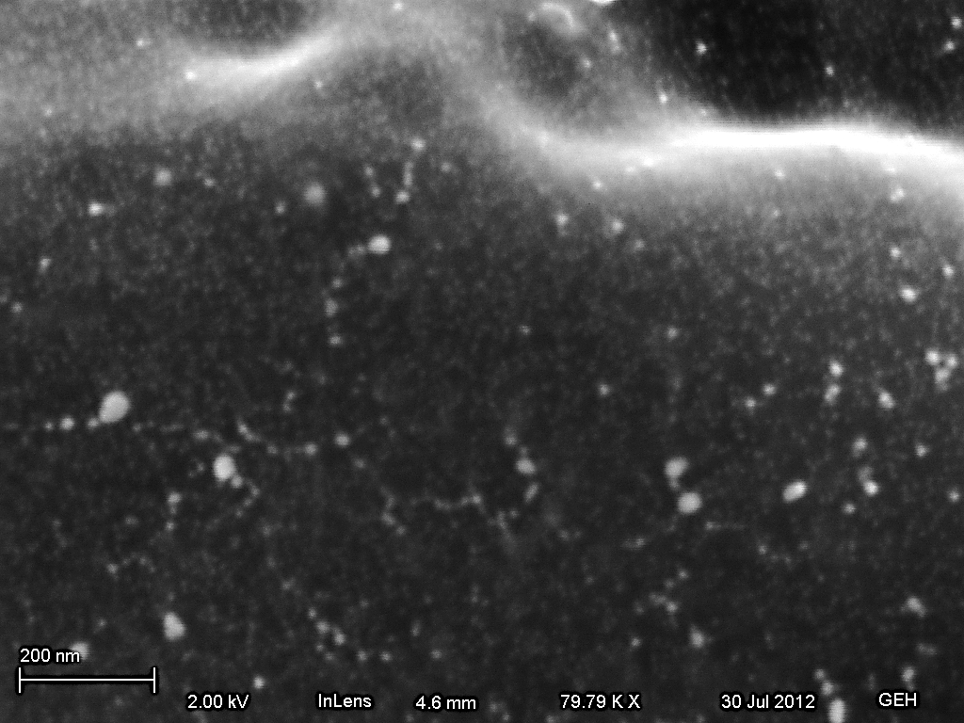
Theme I: Daguerreotype as Nanotechnology -- The biology of a daguerreotype
Notes:
Slide 20
Nano particle structures forming on the bio-fiber surface; the distinct particles and linear assemblages are interpreted as metallic , perhaps aligned with the underlying cellular bio-structure unresolved at <10nm.

Slide 21
Theme I: Daguerreotype as Nanotechnology -- The biology of a daguerreotype
Notes:
Slide 21
Large aggregated mass bridging over the bio-fiber that has distinctive fibriil connections between the aggregate mass and the bio-fiber to be explored further.

Slide 22
Theme I: Daguerreotype as Nanotechnology -- The biology of a daguerreotype
Notes:
Slide 22
Tendrils or fibrils connecting from the bio-fiber backbone into the metallic aggregate. Circled are zones within the fibrils that transition from organo rich to metal rich composition. Had we only the sampling instruments to investigate the chemistry within these zones

Slide 23
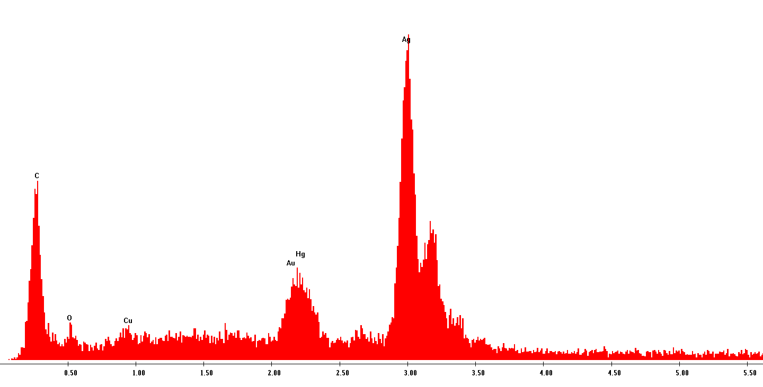
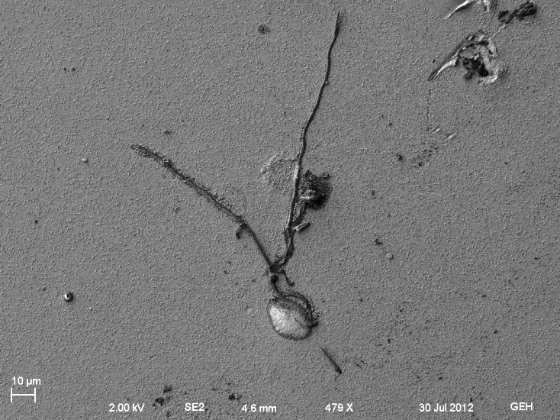
Energy Dispersive X-Ray Analysis
Theme I: Daguerreotype as Nanotechnology -- The biology of a daguerreotype
Notes:
Slide 23
Within the region along the fiber just presented, several nano particle aggregations were analyzed by energy dispersive X-rays to gather elemental information. While the electron beam was tightly focused on the particle as delineated on the right image, the electron voltage required to create enough X-ray emission for analysis will penetrate and extend to the surrounding region, so undoubtedly there is signal from below the particle in the spectrum. However, the interpretation is that the compositional metals have migrated through the bio-fiber and are combined into a supercluster approximately 150nm x 75nm. At some point the invasive biofiber’s interaction with the metal surface has reached into the copper substratum. Overwhelmingly composed of silver, the carbon, oxygen (and probably sulfur which is overlaid by the gold and mercury peaksl) are complexed with the cluster, and/or the signal is drawing from below the fiber. The copper arises from within the surface assembly –the electron energy does not penetrate to the copper layer several microns below the surface.

Slide 24
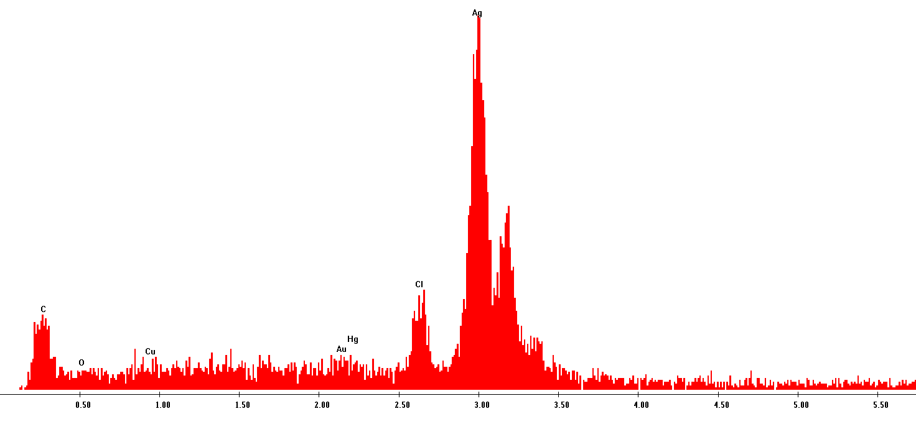
Energy Dispersive X-Ray Analysis
Theme I: Daguerreotype as Nanotechnology -- The biology of a daguerreotype
Notes:
Slide 24
Deep within the cluster encompassing the same fiber, the electron beam was isolated on another rounded feature; interestingly it is differentiated from the previous close-by nanoparticle by not showing gold, mercury, copper, or oxygen, but having as strong chlorine peak --obviously the predominating peak is silver, and then the ever present carbon –as the indicator of the ubiquitous surrounding biology.
Interpretation: the approximate 200nm diameter particle is predominately composed of silver chloride; nearly identical to the previous spectrum.

Slide 25
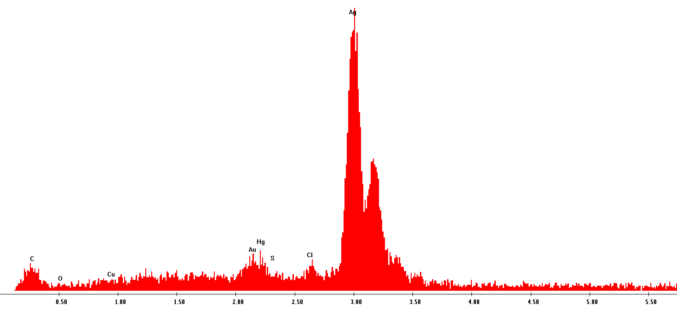
Energy Dispersive X-Ray Analysis
200 nm
Notes:
Slide 25
Deep within the cluster encompassing the same fiber, the electron beam was isolated on another rounded feature; interestingly it is differentiated from the previous close-by nanoparticle by not showing gold, mercury, copper, or oxygen, but having as strong chlorine peak --obviously the predominating peak is silver, and then the ever present carbon –as the indicator of the ubiquitous surrounding biology.

Slide 26
1 µm
Theme I: Daguerreotype as Nanotechnology -- The biology of a daguerreotype
Notes:
Slide 26
These massive crystals have accumulated next to the bio-fiber within this sub-region –and are obviously part of the localized ecology surrounding the fiber; and does not conform to an obvious crystal morphology –at least it doesn’t to us. So, what shall we find?

Slide 27
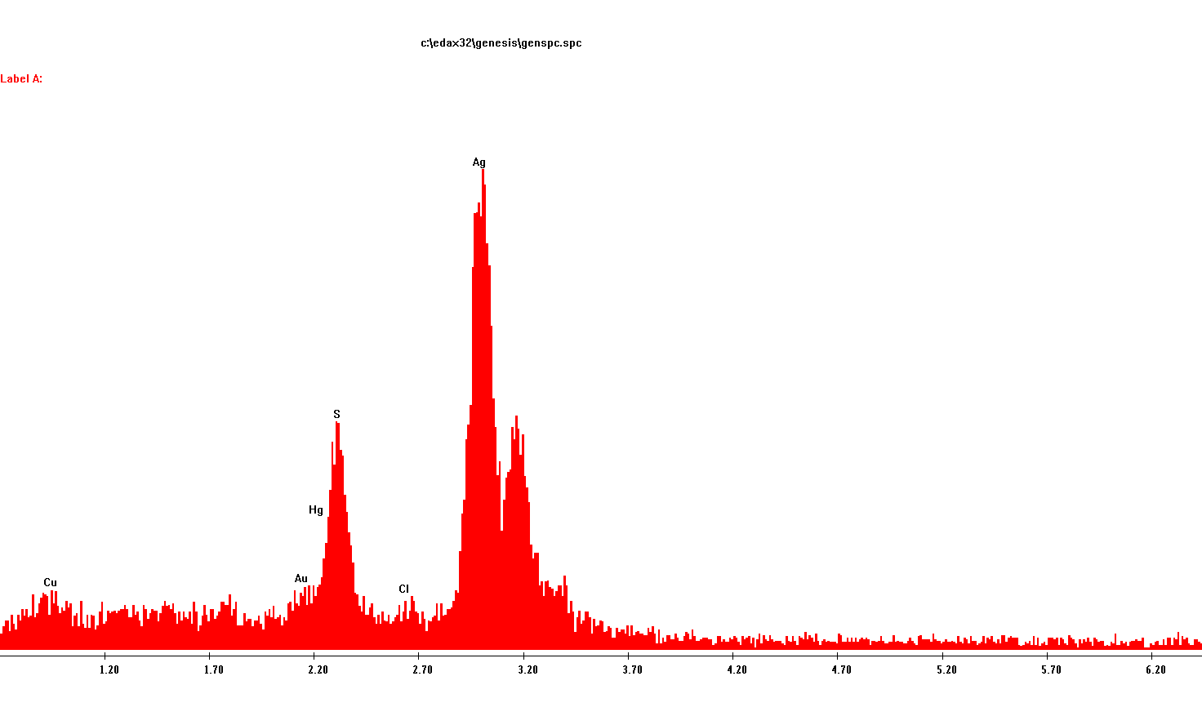
Energy Dispersive X-Ray Analysis
Theme I: Daguerreotype as Nanotechnology -- The biology of a daguerreotype
Notes:
Slide 27
These distinctive sharp angle crystals that range dimensionally from 3 to 5 microns have a very significant sulfur peak. Present is a copper peak in addition to the predominate silver –gold and probably mercury. Here is a graph where the sulfur peak hides the mercury. We cannot assign its ionic crystalline type with the elemental information only.
Our macro interpretation of this massive collection of a sulfur-rich silver species supports the whole systemic pattern we are establishing with biologically mediated nanoparticle fabrication within the bio-fiber; whatever type of life form it is. The explanation for the these particles, both in their elemental make-up and their specific location, supports the notion that at the bio-fiber boundary edge, a less sulfur rich silver salt (most likely silver sulfide, as one assumes is present on an historic daguerreotype) is encountering the cytoplasmic sourced reducing chemistry being leaked out of the fiber and growing in an increasing sulfur-silver ratio that grows into the massive crystals along the fiber boundary. Fantastic!

Slide 28
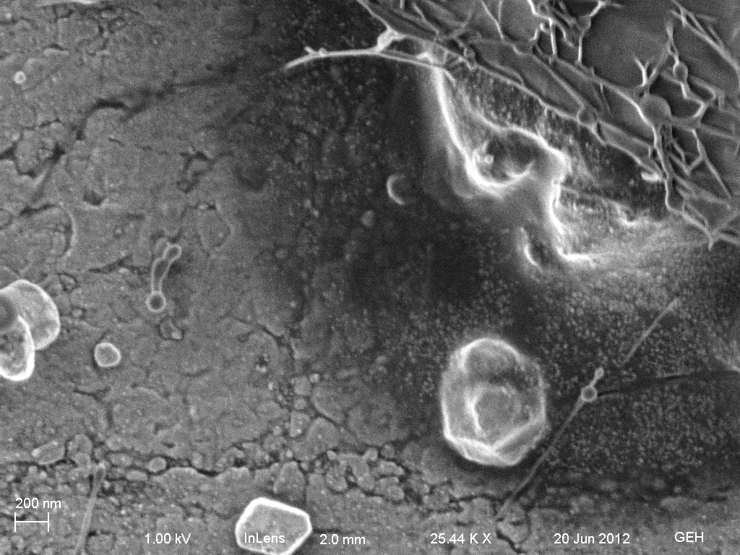
Theme I: Daguerreotype as Nanotechnology – Biological pathways
Notes:
Slide 28
This image from a non-gilded plate in the study collection shows similar aggregating particles at the edge of a complex bio-feature; possibly fungal mediated; it shows what we find on nearly all daguerreotypes we have researched, a surface level veil extending from the carbon, oxygen, and sulfur rich matrix we term biological or bio-fiber that at high magnification is populated by fine nanoparticles –and usually accompanied by larger particles that have agglomerated and are extruded onto the surface as larger nanoparticles or clusters ranging to the micron size.

Slide 29
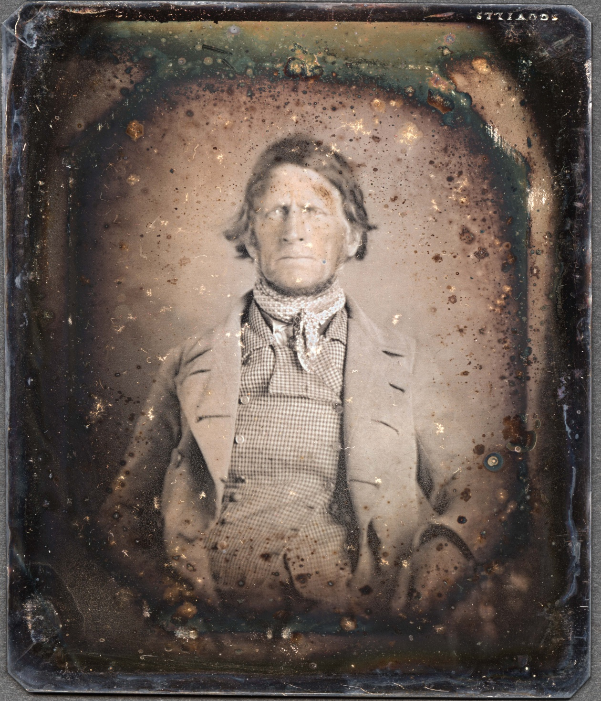
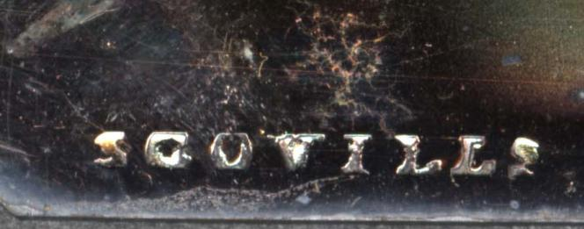
Notes:
Slide 29
High resolution scan of the sixth plate –an early Scoville plate that is unusually heavy silver clad copper. It appears to have never been cleaned, and gives a precious glimpse of the surface features of a non-gilded plate and early preparation; unfortunately we cannot pursue that further here.

Slide 30
Theme I: Daguerreotype as Nanotechnology – Biological pathways
Notes:
Slide 29
High resolution scan of the sixth plate –an early Scoville plate that is unusually heavy silver clad copper. It appears to have never been cleaned, and gives a precious glimpse of the surface features of a non-gilded plate and early preparation; unfortunately we cannot pursue that further here.

Slide 31
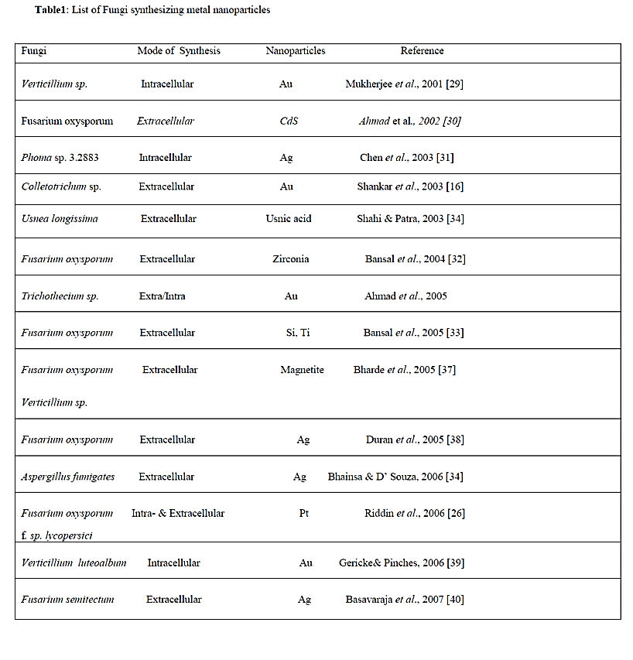
Fungi
Page 1 of 2
Theme I: Daguerreotype as Nanotechnology – Biological pathways
Notes:
Slide 31
This listing is from a review article published in 2010 in
Current Research: Technology and Education Topics in Applied Microbiology and Microbial Biotechnology 2010
The article is entitled:Mycofabrication, mechanistic aspect and Multifunctionality of Metal
Nanoparticles - Where are we? And where should we go?
It is a chronological listing of published research as of 2010 of metal nanoparticle fabrication by fungi as the medium of reducing gold, silver and other reported metals. The most significant fabrication in these two pages is Silver, along with entries for Gold, and several for silver and gold together.
Mycofabrication can be defined as the synthesis of metal nanoparticles using fungi. The fungal system in recent
times has emerged as “Bionanofactories” synthesizing nanoparticles of silver, gold, platinum and CdS etc.
Fungi can accumulate metal ions by physico-chemical and biological mechanisms including extracellular binding by
metabolites and polymers, binding to specific polypeptides, and metabolism-dependent accumulation [23]. The possible
use of fungi has gained much importance, as they are easy to culture in bulk. Also, the extracellular secretion of
enzymes has an added advantage in the downstream processing and handling of biomass [24] when compared to the
bacterial fermentation process which involves use of sophisticated instruments to obtain clear filtrate from the colloidal
broth [25]. Moreover, fungi are excellent secretors of protein compared to bacteria and actinomycetes, resulting into
higher yield of nanoparticles [25]. Thus, using these dissimilatory properties of fungi, it could be extensively used for
the rapid and eco-friendly biosynthesis of metal nanoparticles. The present review focuses on the synthesis of metal
nanoparticles using fungi, various applications, and the present status of research involving its future impressions.

Slide 32
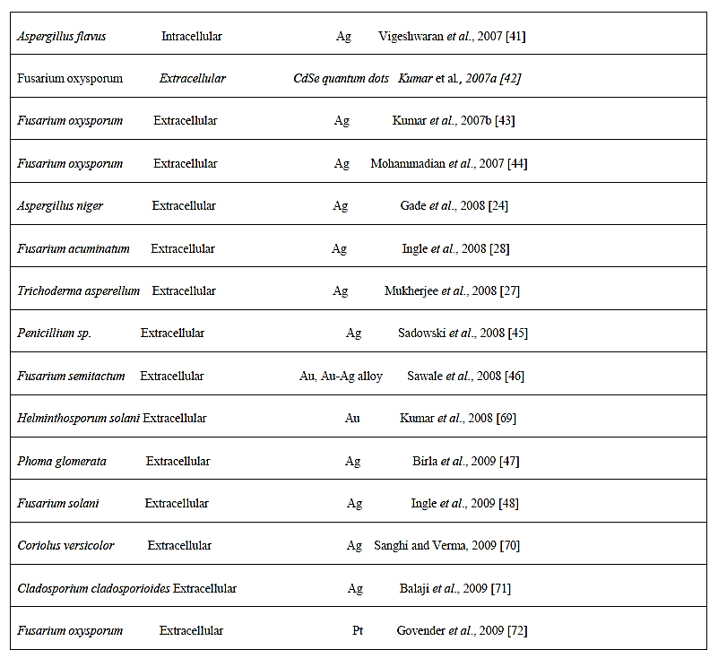
Fungi
Page 2 of 2
Theme I: Daguerreotype as Nanotechnology – Biological pathways
Notes:
Slide 32
The article documents the viability of nanoparticle fabrication achieved by fungi and its versatility over other green synthese (plant, bacteria, enzymes) and this record is consistent with the Harvard research and the assumptions made by many conservators based on observation of a common phenomenon. Up until our research presented here, I do not believe there has been any published reports of the mechanism for fungal engagement on daguerreotypes. Our overview of the fields of nano-chemistry and biology and the drive for producing gold and silver nanoparticles for all the aforementioned purposes in advanced material sciences and medicine has been an open door to offer here an underlying explanation what our extensive SEM imaging and analysis has revealed.

Slide 33
Theme I: Daguerreotype as Nanotechnology – Biological pathways
Notes:
Slide 33
To quote from the review article:
Mycofabrication can be defined as the synthesis of metal nanoparticles using fungi. The fungal system in recent
times has emerged as “Bionanofactories” synthesizing nanoparticles of silver, gold, platinum and CdS etc.
Fungi can accumulate metal ions by physico-chemical and biological mechanisms including extracellular binding by
metabolites and polymers, binding to specific polypeptides, and metabolism-dependent accumulation [23]. The possible
use of fungi has gained much importance, as they are easy to culture in bulk. Also, the extracellular secretion of
enzymes has an added advantage in the downstream processing and handling of biomass [24] when compared to the
bacterial fermentation process which involves use of sophisticated instruments to obtain clear filtrate from the colloidal
broth [25]. Moreover, fungi are excellent secretors of protein compared to bacteria and actinomycetes, resulting into
higher yield of nanoparticles [25]. Thus, using these dissimilatory properties of fungi, it could be extensively used for
the rapid and eco-friendly biosynthesis of metal nanoparticles. The present review focuses on the synthesis of metal
nanoparticles using fungi, various applications, and the present status of research involving its future impressions.

Slide 34
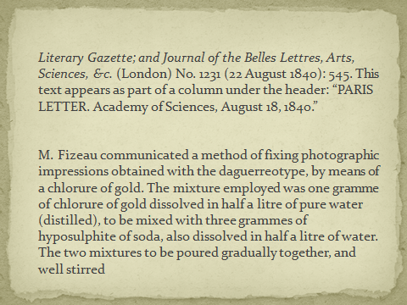
Research on the gilding of daguerreotypes as nano-technology
Theme I: Daguerreotype as Nanotechnology
Notes:
Slide 34
Another significant indicator of the predominance of nano-metallic factors in daguerreotypes is in the gilding, or gold deposition process. The nature of gold deposition onto the silver surface has not yet been fully elucidated. From a standard metallurgical standpoint, the most common explanation posits that the more noble gold plates out onto silver through standard electropotential differentials of the metals – the electrolyte being the disassociated gold chloride and sodium thiosulfate –although I am not aware of research into the actual viability of this pathway. Our research proposes that the widely adopted method first published by Hippolyte Fizeau in 1841 for “gilding” daguerreotypes via gold dissolved in Aqua Regia, forming chloroauric acid and then mixed with sodium thiosulfate, does not result in a plating displacement reaction.

Slide 35
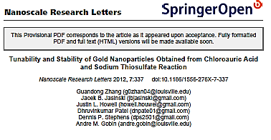
Tunability and Stability of Gold Nanoparticles Obtained from Chloroauric Acid and Sodium Thiosulfate Reaction
Theme I: Daguerreotype as Nanotechnology
Notes:
Slide 35
Our literature review of published research into gold nano-particle fabrication yielded a 2012 investigation of Fizeau’s recipe of 170 years ago by a group at the University of Louisville using the same solutions for bio-medical applications —although they had no knowledge of the daguerreotype, Fizeau, or Herschel’s work. They published on the mechanism and variability of stabilized thiolated gold nanoparticles that form in the mixed solutions by researching from first principles. Their work describes that gold nanoparticles are vary in shape and size according to molar ratios of the mixed solutions. Of great interest to us is that the research characterized the solutions and quantified the size, shape, and the nature of the thiol bonding of the gold nanoparticles in solution. This highly relevant work reveals that the gold nanoparticles formed in Fizeau’s classic recipe are between 10 and nm in diameter, and are surrounded, or complexed (in the form of micelles) by thiol groups that keep them from aggregating in solution.

Slide 36
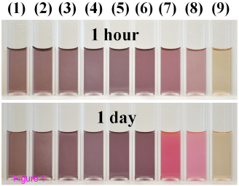
Theme I: Daguerreotype as Nanotechnology
Notes:
Slide 36
This is an Illustration from the publication of the of the solution colors as determined by size and cgold particles the University of Louisville that are indicative of the shape and size and of the gold nanoparticles in solution. The previously described plasmon resonance properties are quantified by the absorbance spectra, and even by eye, we can see that solution 9 is similar to what the traditional gilding solution looks like after preparation; and is consistant with the University of Louisviille’s research; namely unaggregated gold nanoparticles between 5-20 nanometers.

Slide 37
2% gold chloride in distilled water: @ 5 months
Solution mixed 1:1 with sodium thiosulfate solution
Notes:
Slide 37
The 2% gold chloride solution was made up in September 2012 from solid crystalline gold chloride in distilled water seen in flask on left; it has been kept wrapped in foil to block light. On the right are two recent mixtures of the gilding solution made to concentrations used by modern daguerreotypists. The bottle on the left mixed sodium thiosulfate into gold solution; which according to current daguerreotype practitioners is to be avoided, and the one on the left was mixed according to daguerreotype recipes: the gold solution is added the sodium thiosulfate solution. There appears to be a slight color difference, which would indicate that the gold particles are larger in the reversed sequence has not been tried as a gilding solution.

Slide 38
University of Louisville
Eastman House
5 nm
10 nm
Theme I: Daguerreotype as Nanotechnology
Notes:
Slide 38
Comparisons of transmission electron microscopy scans. The scan on the left is from the paper published by the University of Louisville as a characteristic gold nano-particle size and shape formed in their experiments, and one that most closely resembles the isolated gold nanoparticles from the Eastman solution of gold chloride dissolved into the sodium thiosulfate solution. The hexagonal shape is one of the structures that can be formed by 111 face-centered-cubic gold crystals. Adjusting for the scale differences in the images; the Louisville particle is approximately 25nm in diameter, and the two particles in the Eastman house solution are in the range of 10 –20 nm in diameter, and of similar crystal structure.

Slide 39
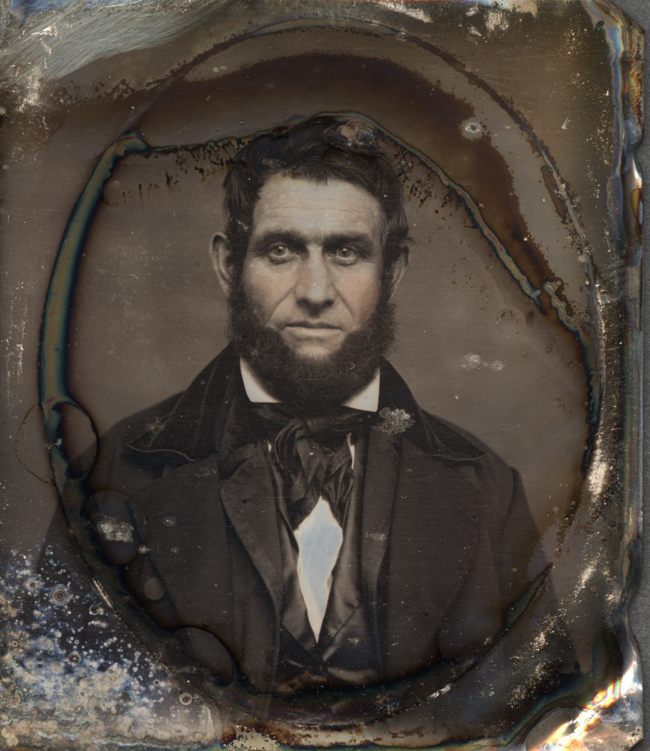
Theme I and II: Daguerreotype are specimens of nano-archaeology
Notes:
Slide 39
I will use this plate in the Eastman House study collection that has yielded some important information regarding the gilding process, as well as some of the more spectacular bio-forms we have been marveling at. It is a 6the plate, and with many of the study collection pieces, there is no evidence of major interventions, cleanings, or deliberate manipulation of the daguerreotype – until, of course, I got ahold of it. The applied color you see in the cheeks is undisturbed and the biogrowths are mature specimens that probably took a century or more to assemble to their current state.
In introducing the daguerreotype as archaeological, and a keeper of its history embedded in its nano-structure, we will appropriately introduce the term nano-archaeology. On and below the surface a daguerreotype yields its material record that we can excavate with ever more powerful instruments that are not only unlocking the increasingly stunning technical achievement that is the daguerreotype, but they are also revealing its archaeological record; circumstances of its fabrication, and event history. Now that we have established the significance of a daguerreotype as a nano-technological object, we must establish the parameters of its nano-archaeology.

Slide 40
200 nm
Theme I and II: Daguerreotype are specimens of nano-archaeology
Notes:
Slide 40
As discussed earlier, a satisfactory explanation of the gilding step has not been achieved. The focused ion beam mode of the SEM is essential to achieve a better understanding. This is a Fib trench cut into the plate shown previously [Scale bar is 200nm] The trench is in an area with few image particles. The cut severs through a low profile biologically mediated structure at a juncture between raised morphological features. We will return this FIB cut for further interpretation on that aspect a bit later in the talk.
This gilded plate shows a a nearly fully continuous horizontal separation or void below the presentation surface. Our studies are showing that that gold is universally distributed onto the plate in 5 – 20 nm diameter gold particles that enjoin with the silver surface during gilding step through nanoscale diffusion properties of certain metals; in this case gold and silver. Our working theory, illustrated here, is that the gold deposition is inducing mass transport diffusion between the gold and silver, and the silver is pulled into a core-shell matrix as a distinct bi-metallic layer. It may not be always as complete or uniform as we see in the FIB section, but it is always observed in gilded daguerreotypes, and is absent in non-gilded daguerreotypes. This particular bi-metallic system is an area of vigorous research in nano-metallurgy – and for us it is yielding relevant results in the interactions of silver into gold diffusion. We believe we are observing this mass transport phenomenon dynamic at play when gold and silver are engaged through the historic gilding processes of the daguerreotype –and again is a remarkable discovery nearly two centuries before it could be explained scientifically.

Slide 41
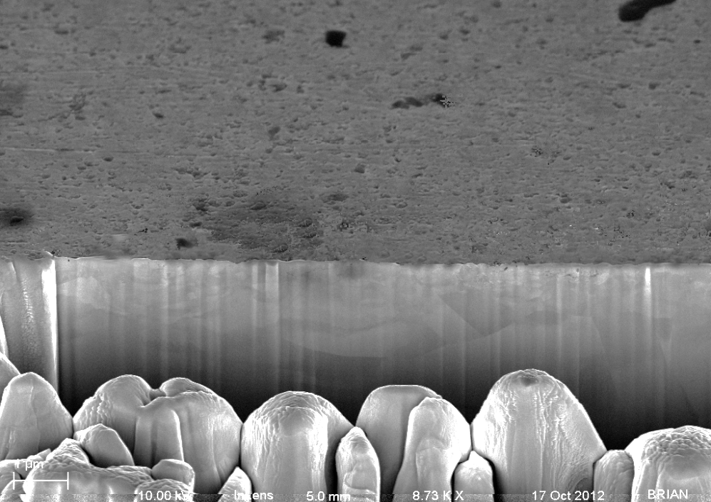
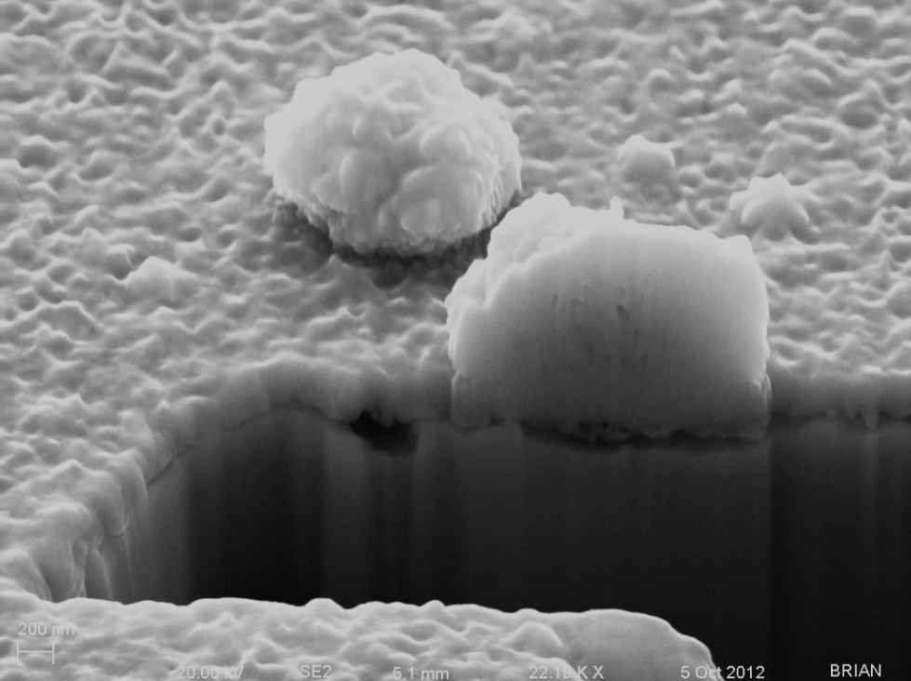
Ungilded Becquerel sample –no image particles
Gilded Becquerel sample
Theme I and II: Daguerreotype are specimens of nano-archaeology
Notes:
Slide 41
In a Becquerel developed daguerreotype (no mercury) there are no sub surface voids in the absence of gold (and mercury) as seen on the left; the FIB trench was made in an area where there were no image particles. The example on the right was gilded, pro-forma, and there are associated voids that appear beneath the silver-gold surface. The void beneath the image particle could also be mediated by the gold enhancement of developed image particle that was grown due to the gold deposition as well –and the void beneath the particle is due to the gilding step and not the image forming step.

Slide 42
FIB trench of historic ungilded daguerreotype
Fib trench of historic gilded daguerreotype
Theme I and II: Daguerreotype are specimens of nano-archaeology
Notes:
Slide 42
To further reinforce our findings we return to the ungilded historic sixth plate in the study collection seen on the left; There are no subsurface voids –even in association with the mercury developed image particles; we are quite convinced that the gilding step is responsible for the voids, and even continuous discontinuity just below the surface which is composed of a yet to be determine bimetal structure.
This is well demonstrated on a marvelous find in the study collection; as sixth plate that had previously been removed from its preserver, and the condition of the plate was nearly pristine –with a delicate flush of hand coloring. Not the continuous gap beneath the 200 nm top stratum. Note also that the sectioned image particle is attached below the gold layer, and there is no separation between the image forming particle and the ungilded surface below. These few dramatic explanatory images are supported by extensive EDS analysis including the ternary metallic composition within the image particle. You may notice a distinctive feature we have seen before, and rest assured we shall seen it again momentarily.

Slide 43
The Conservation Response
Theme III: Conservation and preservation of the daguerreotype
Notes:
Slide 43
We now approach theme three of this presentation after establishing the material attributes of the daguerreotype as ones predominately governed by physics and chemistry at the nano-scale, and that perhaps that the state of the conservation response is not taking this reality into account. In attempting to arrive at a possible advancement to at least substantially slow nano-deterioration that appears trivial due to scale or rate, but is not trivial at all given the ethical and societal mandate of the profession. To make that case, I offer this last case study. We are looking at the unattributed, and unidentified 6th plate introduced in the last slide –and yes it does have an 8 x 3 micron FIB cut into it that I defy all to find except by at least 200 X magnification. Because of its unusually fine condition, and its apparent non-intervened with state, I was motivated to determine if there was any evidence of biological engagement –if so it would be the first evidence to the contrary that such a favorable petri dish would not harbor some life products. Nothing was revealed by light microscopy with a comprehensive scan sweeping examination at 20 to 50X. After a three hour session on the SEM, which included both overall visual low magnification mapping and higher magnification in regions that appeared most likely locations for possible some identifiable feature –I was about to rethink my conclusions from research. And then:

Slide 44
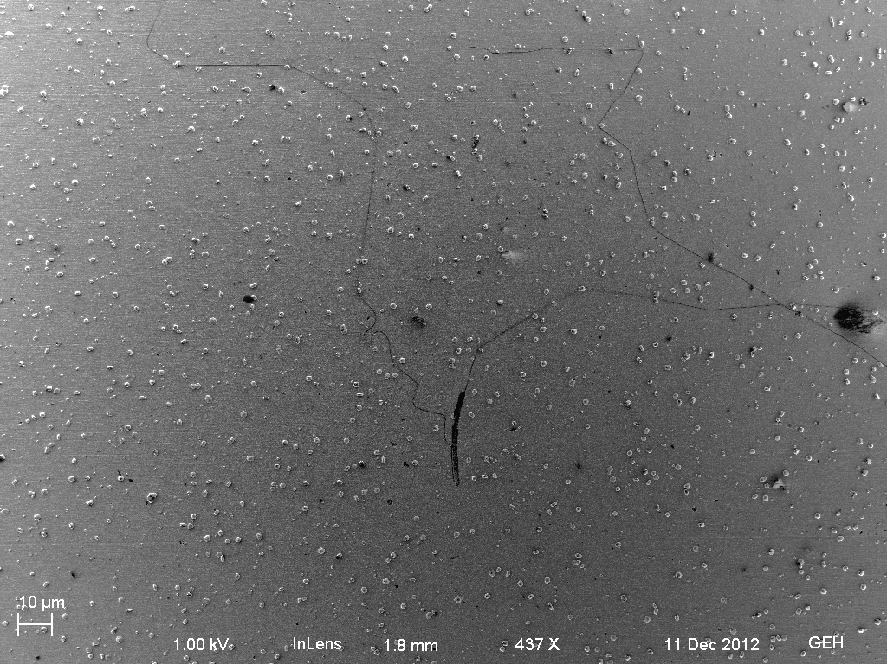
Theme III: Conservation and preservation of the daguerreotype
Notes:
Slide 44
Just off the sitters left ear in the neutral background area I noted a very thin and unusual threadlike squiggly line.

Slide 45
Notes:
Slide 45

Slide 46
Notes:
Slide 47

Slide 47
Notes:
Slide 48

Slide 48
Notes:
Slide 49

Slide 49
Notes:
Slide 51

Slide 50
Notes:
Slide 52

Slide 51
Notes:
Slide 54

Slide 52
Notes:
Slide 55

Slide 53
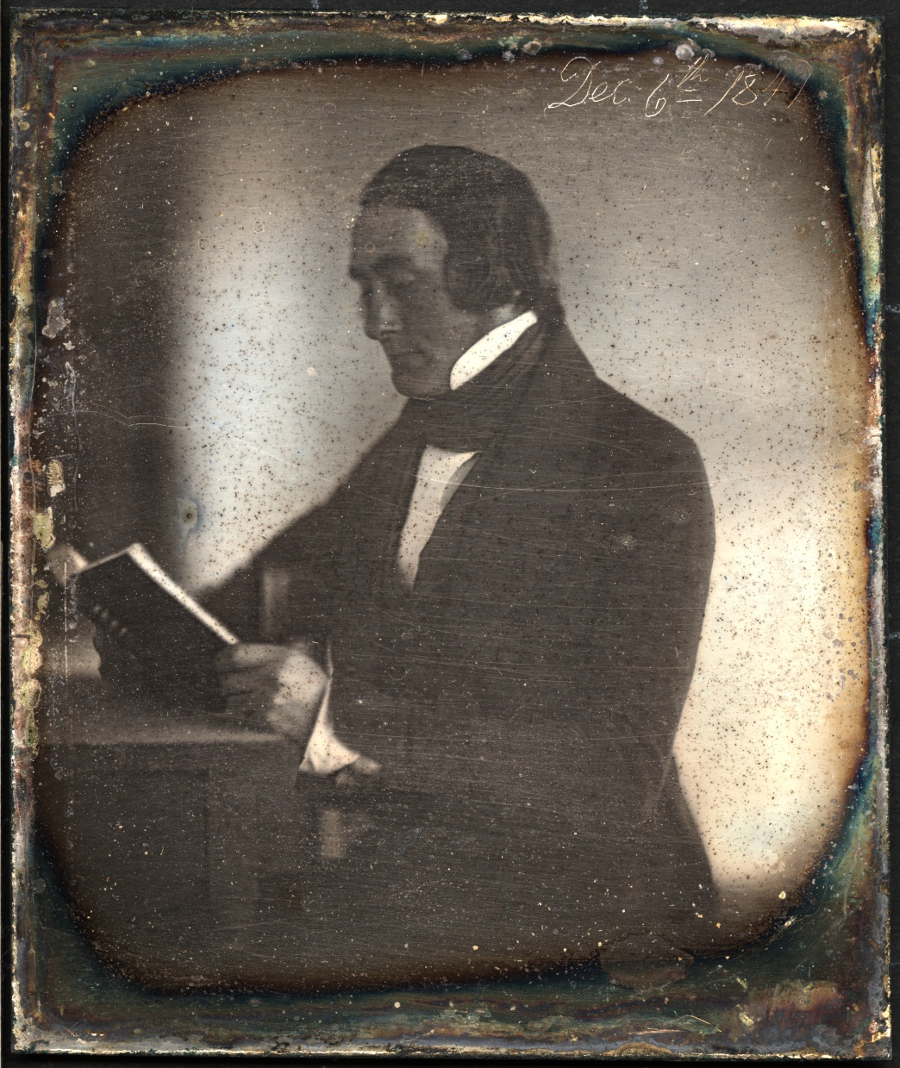
Theme III: Conservation and preservation of the daguerreotype
Notes:
Slide 56

Slide 54
Evidence of harsh chemical treatment
Theme III: Conservation and preservation of the daguerreotype
Notes:
Slide 57
This is a record of a non specific region depicting a disrupted surface undoubtedly caused by a harsh chemical interaction –the holes may actually be preferential attack –if cyanide of thiourea they can complex with gold –especially gold at the nano-level, and we may be seeing the loss of gold with the result being an actual loss of the gilding.

Slide 55
Comparison of two surfaces
The nano-structure of the Cornelius plate
The nano-structure of the study plate with the nan0fiber
Notes:
Slide 58
These surfaces are distinctly different; the cornelus plate has lost what might be some of the larger distinctive nanoparticles and appears more amorphous and clumped into clusters as if an active chemistry induced reactions – there is a morphology that may be related to the subsurface, and what we have seen in undisturbed daguerreotypes the voids beneath the gold-silver upper microns is a unified planar surface –the depressions and combined morphological aggregates are not apparent in the robust differentiated morphology in the well preserved historic sample.

Slide 56
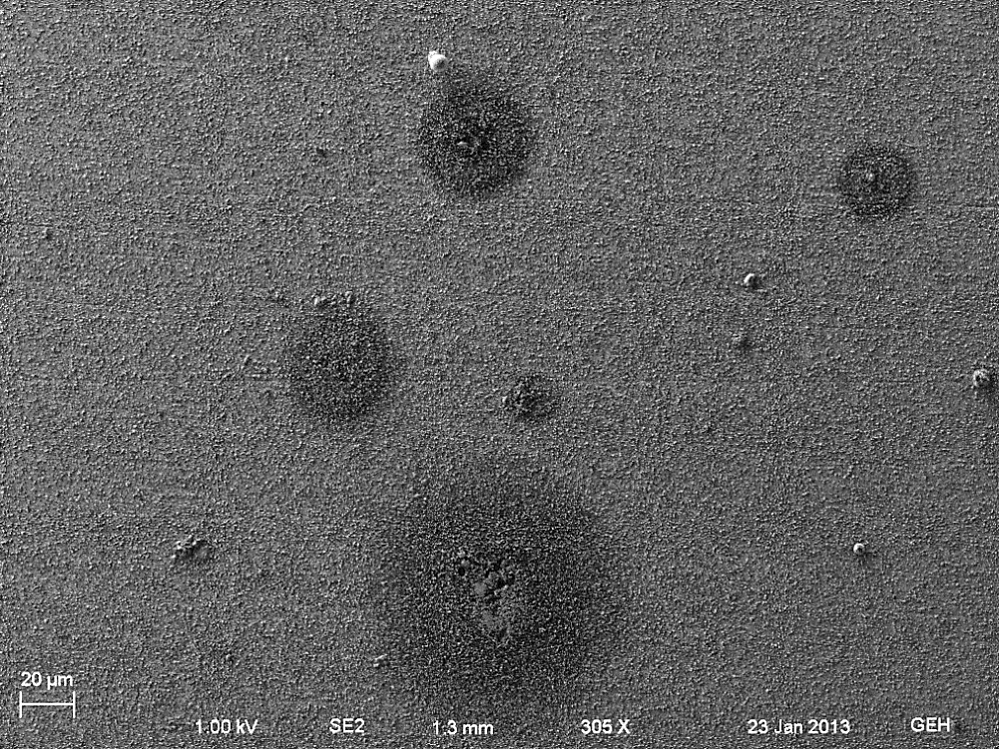
Evidence of harsh chemical treatment
Theme III: Conservation and preservation of the daguerreotype
Notes:
Slide 59
characteristic brown spot assembly in the collar area is imaged and analyzed by EDS; the red circle is in a perimeter band characterized by a vertical crystalline structures, and the yellow core area; interpreted as being the propagation center, provides further visual and analytical information of a ubiquitous phenomenon of unfortunate intervention with this historically significant plate.

Slide 57
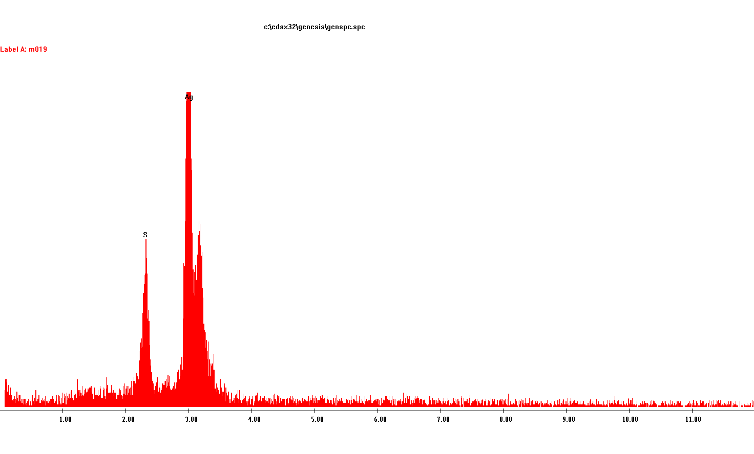
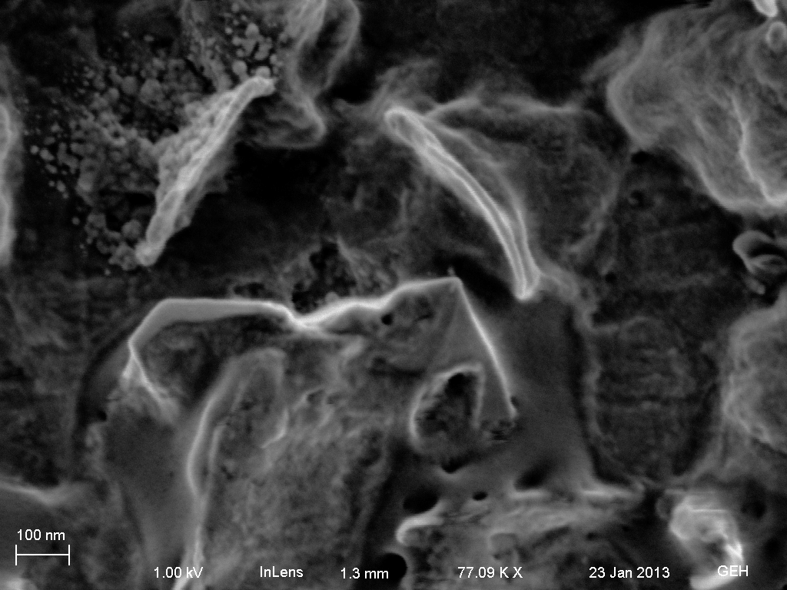
Theme III: Conservation and preservation of the daguerreotype
Notes:
Slide 60
The exterior perimeter of the brown spots – as they appear by the unaided eye have a vertical platelet aggregation of what appears to be a hexagonal or pentagonal this crystal. Their EDS spectra indicates a consistent strong sulfur peak along with silver, without any other peaks, except for carbon.

Slide 58
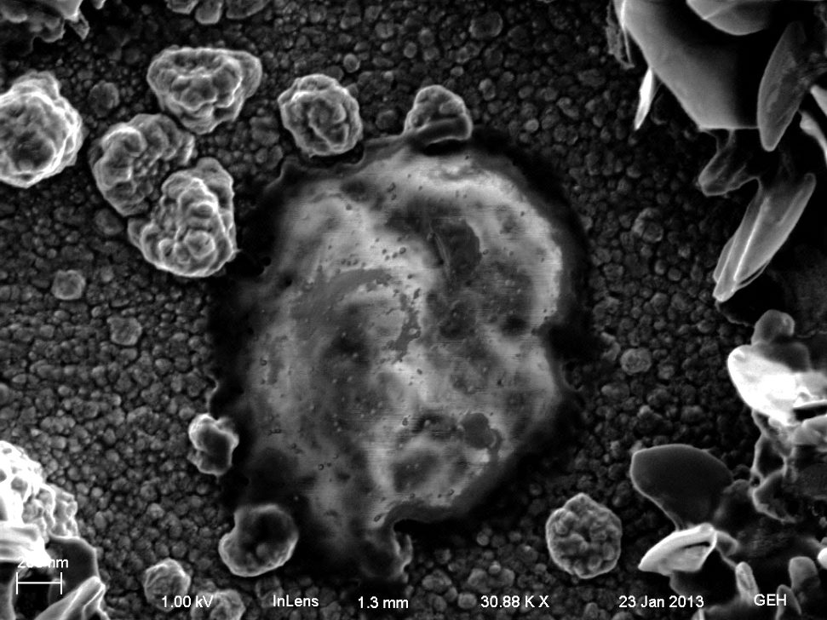
Theme III: Conservation and preservation of the daguerreotype
Notes:
Slide 61
In the core of the large nucleated shows that the silver chloride platelets are crowding around what appears to be a subsurface feature emerging from beneath the surface through a hole approximately 1 micron in diameter. Note that the surrounding silver surface appears pristine, and may be an area that preserved the original surface preparation of the daguerreotype by Cornelius on December 6, 1841; and if so is extraordinarily valuable evidence. Why this is so is less easily determined; as is what precisely caused the massive surrounding disturbance.
EDX spectrum of approximate region of signal [10KV accelerating voltage @ 5mm working distance] image inset is cropped from the previous.
Spectrum interpretation reveals a distinct copper signal, in addition to the prominent silver signal, and there is some gold present. Sulfur remains a strong signal, along with carbon and oxygen; there appears to be mercury that shows up in the more definitive L line at higher energy. Some agent appears to have etched down into the plate and created an active electrolytic cell capable of interacting with all the species on the daguerreotype; if it reached to the copper sub-layer, either as a thiourea or a cyanide complex, the essential elements are present to form copper sulfates or other complexes if considering standard electropotentials. At the nano-level, we are not able to predict the mechanisms that might occur if gold and silver are active species and their discrete particle sizes are in the described nano-dimension realm; which is assuredly the case.

Slide 59
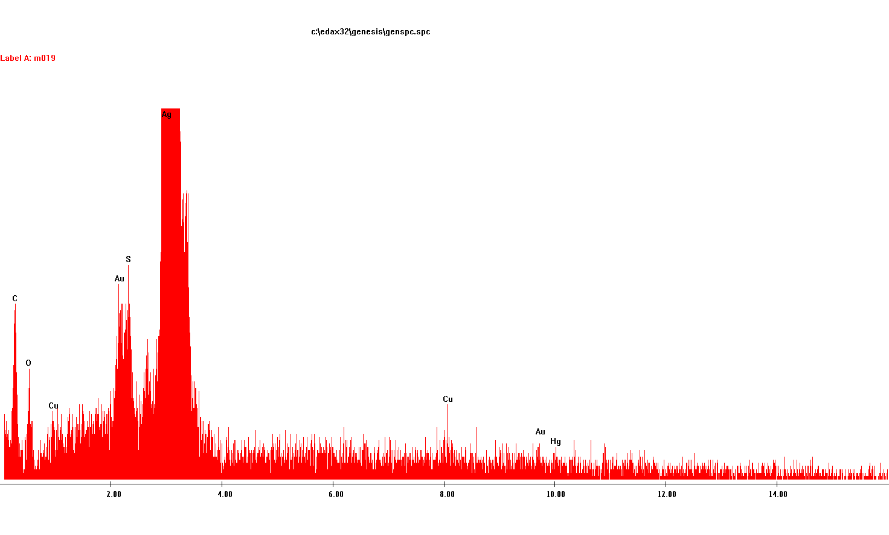
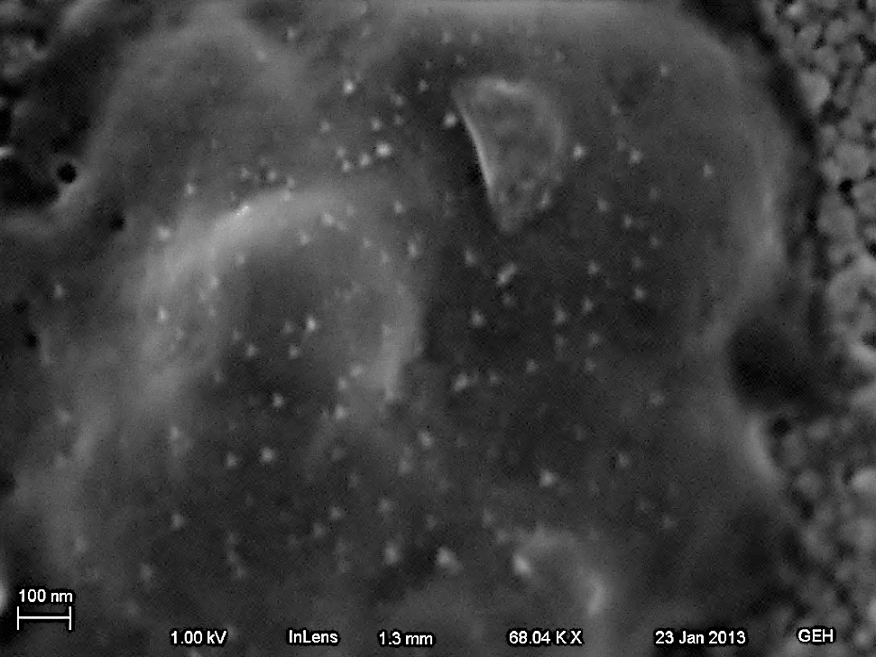
Theme III: Conservation and preservation of the daguerreotype
Notes:
Slide 62
Emerging from below; possibly a function of what we know of the porosity and presence of a non continuous surface in gilded plates, the active species of sulfur, and possibly chlorides –have engaged with the copper into the copper layer and have an electrolytic effect that resulted in dissolution and interaction outward from the active core region.

Slide 60
What do we do now?
Are there surface intervention treatments that can effectively remove reactive chemistry and retain the original nano-structure of the daguerreotype?
Are original cases and framing materials effective in preventing the nano-scale reactions as we have see here –for which there is no known scientific rationale for them to not progress.
Is it possible to slow or halt nano-chemical reactions now –and wait for new science to emerge that may provide better solutions to these critical issues for the preservation of the daguerreotype?
Theme III: Conservation and preservation of the daguerreotype
Notes:
Slide 63
Are there surface intervention treatments that can effectively remove reactive chemistry and retain the original nano-structure of the daguerreotype?
Are original cases and framing materials effective in preventing the nano-scale reactions as we have see here –for which there is no known scientific rationale for them to not progress.
Is it possible to slow or halt nano-chemical reactions now –and wait for new science to emerge that may provide better solutions to these critical issues for the preservtion of the daguerreotype

Slide 61
The answer is yes –but it requires adopting new practices
Notes:
This is an anodized aluminum frame that retains pure argon for an indeterminant period. The front and back are borosilicate glass by sealed around the perimeter by NASA specification grade low off-gassing epoxy. The epoxy, pre-cured is isolated from the interior space by a compressed teflon gasket. The detachable endcap is the only exterior gasketted component, and allows access from the end only and keeps the need for compressed gasketing to the mimum. The enclosure olds argon @ <.001%, and testing has been 100% effective for the ongoing testing of over a year. There are small ports in the endcap so that the purging and refilling does not require opening the enclosure. The white dot you see in the obverse image is an oxygen sensor within the housing that is measured optically based on the period of fluorescence emission of a Ruthenium compound that varies directly with the percent oxygen. The three mm tab simply needs to be within the enclosure and optically accessible to a fiber optic probe that emits a specific pulsating near UV signal, and the fluorescence period is read by a spectrometer. Readouts and records are maintained through the manufacturer’s software –it is the Ocean Optics Neofox kit.; and the unit (probe spectrometer, and software cost approximately 3K (US), and the long-service patches are between $10 and $20 each depending on volume price break.
George Eastman house is implementing this program for its collection of 1270 item collection of Southworth % Hawes daguerreotypes that came into the collection without any original housing material; and as most of you know, it has had documented environmentally induced changes –
The particular features of this system will be released shortly –it is designed and has shown by pressure testing to clearly meet the 5 year specification of no measureable ingress of Oxygen –which means that the interior environment is effectively 100% Argon.
There is no need for any moisture for a daguerreotype, and the absence of oxygen and moisture will halt all life forms –and related intermetallic or organic phase reactions that would progress in any non-modified air environment; no matter how clean and museum stable it might be.
Plans are in place to answer the obvious –what about original housings? Aren’t they part of the object? Who are we to alter what was passed down to us with such a radical intervention in presentation; and all the concerns that are within the conservators domain.
It becomes a very important ethical and value laden issue –but there is a real cost involved in not considering altering current practices. Much of the answer lies in engineering. Ongoing research into the use of .5mm thick Gorilla glass (which will be in the next generation of ultra-slim smart Phones will allow an interior enclosure, exquisitely thin, that can be an extraordinarily low profile argon interior of a cased daguerreotype –with still room for original glass to be retained. Only in a few anomalies are daguereotypes larger than their brass mats. The applicability to the Passepartout style is a straightforward solution using these concepts.
So in closing –we are learning a great deal of what is one of the most challenging and remarkable object; that just happens to fall within the domain of photograph conservators; but requires reliance on the most advanced chemistry and physics to understand it, and bold action to preserve this seminal object for the future. It is only right to seek answers that honor the incredible scientific and cultural leaps that were generated by the daguerreotype 180 years ago.

