Slide 1
From the ISM to the IMF: Multi-Scale, Multi-Physics Modeling of Star Formation
Shule Li, Richard Klein, Chris McKee
University of California Berkeley
shuleli@Berkeley.edu
10.27. 2015

Slide 2
Methodology: Radiation Transfer with Short Characteristic Ray Tracing

Slide 3
Motivation
Radiation transfer plays an important role in the process of star formation. The radiation energy density and pressure tensor can be obtained by solving the following coupled equations:
$$\frac{∂E}{∂t}+\frac{c}{a}∇∙F=S(E, P)$$
Closure relation:
$$\frac{∂F}{∂t}+\frac{c}{a}∇∙P=S(E, P)$$
$P$ = f E
The current flux limited diffusion method (FLD) of ORION assumes the pressure tensor P is diagonal, and f is a scalar value tied to the gradient of radiation energy density E. It has the following limitations:
The fact that the direction of the flux is not computed from the transfer equation can introduce error in optically thin regions.
Dropping the time-dependent term in the radiation flux can lead to error when the radiation field carries a significant portion of the total momentum of the flow.
The diagonal terms in the radiation pressure tensor are dropped, hence eliminating effects such as radiation viscosity.
The variable Eddington tensor (VET) method computes f directly from the integration of a set of angular moments and thus provides an accurate closure relation for radiation transfer and can significantly improve the accuracy of star formation simulations where radiation transfer is important.

Slide 4
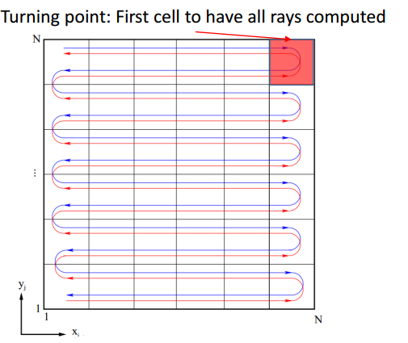
Short Characteristic Ray Tracing
Short characteristic ray tracing sets up a set of rays for each cell, and updates their intensities through an 8-way sweep mechanism. We are using Athena code from the Princeton node as a code reference.
Ray Initialization (from prolongation and overlap)
convergence
Example: 4-way sweep in 2D
Source and Ray Interpolation
Sweep
Source Function Initialization
The ray intensities are then used to integrate the zeroth and second moment to obtain E and P, and obtain f through:
$P$ = f E

Slide 5
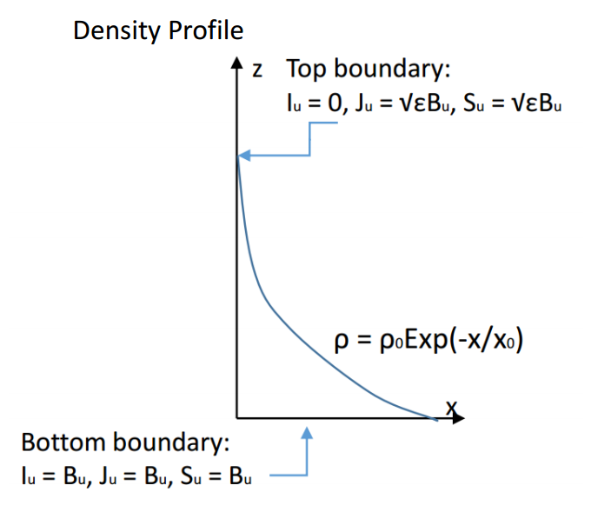
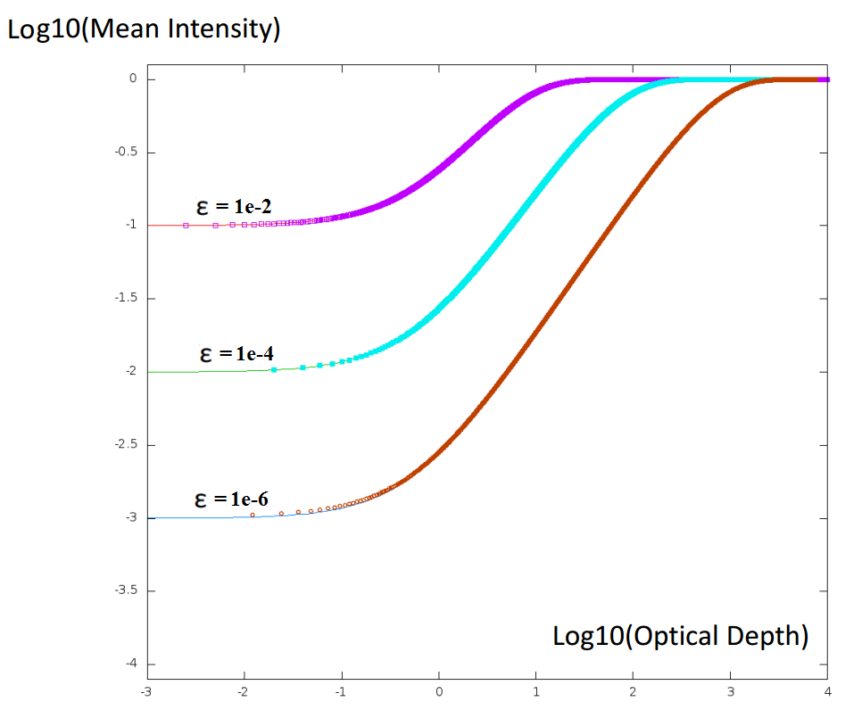
Test: Radiation Intensity Distribution Under Uniform Isothermal Atmosphere
The photon destruction rate ε characterizes the scattering effect: for weakly scattering cases, ε << 1. For strongly scattering cases, ε >> 1. We test the ray tracing in a strong scattering test against analytic intensity profile.

Slide 6
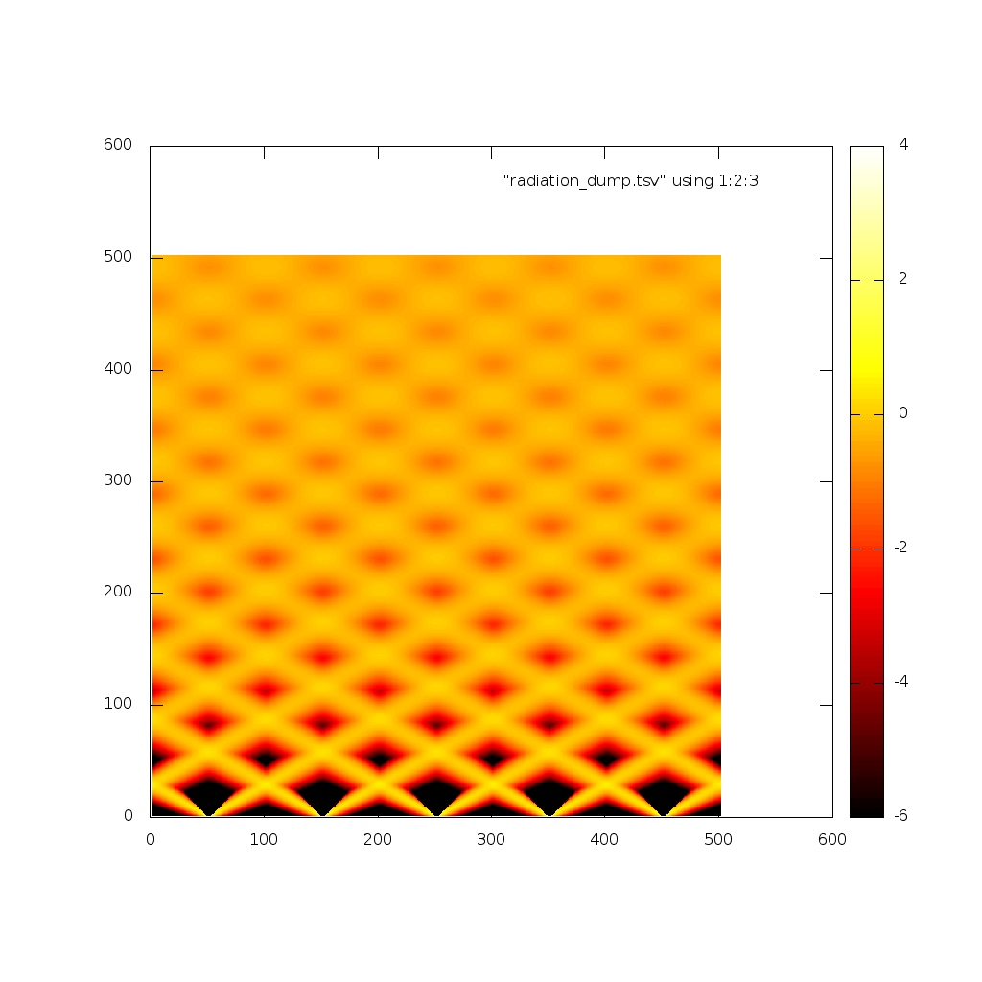
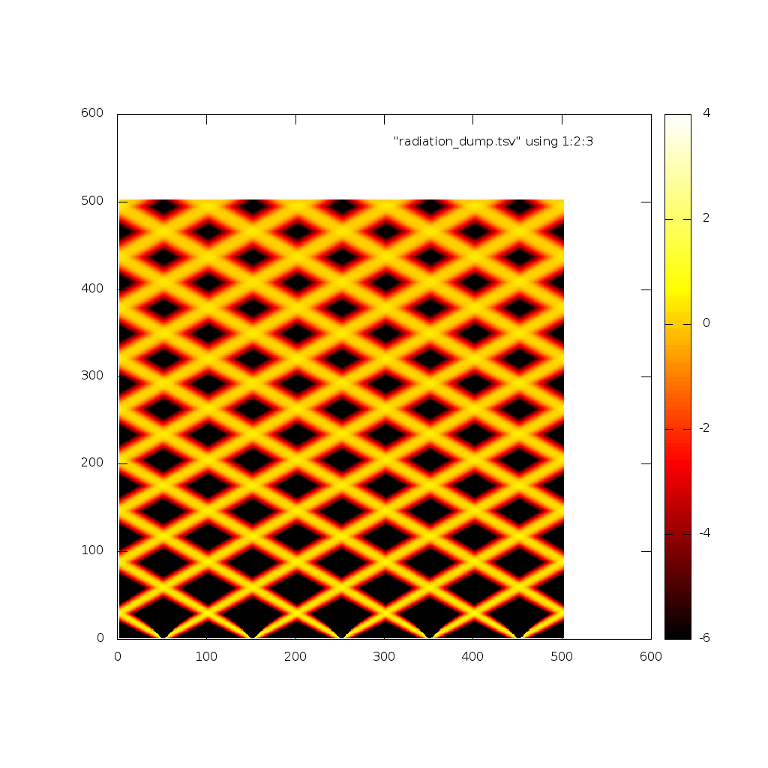
Test: Beam Propagation Under Periodic Boundary Condition
Cubic Monotonic Interpolation
Linear Interpolation
Log10(Radiation Intensity)
Transparent Boundary
Linear Ray Interpolation in Parallel
Periodic Boundaries
Incident Rays
The beam test is inspired by the same test carried out by the short characteristic solver in Athena, to which we compared our result and found good agreement.

Slide 7
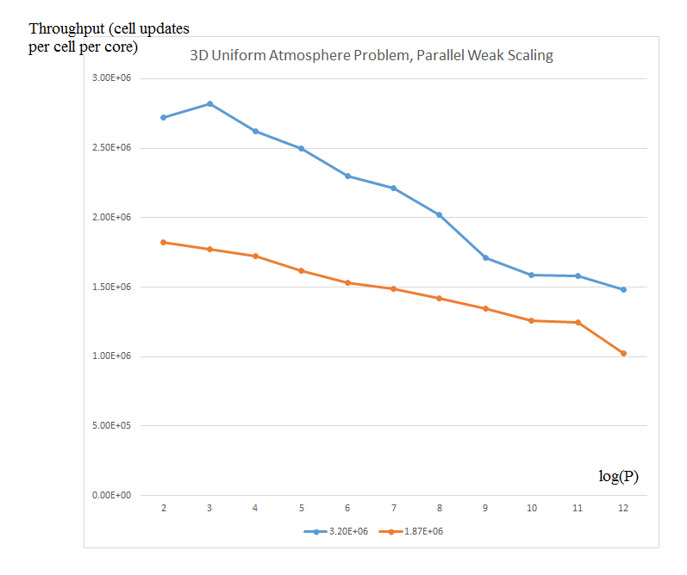
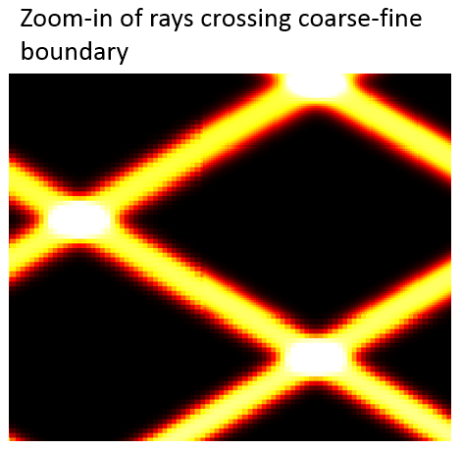
Ray Tracing in AMR
Parallel ray tracing: the ray information in the ghost zone is interchanged through the Chombo interface.
AMR ray tracing: the initial condition of ray tracing are derived from grid overlapping (grid information from at the same spatial location and level from the previous time step) and prolongation (grid information from the same spatial location and time step on the previous level).
3D Beam Test with AMR Turned on
3D Uniform Atmosphere Problem, Parallel Weak Scaling
3e6
2.5e6
vectorized
2e6
unoptimized
1.5e6
1e6
0.5e6
Log2(number of processors)
2 3 4 5 6 7 8 9 10 11 12
Some parts of the ray tracing have undergone code transformation to take advantage of vectorization capability of the intel compiler.

Slide 8
Simulation: ORION Zoom-in AMR Simulation of An Athena Simulation Data Set

Slide 9
Motivation
Star formation lies at the center of a web of processes that drive cosmic evolution. A detailed, predictive theory of star formation is crucial for progress in many fields of astrophysics. In order to investigate low-mass star formation, a two-stage simulation is carried out:
A large-scale Athena MHD simulation of a 500 pc portion of a galactic disk. This simulation has conditions comparable to the Solar neighborhood in terms of total ISM gas surface density, gravitational potential of the stellar disk, background galactocentric rotation and shear rates, and mean magnetic field strength.
At 380 Myrs, the Athena simulation is in statistical equilibrium in its SFR and turbulence level. We extract a 250 pc subregion from the above simulation, and add ~ 50 pc zoom-in boxes for high resolution zoom-in simulation. These zoom-in boxes contain dark molecular clouds with mass 10 Solar mass, in which only low-mass star formation is observed. Through this high resolution zoom-in simulation, we expect to address the following crucial topics regarding low-mass star formation:
the relation between the core mass function and the IMF
the role of ongoing/competitive accretion in moderate-mass clouds?
How does magnetic field regulate star formation?
Does limited thermal feedback prevent the formation of high-mass stars?
4

Slide 10
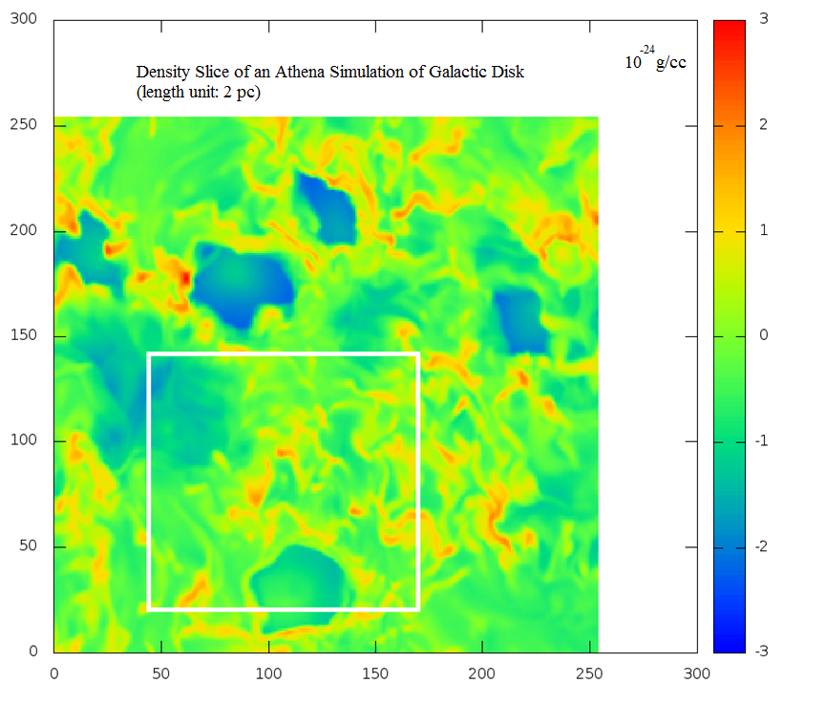
Zoom in Simulation of Athena Data Set
Original Athena Data Set: a shearing disk simulation of a 512 x 512 x 1024 pc region (2 pc in resolution), with shearing box boundary conditions, supernova feedback, a subgrid model for star formation at 380 Myrs simulation time.
Log10(Density)
ORION Simulation Subregion:
256 x 256 x 256 pc with outflow boundary condition
ORION Zoom-in Box Size:
a 35 x 70 x 65 pc box and a 25 x 35 x 65 pc box
ORION Simulation Maximum Resolution:
400 AU in zoom-in box (with 10 AMR levels)
25 AU in selected 5 pc regions (with 14 AMR levels)
Included Physics:
MHD
CO cooling
Fine structure line cooling
Dust heating through radiation transfer employing a two temperature (gas and dust) model, newly implemented in ORION for this simulation.
ORION Subregion

Slide 11
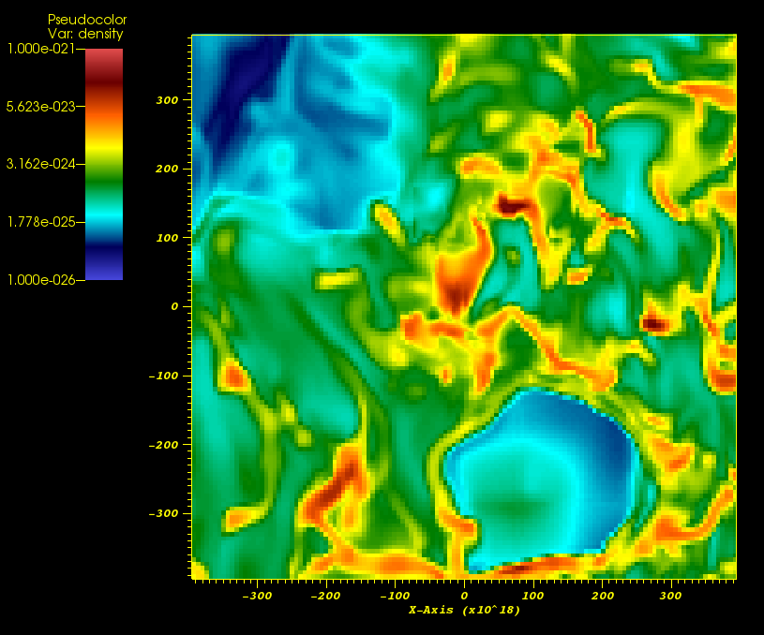
Zoom in Simulation of Athena Data Set
Cooling module is newly supplied by the Santa Cruz node as part of the chemistry solver package. The simulation is divided into three stages:
1. Three scoping simulations with 2 AMR levels are carried out to study the difference between cases where no cooling is applied vs Athena code cooling module vs ORION’s new cooling module.
2. A scoping simulation with 6 AMR levels is then carried out to observe the general evolution up till the time when stars begin to form. We have determined from this simulation that the simulation time when the first star is formed is around 1.8 Myrs.
3. Restart from an early check point (e.g. 1 million years) of the 6 level simulation, with 10 AMR levels. This production run requires 400 AU resolution to properly resolve the turbulence. Once the stars begin to form, we will turn on radiation transfer with 4 additional AMR levels.
ORION High Resolution Zoom-in Box

Slide 12
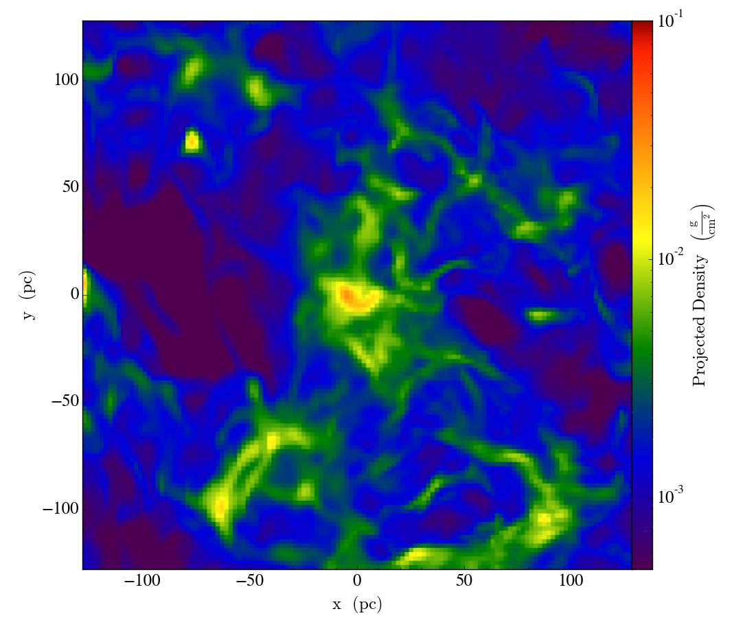
Column Density Evolution for 2 AMR Level Simulation (up to 3.5 million years)
Without Cooling
With CO Cooling

Slide 13
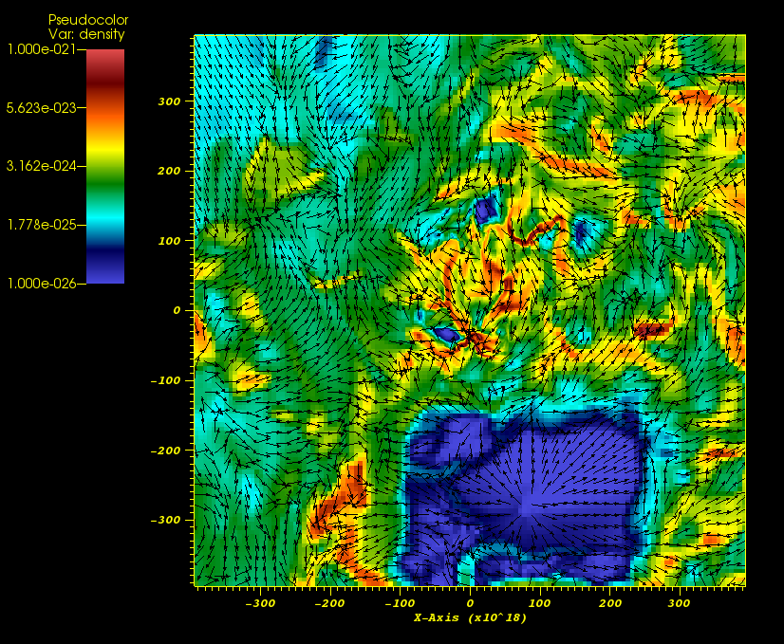
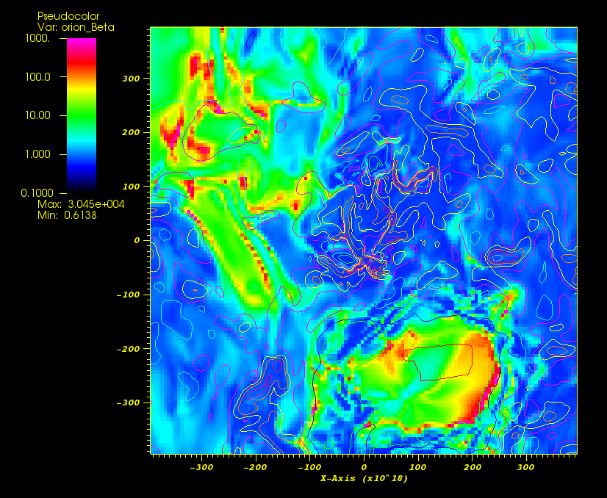
State of Magnetic Field and Velocity Field (2 AMR levels at 3.5 million years)
Density and Velocity Field
Magnetic Beta with Density Contour
Candidates for further zoom-in
In the above slice plot, flow converges to high density collapsing regions (examples shown as highlighted boxes). These are potential regions where we will put in additional resolution. The zoom-in high density region has low magnetic beta (< 1).

Slide 14
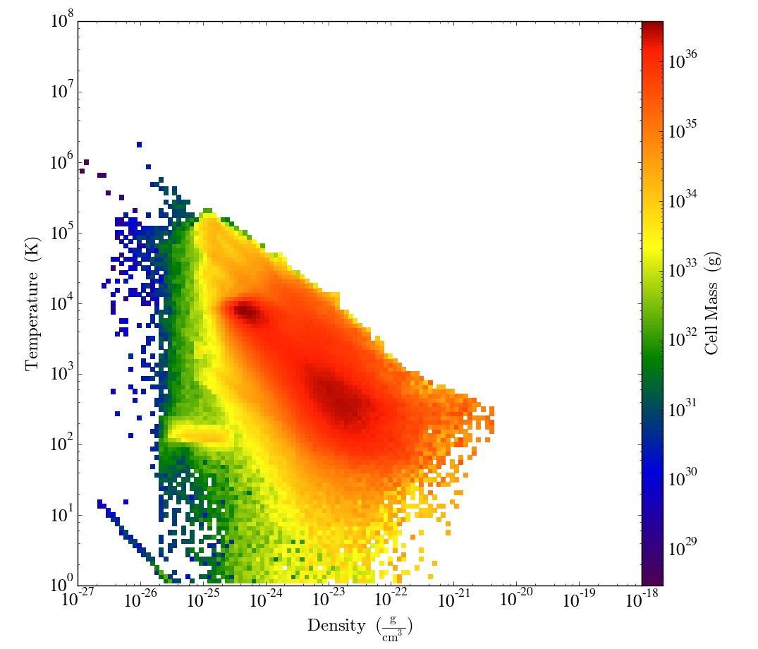
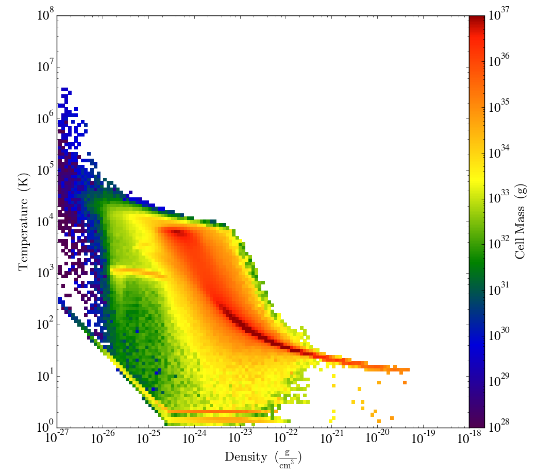
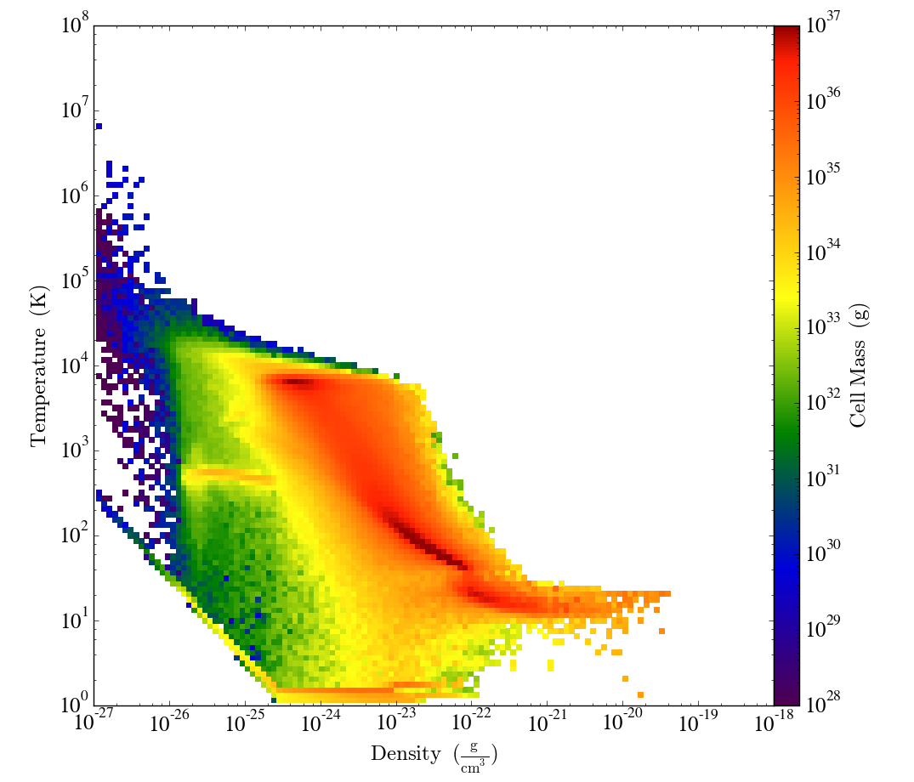
Density Temperature Phase Diagram
To evaluate the accuracy of the new cooling module, we compare the density temperature diagram under three different cases. The “step” feature observed for ORION CO cooling at 30 K is because of the turning on of the CO cooling.
No Cooling 2 million yrs
Athena Cooling 2 million yrs
CO Cooling 2 million yrs
In this comparison, we observe the temperature regime above 20 K is similar for both cooling modules. However, the high density gas below 20 K is more efficiently cooled with CO cooling because of the transition to molecular cooling.

Slide 15
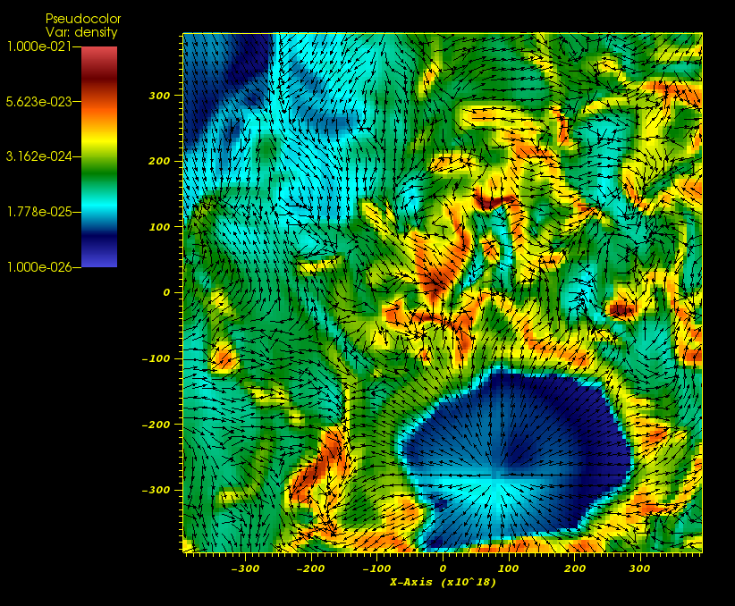
Current Results for 6 AMR Levels Simulation (up to 1 million years)
Density and Velocity Field
Column Density
We have run this simulation to 2 Myrs to confirm that 1.8 Myrs is the simulation time when stars start to form. Our simulation with 10 AMR levels restarts right from the end of the above animation.

Slide 16
Future Plan
We will complete the radiation transfer solver with short characteristic ray tracing, using modified Godunov method, where the radiation source term from the variable Eddington tensor (VET) solver will be applied o the L-R reconstruction stage of ORION’s MHD solver as stiff source term in AMR. The VET solver in AMR will then be ported to Athena, and used as the default radiation transfer solver for subsequent ORION simulations.
After the completion of the current ORION zoom-in simulation, we plan to launch two additional simulations, also taking data sets from Athena simulations.
One such simulation is a 50 pc subregion taken from Athena’s dwarf galaxy simulation. This is important because nearby dwarf galaxies provide a natural laboratory for the effects of lower metallicity and different environmental effects on star formation.
Another is a 5 pc subregion taken from Athena’s starburst simulation. This allows us to investigate the possibility of variations in the IMF due to increased pressure or temperature and determine whether radiation pressure controls star formation efficiencies in extreme environments.
Both simulations will utilize ORION’s newly developed components: AMR VET solver (USB and Princeton), chemistry (UCSC, UCB and Princeton) and ray tracing ionization (UCSC and UCB).

Slide 17
Thank You!

Slide 18
Solving Radiation Transfer Energy Equations
Once VET is obtained, we solve the radiation energy equations through converting the energy equation into a linear system, and solve it with our own multigrid method.
N cycles
N cycles
Gauss-Seidel Kernel
Restriction to Coarser Grid (Matrix and RHS)
Gauss-Seidel Kernel
Prolongation to Finer Grid (Error Correction)
Convergence check
The implementation of multigrid method (V cycle), with red-black based Gauss-Seidel cycle and basic vectorization for certain parts. The radiation source term obtained from the linear system is then fed into MHD solver through modified Godunov method.

