Slide 1
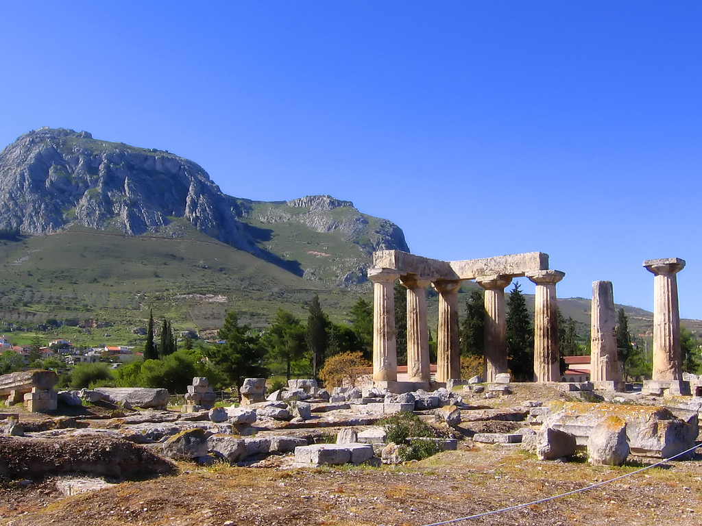
2 Corinthians:
Suffering and Glory
The Temple of Apollo in Corinth

Slide 2
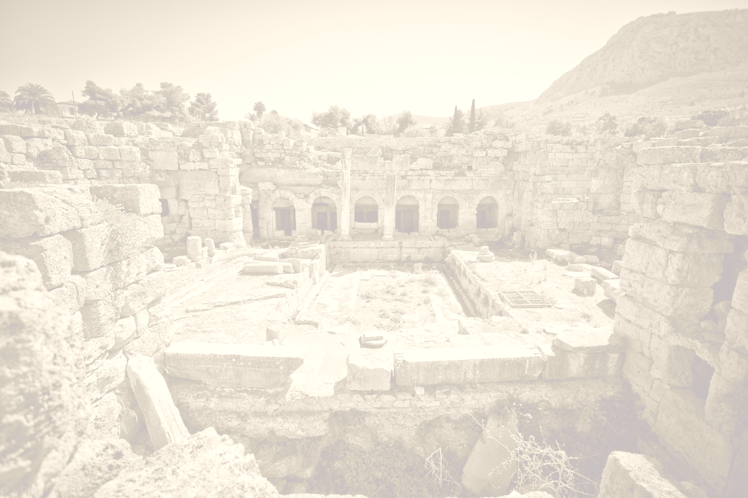
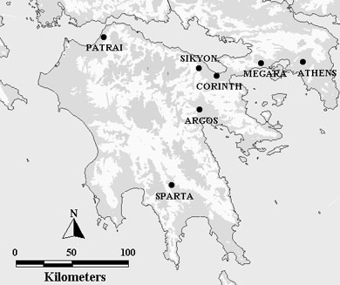
The city of Corinth
Corinth was a prominent Greek city-state dating back to the 8th cent. B.C.
Corinth was destroyed by the Romans in 146 B.C. and lay in ruins until 44 B.C. when it was re-founded by Julius Caesar as a Roman colony
By the first century it had become the foremost commercial center in southern Greece, and third largest city in the empire after Rome and Alexandria
Corinth was located at a 4.5-mile isthmus
Portaging this isthmus allowed trading vessels to avoid a lengthy trip in the treacherous waters of the Peloponnesus

Slide 3
The city of Corinth
It was also famous for the biennial Isthmian games, which were second only to the Olympic games in importance
The first Corinth was famous for vice, particularly prostitution, so much so that “to act like a Corinthian” mean “to fornicate”, and a “Corinthian girl” was a prostitute (Plato)
The temple prostitutes from the temple of Aphrodite are said to have walked the streets at appointed times wearing wooden shoes which had written on their backs the words “follow” and “me”
This culture was aided by the sailors from the two nearby ports
Even if the re-founded city didn’t fully share the culture or reputation of its first iteration, it’s likely it didn’t fully escape it either.

Slide 4
The city of Corinth
The re-created city was settled largely by “freedmen”, who were just above slaves in status
Importantly, the city probably had little to no landed aristocracy in Paul’s day, so that status was likely tied to wealth
“By Paul’s day, Corinth had thus become a pluralistic melting pot of cultures, philosophies, lifestyles and religions, and had the feel of an economic ‘boom-town’” (Witherington)

Slide 5
The church in Corinth
As was his practice, Paul went first to the synagogue, and after hostile Jews tried unsuccessfully to get proconsul Gallio to jail him or worse, Paul opened the doors to the Gentiles
By the writing of 2 Corinthians, the church was mostly Gentile (6:9-22; 8:7; 12:2)
Many scholars believe that Corinthian attitudes were strongly influenced by the admiration and honor given to public philosophical speakers of the day
  In this climate, the message was often secondary to the rhetorical skill of the speaker
  These speakers drew students, fans, and support
  The Corinthian Christians hadn’t shaken loose this cultural belief

Slide 6
Themes in 2 Corinthians
Suffering: Some of the Corinthians see Paul’s suffering as invalidating his spiritual authority
Paul’s travel plans: The Corinthians were put out by Paul’s not visiting when he said he would
What it means to be a leader: In 2 Cor 10-13 we learn that some Hellenistic Jews, calling themselves apostles, had inveigled their way into the church and were undermining Paul’s authority
Paul’s refusal to accept their patronage: Paul is unwilling to take money, except for the Jerusalem collection, in stark contrast to those inveigling apostles
In addition to our 1 and 2 Corinthians, these letters refer to two other letters, for a total of four: Letters A, B, C and D;
1 and 2 Corinthians are letters B and D

Slide 7
2 Corinthians shows us how to conduct ministry in a messy, realistic church context
Despite his best efforts, Paul in 2 Corinthians is dealing with an unhealthy church which is questioning his authority and in danger of polluting or rejecting the gospel
This letter addresses practical questions for leaders:
  If you feel you need to speak a disciplinary word, and people aren’t reacting well, how do you follow up?
  If people are challenging your credibility, should you defend yourself?
  How do you win the person, not just the argument?
  Since the Corinthians seem to view spiritual leadership ego-centrically, how will he show them the right view?
(Questions from a teaching by Dennis McCallum)

Slide 8
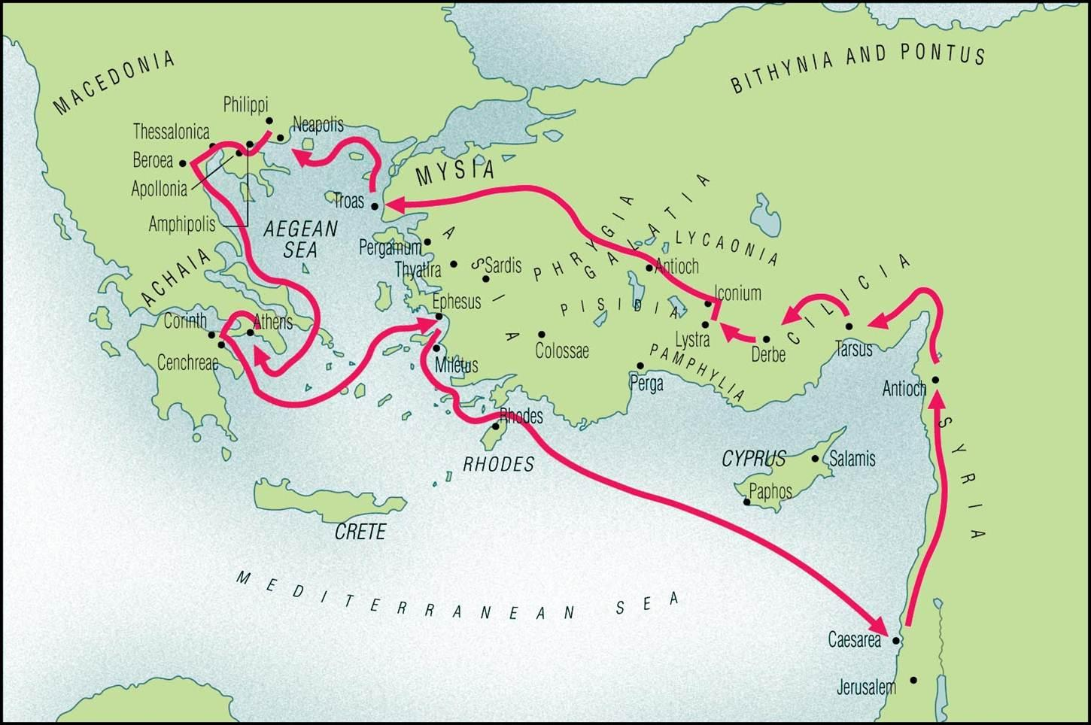
In AD 52 Paul travels from Athens to Corinth,
where he founds the church there
2 Corinthians: Background
Paul founds the Corinthian church
during his second missionary journey

Slide 9
In AD 52 Paul travels from Athens to Corinth,
where he founds the church there

Slide 10
Paul visits a second time and has a painful confrontation (2 Cor 2:5; 7:12; 13:2) which he’d warned they should avoid (1 Cor 4:21)
During this visit there is strong hostility against Paul, focused in one or two leaders whom the Corinthians either support or refuse to condemn
At least one of his opponents attacks him in deeply insulting ways (2 Cor 2:5-8, 10; 7:12) and the gospel itself is in jeopardy
Paul leaves, resolving not to return immediately, leaving him open to charges of fickleness, even though his reason for staying away was to spare them another confrontation (2 Cor 1:16+)
Timothy finds the Corinthian church beset by troubles
When his report makes it back to Paul, Paul leaves immediately
Paul ministers in Ephesus (traveling first to Syria, then Antioch) from 52-55, writing Letter A to the Corinthians (predating our 1 Cor)
Paul receives distressing reports of problems I Corinth in an oral report from Chloe’s people (1 Cor 1:11) and a written letter from the church in Corinth (1 Cor 7:1)
Paul writes Letter B, “1 Corinthians” from Ephesus, referred to in 1 Cor 5:9, probably dealing with church discipline, sending with it Timothy (1 Cor 16:10-11; Acts 19:22) to gather intel
At this point, Paul intends to visit Corinth on the way to and from Macedonia, and then to sail from Corinth to Judea (2 Cor 1:15-16), hoping to gather contributions to the Jerusalem collection (to help believers in Jerusalem suffering from famine and persecution)
Paul founds the church (Acts 18:1-18; 2 Cor 1:19) around AD 51-52, ministering there for 1.5 years
Fun fact: it’s in Corinth that he first meets his good friends Priscilla and Aquila.
It’s also in Corinth during this period that the Lord has to reassure Paul of his safety, since Paul was afraid (Acts 18:9-10)

Slide 11
Paul writes Letter C, delivered by Titus and referred to in 2 Cor 2:3-4; 7:12, expressing his love for them but laying down the standards he expected, demanding punishment for the ringleader who had opposed him so severely
Meanwhile in Ephesus things are looking grim as he faces a “deadly peril” such that he “despaired of life itself” (2 Cor 1:8-10)

Slide 12
Paul leaves Ephesus after the Demetrius riot (Acts 19:23-20:1) for Troas where, although a door to ministry opens up (2 Cor 2:12), he fails to meet Titus
At this point Paul anxiously heads for Macedonia (2 Cor 2:13)
In Macedonia Paul continues his pastoral ministry (Acts 20:1-2) and the Jerusalem collection (2 Cor 8:1-4; 9:2), though the churches there are very poor (8:2) and undergoing active persecution, and Titus was still AWOL, all of which left Paul very anxious (7:5)
Paul finally meets Titus and receives his report of goodwill in Corinth (2 Cor 7:6-7) leaving Paul euphoric; there’s every indication that the Corinthians have not been permanently alienated by the Severe Letter (C) and the worst is over
Letter D: 2 Corinthians (Some break this out into separate, subsequent letters)

Slide 13
Was Paul successful?
It seems likely Paul reconciled with the Corinthians, despite the tone of chapters 10-13, because he wintered with them (Acts 20:3, 6) and the situation was stable enough for him to write the letter to the Romans during while there (Rom 15:26; 16:1)
In Romans Paul reports that the Corinthians contributed to the Jerusalem collection, suggesting their misgivings had been overcome and Paul’s authority had been accepted
Much later, c. 95, Clement, the bishop of Rome, wrote a letter to the Corinthian church complaining of divisions much the way Paul did in 1 Corinthians, so their issues didn’t simply vanish

