Slide 1
…
Tim Collins
http://www.pas.Rochester.edu/~tim/study/study.html
Sermon on the Mount:
Adultery and Divorce

Slide 2
Review from last meeting
We are looking at the antitheses—“you have heard… but I tell you”
Why are they called “antitheses”, and how is this misleading?

Slide 3
Review from last meeting
We are looking at the antitheses—“you have heard… but I tell you”
Not so much antitheses as intensifications of the Law of Moses
First one: murder
You have heard: don’t murder
But I say… (what?)

Slide 4
Review from last meeting
We are looking at the antitheses—“you have heard… but I tell you”
Not so much antitheses as intensifications of the Law of Moses
First one: murder
You have heard: don’t murder
But I say, anyone who
Is angry is subject to judgment
Who says “raca” is answerable to the court
Who says “you fool” is in danger of the fires of hell

Slide 5
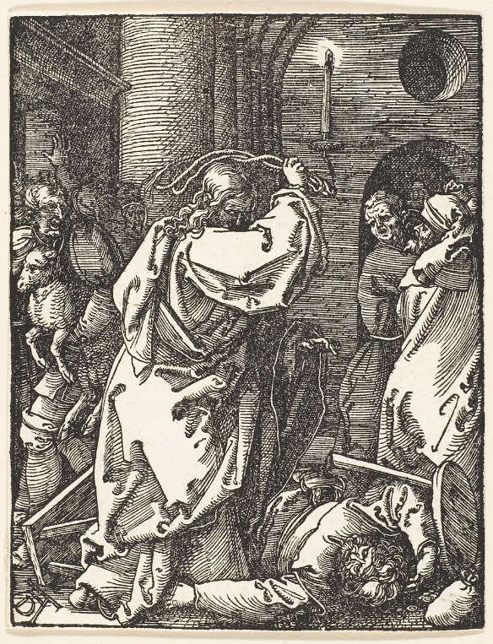
Review from last meeting
First, note that not all anger is sinful (Jesus in the temple)
Detachment is not the goal (and Christianity is not Buddhism)

Slide 6
Review from last meeting
Second, Jesus’ teaching:
ANGER ⇒ SLANDER ⇒ DISCORD ⇒ VIOLENCE ⇒ MURDER
Focus here, not here

Slide 7
Review from last meeting
Second, Jesus’ teaching:
ANGER ⇒ SLANDER ⇒ DISCORD ⇒ VIOLENCE ⇒ MURDER
Focus here, not here
Jesus: Uproot the sin before it can grow!
Quick quiz: which New Testament Epistle is a commentary on the SOTM?

Slide 8
Review from last meeting
Second, Jesus’ teaching:
ANGER ⇒ SLANDER ⇒ DISCORD ⇒ VIOLENCE ⇒ MURDER
Focus here, not here
Jesus: Uproot the sin before it can grow!
Quick quiz: which New Testament Epistle is a commentary on the SOTM?
Answer: James!

Slide 9
Review from last meeting
Second, Jesus’ teaching:
ANGER ⇒ SLANDER ⇒ DISCORD ⇒ VIOLENCE ⇒ MURDER
Focus here, not here
Jesus: Uproot the sin before it can grow!
The epistle of James, a commentary on the SOTM, puts it this way:
“But one is tempted by one’s own desire, being lured and enticed by it; 15 then, when that desire has conceived, it gives birth to sin, and that sin, when it is fully grown, gives birth to death.” (James 1:15)

Slide 10
Not just murder but anger and harsh words
Sages of Jesus’ day tried to build a “fence around the law”
The theory: if you try to obey the law you’ll fail sometimes
So add more laws around it, and try to follow that bigger set and you’ll be less likely to break the law itself
So: if you want to avoid becoming unclean, don’t just follow the Torah; don’t even talk to a Gentile and certainly don’t walk through Samaria

Slide 11
Not just murder but anger and harsh words
Sages of Jesus’ day tried to build a “fence around the law”
The theory: if you try to obey the law you’ll fail sometimes
So add more laws around it, and try to follow that bigger set and you’ll be less likely to break the law itself
So: if you want to avoid becoming unclean, don’t just follow the Torah; don’t even talk to a Gentile and certainly don’t walk through Samaria
Jesus is raising the bar: not just murder, but anger
Q: Is Jesus also building a fence around the law?

Slide 12
This week: adultery and divorce
27 “You have heard that it was said, ‘You shall not commit adultery.’ 28 But I say to you that everyone who looks at a woman with lust has already committed adultery with her in his heart. 29 If your right eye causes you to sin, tear it out and throw it away; it is better for you to lose one of your members than for your whole body to be thrown into hell. 30 And if your right hand causes you to sin, cut it off and throw it away; it is better for you to lose one of your members than for your whole body to go into hell.
31 “It was also said, ‘Whoever divorces his wife, let him give her a certificate of divorce.’ 32 But I say to you that anyone who divorces his wife, except on the ground of unchastity, causes her to commit adultery; and whoever marries a divorced woman commits adultery.

Slide 13
“anyone who looks at a woman lustfully”
The word “looks” is in the present tense
In Greek, the present tense often has a sense of continuous action
This verse probably refers “not to noticing a person’s beauty, but to imbibing it, meditating on it, seeking to possess it” [Keener]

Slide 14
“anyone who looks at a woman lustfully”
The word “looks” is in the present tense
In Greek, the present tense often has a sense of continuous action
This verse probably refers “not to noticing a person’s beauty, but to imbibing it, meditating on it, seeking to possess it” [Keener]

Slide 15
“anyone who looks at a woman lustfully”
The word “looks” is in the present tense
In Greek, the present tense often has a sense of continuous action
This verse probably refers “not to noticing a person’s beauty, but to imbibing it, meditating on it, seeking to possess it” [Keener]
Clearly, this passage is for both men and women, since adultery is not gender specific

Slide 16
“anyone who looks at a woman lustfully”
The word “looks” is in the present tense
In Greek, the present tense often has a sense of continuous action
This verse probably refers “not to noticing a person’s beauty, but to imbibing it, meditating on it, seeking to possess it” [Keener]
In this passage Jesus combines the commandment against adultery with that against coveting

Slide 17
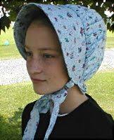
Ancients differed in their views of lust
Some Mediterranean cultures saw lust as natural
Much like my French friend Jacques, who sees appreciation of the bodily form as natural and healthy
Jewish writers weren’t so sanguine about lust; e.g. Job:
“I have made a covenant with my eyes; how could I look upon a virgin?”
Some Jewish writers also saw lust as equivalent to adultery
Testament of Isaachar 7:2: “Except my wife I have not known any woman. I never committed fornication by the uplifting of my eyes” (2nd cent. AD)
In a culture where married women were expected to cover their heads to avoid provoking lust, Jesus puts responsibility squarely back on the viewer

Slide 18
Jesus’ solution for adultery parallels that for murder
What does Jesus teach?
(…John Stott clip, below…)
Has anyone here deliberately restricted activities, reading, movies, time with others, etc., to avoid sinning in this area?

Slide 19
Jesus’ solution for adultery parallels that for murder
What does Jesus teach?
(…John Stott clip…)
Has anyone here deliberately restricted activities, reading, movies, time with others, etc., to avoid sinning in this area?
Pornography is, famously, at epidemic proportions
In Jesus’ day, communities were small, lust was restricted to personal interactions
Now we give our children pornography machines (youtube, file sharing, etc.)

Slide 20
Addiction counseling focuses on impulse control

Slide 21
Addiction counseling focuses on impulse control
Q: How can we use Jesus’ teaching to tackle porn?

Slide 22
Review: anger, adultery
The law forbids murder; Jesus teaches:
ANGER ⇒ SLANDER ⇒ DISCORD ⇒ VIOLENCE ⇒ MURDER
Focus here, not here

Slide 23
Review: anger, adultery
The law forbids adultery; Jesus teaches:
LUST ⇒ DESIRE ⇒ OBSESSION ⇒ TEMPTATION⇒ ADULTERY
Focus here, not here
If your eye causes you to sin, pluck it out
What’s an application of this?

Slide 24
Review: anger, adultery
The law forbids adultery; Jesus teaches:
LUST ⇒ DESIRE ⇒ OBSESSION ⇒ TEMPTATION⇒ ADULTERY
Focus here, not here
If your eye causes you to sin, pluck it out
What’s an application of this?
It’s better to miss out on Game of Thrones if it is a temptation

Slide 25
Review: anger, adultery
The law forbids adultery; Jesus teaches:
LUST ⇒ DESIRE ⇒ OBSESSION ⇒ TEMPTATION⇒ ADULTERY
Focus here, not here
If your eye causes you to sin, pluck it out
What’s an application of this?
It’s better to miss out on Game of Thrones if it is a temptation
Hungry, Angry, Lonely/alone, Tired: Avoid triggers, avoid an empty gas task

Slide 26
Review: anger, adultery
The law forbids adultery; Jesus teaches:
LUST ⇒ DESIRE ⇒ OBSESSION ⇒ TEMPTATION⇒ ADULTERY
Focus here, not here
If your eye causes you to sin, pluck it out
What’s an application of this?
It’s better to miss out on Game of Thrones if its soft-core porn is a temptation
Hungry, Angry, Lonely/alone, Tired: Avoid triggers, avoid an empty gas task
Live as if following Jesus were more important to you than entertainment and pleasure—and this will mean being deliberate about priorities

Slide 27
This week: divorce
Matthew 5:31: “It was also said, ‘Whoever divorces his wife, let him give her a certificate of divorce.’ But I say to you that anyone who divorces his wife, except on the ground of unchastity, causes her to commit adultery; and whoever marries a divorced woman commits adultery.

Slide 28
This is a tough topic
Many (most?) of us have been touched by divorce
Half of marriages end in divorce
Churches in generations past haven’t always done well with this topic
As a result, divorced Christians often feel shame and guilt
This is on top of feelings of pain, disappointment, betrayal and loss
If the shame of previous generations in the church was unhealthy, the high rate of divorce is too
Our culture and our churches need wise teaching from Jesus on this topic!

Slide 29
Today’s modest goal: Understand what Jesus teaches
What we won’t do today:
Explain or excuse the actions and policies of the church in days past
Pick up stones or pronounce judgment on you or your loved ones
What we will do today:
Unpack Jesus’ teaching
Understand it in light first-century culture
Think about what it means for us
If our discussion makes you want to talk more to someone, our pastors and Council members (as well as myself) are here for you

Slide 30
Background: Jesus on Divorce
Deuteronomy 24:1-4: Divorce is permitted in cases of “indecency”
This was a hotly debated topic in Jesus’ day
Rabbi Shammai
Indecency should be narrowly construed, i.e. unchastity
Rabbi Hillel
Indecency should be broadly construed
“Even if she spoiled his dish”
“Even if he found someone else prettier than she”

Slide 31
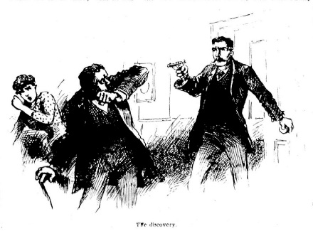
Background: Jesus on Divorce
Deuteronomy 24:1-4: Divorce is permitted in cases of “indecency”
This was a hotly debated topic in Jesus’ day
Rabbi Shammai
Indecency should be narrowly construed, i.e. unchastity
Rabbi Hillel
Indecency should be broadly construed
“Even if she spoiled his dish”
“Even if he found someone else prettier than she”

Slide 32
Background: Jesus on Divorce
Deuteronomy 24:1-4: Divorce is permitted in cases of “indecency”
This was a hotly debated topic in Jesus’ day
Rabbi Shammai
Indecency should be narrowly construed, i.e. unchastity
Rabbi Hillel
Indecency should be broadly construed
“Even if she spoiled his dish”
“Even if he found someone else prettier than she”
The in flagrante delicto school
The burnt toast school

Slide 33
Jews and Romans treated divorce differently
Roman law permitted either husband or wife to divorce each other, regardless of the others’ wishes
Except in extraordinary circumstances, Jewish law permitted only the husband to divorce the wife, regardless of her wishes
Women in both cultures were usually financially and legally dependent on their husbands
“The purpose of the Deuteronomy 24 law itself was probably ‘to check haste in divorce’, hence to provide some legal protection for the wife” [Keener]

Slide 34
Jesus focuses on the purpose of marriage
Matthew 19:3: Some Pharisees came to him, and to test him they asked, “Is it lawful for a man to divorce his wife for any cause?”
4 He answered, “Have you not read that the one who made them at the beginning ‘made them male and female,’ 5 and said, ‘For this reason a man shall leave his father and mother and be joined to his wife, and the two shall become one flesh’? 6 So they are no longer two, but one flesh. Therefore what God has joined together, let no one separate.”

Slide 35
Jesus focuses on the purpose of marriage
Matthew 19:3: Some Pharisees came to him, and to test him they asked, “Is it lawful for a man to divorce his wife for any cause?”
4 He answered, “Have you not read that the one who made them at the beginning ‘made them male and female,’ 5 and said, ‘For this reason a man shall leave his father and mother and be joined to his wife, and the two shall become one flesh’? 6 So they are no longer two, but one flesh. Therefore what God has joined together, let no one separate.”
7 They said to him, “Why then did Moses command us to give a certificate of dismissal and to divorce her?” 8 He said to them, “It was because you were so hard-hearted that Moses allowed you to divorce your wives, but from the beginning it was not so. 9 And I say to you, whoever divorces his wife, except for unchastity, and marries another commits adultery.”

Slide 36
Jesus focuses on the purpose of marriage
Matthew 19:3: Some Pharisees came to him, and to test him they asked, “Is it lawful for a man to divorce his wife for any cause?”
4 He answered, “Have you not read that the one who made them at the beginning ‘made them male and female,’ 5 and said, ‘For this reason a man shall leave his father and mother and be joined to his wife, and the two shall become one flesh’? 6 So they are no longer two, but one flesh. Therefore what God has joined together, let no one separate.”
7 They said to him, “Why then did Moses command us to give a certificate of dismissal and to divorce her?” 8 He said to them, “It was because you were so hard-hearted that Moses allowed you to divorce your wives, but from the beginning it was not so. 9 And I say to you, whoever divorces his wife, except for unchastity, and marries another commits adultery.”
Porneia: forbidden sexual acts, e.g. adultery, prostitution, incest, etc.; more general than the specific term for adultery, moichaō

Slide 37
Jesus focuses on the purpose of marriage
10 His disciples said to him, “If such is the case of a man with his wife, it is better not to marry.”
11 But he said to them, “Not everyone can accept this teaching, but only those to whom it is given. 12 For there are eunuchs who have been so from birth, and there are eunuchs who have been made eunuchs by others, and there are eunuchs who have made themselves eunuchs for the sake of the kingdom of heaven. Let anyone accept this who can.”
DISCORD ⇒ LUST, &c. ⇒ UNCHASTITY ⇒ DIVORCE
Focus here, not here

Slide 38
Jesus focuses on the purpose of marriage
10 His disciples said to him, “If such is the case of a man with his wife, it is better not to marry.”
11 But he said to them, “Not everyone can accept this teaching, but only those to whom it is given. 12 For there are eunuchs who have been so from birth, and there are eunuchs who have been made eunuchs by others, and there are eunuchs who have made themselves eunuchs for the sake of the kingdom of heaven. Let anyone accept this who can.”
DISCORD ⇒ DISTANCE ⇒ CONFLICT, ANGER ⇒ DIVORCE
Focus here, not here

Slide 39
Paul’s teaching makes it clear this wasn’t just legalism
Just as Jesus didn’t prohibit all forms of anger or sexual desire, and “just as the exceptions to Jesus’ commands are more implicit than explicit, so also 5:32 most likely does not reflect a consideration of every conceivable legitimate or illegitimate ground for divorce. Instead Jesus is responding to a specific debate in first-century Judaism.
“At least Paul seems to have recognized Jesus’ words as not comprehensive, since in 1 Cor 7:15 he introduces a second legitimate ground for divorce that Jesus never mentions.” (Craig Blomberg)
1 Corinthians 7:15: “But if the unbelieving partner separates, let it be so; in such a case the brother or sister is not bound. It is to peace that God has called you.”

Slide 40
God sometimes allows what’s less than ideal
Due to weakness or hardness of heart:
God permitted Israel to have a king (1 Sam 12:12-13)
God led Israel through the desert, not near the Philistines, lest they change their minds and return to Egypt (Ex 13:17)
The law of Moses often tolerated and regulated that which was less than best (and in some cases downright bad):
Slavery, avengers of blood, polygyny, marrying captive Gentile women, and (here) divorce)
Jesus challenges the Pharisees of proof-texting when they should have been reading in light of God’s entire plan

Slide 41
Jesus: With your whole heart try to achieve God’s aims
Jesus is stricter than Shammai because Shammai couldn’t invalidate Hillel marriages; Jesus does [Keener]
Jesus wants us to back up and ask how to make God’s will for us a reality
…and like the “gouged eyes” teaching, if we don’t think we are up to it, maybe we should take the high road and not marry at all
The eunuch reference would have had the same “ick factor” for Jews as it does for us
Far more than with Game of Thrones, we might need to sacrifice to achieve this
Wherever you are at (married, single, divorced), wherever your relationships are at (healthy? toxic?),
aim high and try to make it a reality by God’s strength and with the support of others

Slide 42
Jesus: With your whole heart try to achieve God’s aims
Jesus is stricter than Shammai because Shammai couldn’t invalidate Hillel marriages; Jesus does [Keener]
Jesus wants us to back up and ask how to make God’s will for us a reality
…and like the “gouged eyes” teaching, if we don’t think we are up to it, maybe we should take the high road and not marry at all
The eunuch reference would have had the same “ick factor” for Jews as it does for us
Far more than with Game of Thrones, we might need to sacrifice to achieve this
Paul adds: don’t focus on judgment; you are forgiven and set free. Focus on love and obedience whatever the cost
Wherever you are at (married, single, divorced), wherever your relationships are at (healthy? toxic?),
aim high and try to make it a reality by God’s strength and with the support of others

Slide 43
Modern conservative Christians often allow divorce for the 3 A’s
Adultery
Addiction
Abuse

Slide 44
Modern conservative Christians often allow divorce for the 3 A’s
Adultery
Addiction
Abuse
Q: How can we follow Jesus’ teaching without just joining the burnt-toast school?

Slide 45
Modern conservative Christians often allow divorce for the 3 A’s
Adultery
Addiction
Abuse
If you are just starting out in marriage, work very hard to make a healthy marriage that will last.
Q: What does this teaching say to those who are about out of hope?

Slide 46
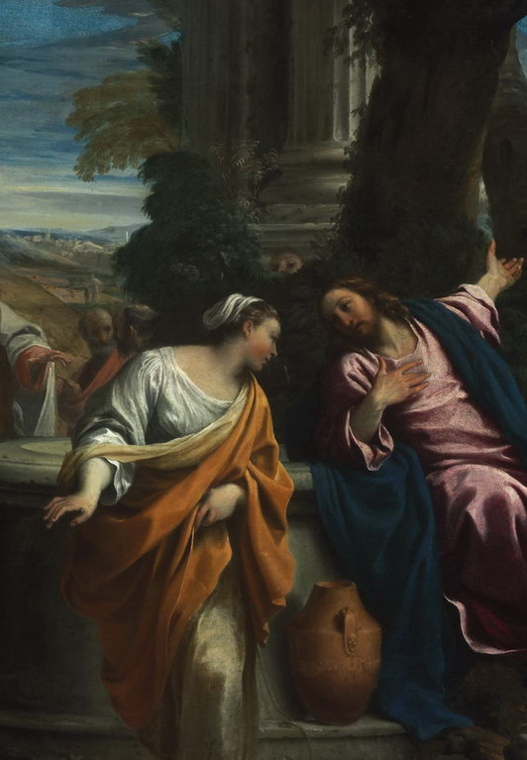
If you are divorced, what is it like to talk to Jesus?
We have record of a conversation between Jesus and a multiply divorced woman in John 4
Jesus doesn’t let honor/shame/culture keep him from interacting with her
He doesn’t ignore her broken marriages but he also doesn’t shame or harangue her; Jesus points her to himself
“Then the woman left her water jar and went back to the city. She said to the people, ‘Come and see a man who told me everything I have ever done! He cannot be the Messiah, can he?’”
Q: What does her reaction to Jesus tell us about her experience of their conversation?

Slide 47
Modern churches often treat divorce as no-fault
Husband leaves wife
Husband leaves the local church
Church intervenes, encourages counseling, threatens disciple, but does nothing public
Leadership meets privately with the wife to offer support
The wife, lacking public or corporate support, also leaves the local church
Q: How can we improve on this process?

Slide 48
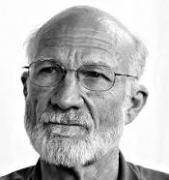
Maybe we’ve been looking at the SOTM all wrong
Stanley Hauerwas, modern evangelist for Mennonite views and Duke University’s bad boy of theology:
“All the so-called ‘hard sayings’ of the SOTM are designed to remind us that we cannot live without depending on the support and trust of others. We are told not to lay up treasure for ourselves so we must learn to share. We are told not to be anxious, not to try to ensure the future, thus making it necessary to rely on one another for food, clothing, and housing. We are told not to judge, thereby requiring that we live honestly and truthfully with one another. Such a people have no need to parade their piety because they know in a fundamental sense it is not theirs.
From “Living the Proclaimed Reign of God”, Interpretation 47, 152-8 (1993)

Slide 49
Maybe we’ve been looking at the SOTM all wrong
Stanley Hauerwas, modern evangelist for Mennonite views and Duke University’s bad boy of theology:
“Rather, the piety of the community capable of hearing and living by the Sermon is that which knows the righteousness that exceeds that of the scribes and Pharisees is possible on when a people have learned that the righteousness that exceeds that of the scribes and Pharisees is possible only when a people have learned that their righteousness is a gift from God gives them through making them learn to serve one another.

Slide 50
Maybe we’ve been looking at the SOTM all wrong
Stanley Hauerwas, modern evangelist for Mennonite views and Duke University’s bad boy of theology:
“Surely this is also the necessary presupposition for understanding the antitheses in Matthew 5. To be capable of living chastely, to marry without recourse to divorce, to live without the necessity of oaths, to refrain from returning evil with evil, to learn to love the enemy is surely impossible for isolated individuals.

Slide 51
Maybe we’ve been looking at the SOTM all wrong
Stanley Hauerwas, modern evangelist for Mennonite views and Duke University’s bad boy of theology:
“As individuals we can no more act in these ways than we can will not to be anxious. For the very attempt to will not to be anxious only creates anxiety. To be free of anxiety is possible only when we find ourselves part of a community that is constituted by such a compelling adventure that we forget our fears in the joy of the new age.”

Slide 52
Maybe we’ve been looking at the SOTM all wrong
Stanley Hauerwas, modern evangelist for Mennonite views and Duke University’s bad boy of theology:
“As individuals we can no more act in these ways than we can will not to be anxious. For the very attempt to will not to be anxious only creates anxiety. To be free of anxiety is possible only when we find ourselves part of a community that is constituted by such a compelling adventure that we forget our fears in the joy of the new age.”
Q: How have you found it easier to follow Jesus teachings by being in a trusting, loving Christian community—if you have?

