Slide 1
EOS
Physics of the EOS
Range of thermodynamical parameters $(ρ,T,P,E_{int})$
Metallicity $\left(X, Y, Z\right)$
Current status regarding putting into ASTROBear

Slide 2
Parameters
Range of parameters in CE run 143
$−9.2<\log{ρ}<−2.3$
$0.5<\log{T}<7.3$
$1.3<\log{E^{(1)}}<13.1$
$1.1<\log{P}<12.9$
$^{(1)}$From VISIT, per volume?
Other simulations have similar ranges?

Slide 3
Ideal Gas
Particles are classical and in motion.
The particles have negligible volume.
The particles don't interact. There are no attractive or repulsive forces between them.
The average translational kinetic energy of the gas particles is proportional to temperature.
Notes:
You don’t need to be monoatomic but EOS change when deal with diatomic or more complicated gas

Slide 4
Two ways to calculate EOS
Physical Picture (OPAL)
Treat gas as individual particles
Start from Grand Canonical Ensemble: assume a system in thermodynamical equilibrium with a heat reservoir; but allow heat exchange and particle exchange
Physical but computationally expensive
Chemical picture (all others)
Consider atoms and molecules retain a definite identity and interact through pair potentials
Solve the quantum problem first, then consider everything as “states’’
Drawback: when pressure allows pressure-ionization, pair potential becomes meaningless

Slide 5
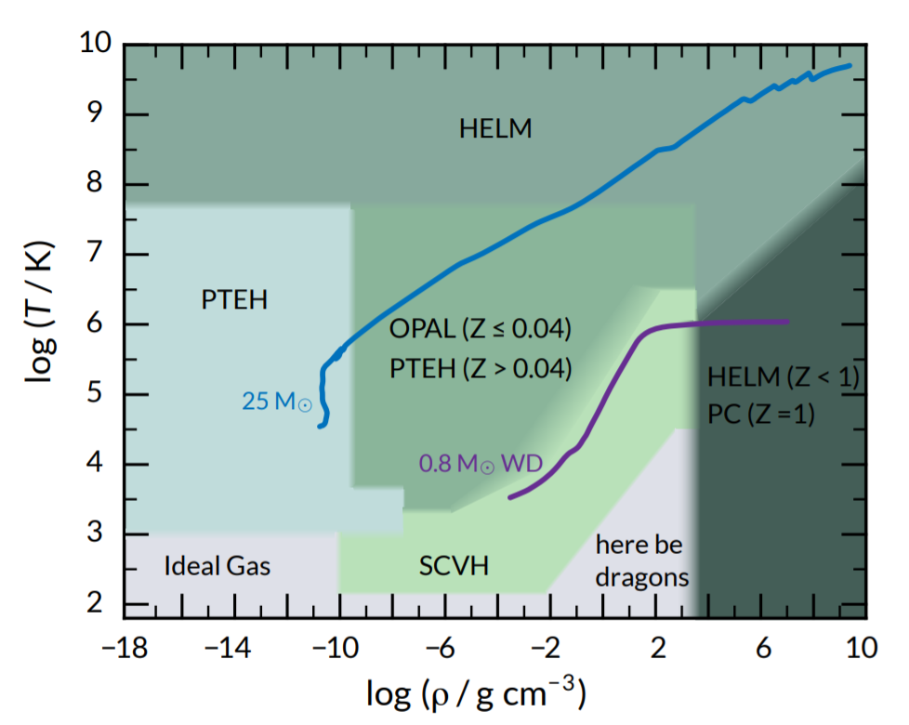
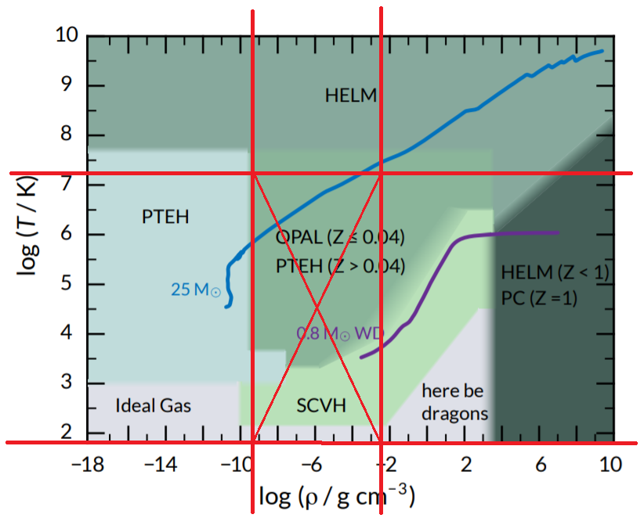
OPAL

Slide 6
OPAL EOS
Considers …
Physical picture
Expands pressure into two-body, three-body clusters
Non-relativistic Fermi-Dirac electron
All stages of ionization and excitation
Degenerate coulomb corrections
Quantum electron diffraction
Pressure ionization
Ladder diagram (consider particle size)
Accuracy to the order ${\left(n_{e}^{2}\right)}^{5/2}$

Slide 7
OPAL EOS
Limitation…
Consider elements up to neon (anything heavier then neon is neon)
Relative abundance of heavier elements (ignore H and He)
above $T∼ {10}^{9} K$: pair production becomes an issue
Below $T∼ 5000 K$: numerical difficulty
Above $ρ∼{10}^{5} g cm^{−3}$: electron are relativistic.

Slide 8
SCVH

Slide 9
SCVH EOS
Considers …
“chemical picture”
Uses “ (Helmholtz) free energy minimization method” $F=U−TS$
Obtained a EOS for pure hydrogen; a EOS for pure helium
Interpolate to get values in between
Excludes all heavier elements (Z=0)

Slide 10
SCVH EOS
Hydrogen
“plasma phase transition” (PPT): Pressure ionization occurs discontinuously through first-order phase transition (at $\log{T_{c}}\sim 4.185$)
Considers $H$, $H^{+}$, $H_{2}$, $e$
Accounts for weak diffraction in the interaction of heavy particles
Helium
Also considers Helium PPT
Considers $He$, ${He}^{2+}$, ${He}^{+}$, $e$
In between
Interpolation and approximation

Slide 11
PTEH

Slide 12
PTEH EOS
Based on Helmholtz free energy minimization
Elements included are $H$, $H^{+}$ ,$H_{2}$ , ${He}^{2+}$, ${He}^{+}$, $He$, $e$; as well as 7 heavier elements C, N, O, Ne, Mg, Si and Fe, which are assumed to be fully ionized, at all temperature and density.
Heavy elements effects EOS insignificantly; but influences opacity greatly

Slide 13
HELM

Slide 14
HELM EOS
Assume fully ionized gas (at very high temperature or density)
Deals with electron-positron physics
Based on Helmholtz free energy

Slide 15
Dragons

Slide 16
Proposed range
Pair
production
Physical & monotone
One more thing …
Metallicity
Quantum
Mechanics

Slide 17
One last thing … Metallicity
Slight variation in Metallicity is insignificant for EOS, but impacts greatly for opacity
Solar metallicity
$X\sim 0.74$
$Y\sim 0.25$
$Z\sim 0.0134$
High-metallicity star: $Z\sim 0.03$, theoretically people considers up to $Z\sim 0.05$
Helium abundance goes up to $Y\sim 0.42±0.1$ for very old star cluster. Typical value close to that of the sun
Ref: Big orange book (Carroll & Ostlie), Pg 474 sec. 13.3
Ref: AAS 106, 275-302 (1994) http://articles.adsabs.harvard.edu/pdf/1994A%26AS..106..275B
Ref: (Y abundance) https://arxiv.org/ftp/arxiv/papers/0811/0811.2980.pdf

Slide 18
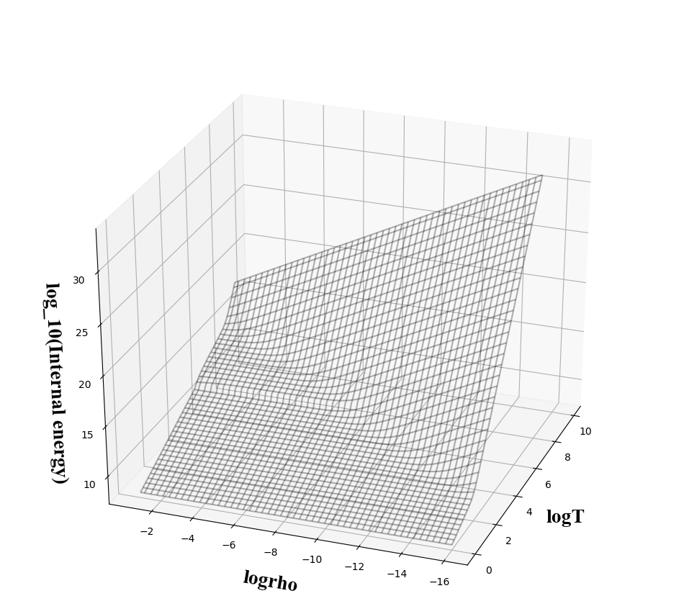
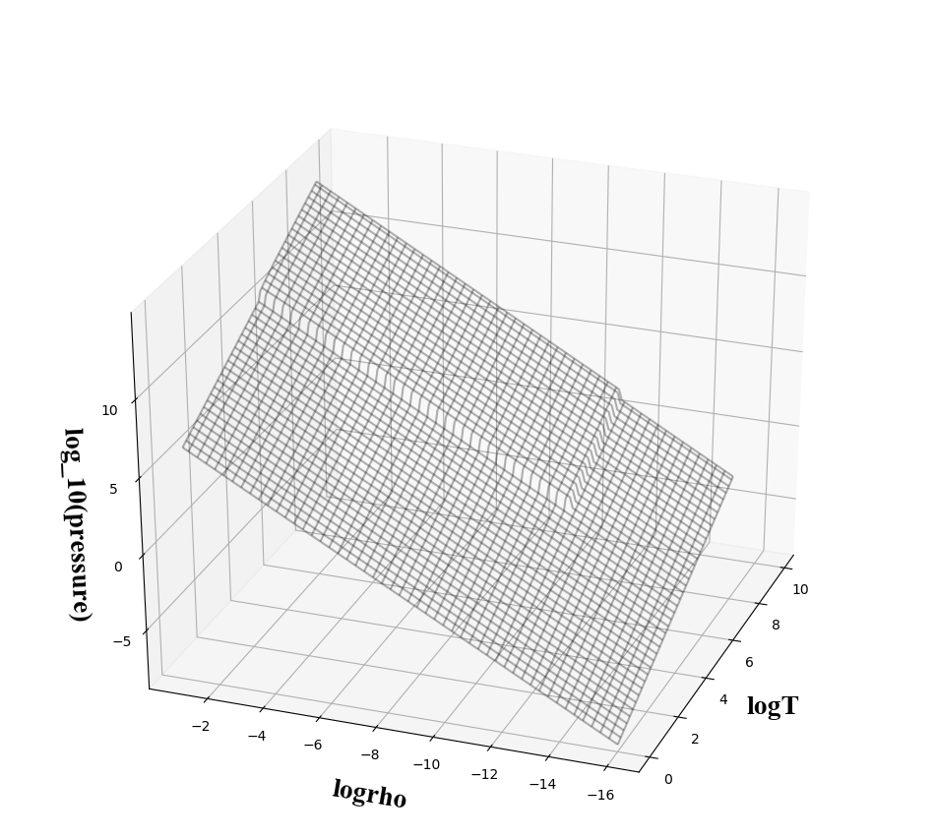
$$−18≤\log{ρ}≤−1 0≤\log{T}≤8 \\ \left(Z=0.02\right)$$
Monotonicity implies that in the range we choose, if we have two parameters out of $\left\{ρ, T, P, E\right\}$, then the other two are uniquely defined.
In other words, we only need two tables to create all others.
$$E(ρ, T)$$
$$P\left(ρ, T\right)$$
$P\left(ρ, T\right)$ and $E(ρ, T)$are both monotone

Slide 19
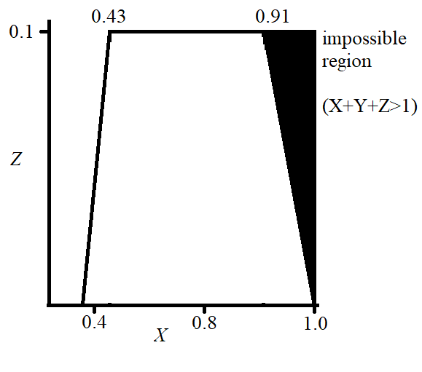
$$−18≤\log{ρ}≤−1 0≤\log{T}≤8$$ EOS is monotone$∀X≥0.5, 0≤Z≤0.1$
Proposed metallicity range
$0≤Z≤0.1$
$0.5≤X≤1$
This leads to $0≤Y≤0.5$
MESA is able to produce the
tables in the unphysical region…
(without warning)

Slide 20
Currently available EOS tables
$P\left(ρ, T\right)$ (MESA)
$E\left(ρ, T\right)$ (MESA)
$T\left(ρ, P\right)$
$T\left(ρ, E\right)$
$C_{s}\left(ρ,T\right)$ (MESA)
$C_{V}\left(ρ,T\right)$ (MESA)
Can be calculated indirectly…
$P\left(ρ, E\right)=P\left(ρ,T\left(ρ, E\right)\right)$
$E\left(ρ,P\right)=E\left(ρ,T\left(ρ,P\right)\right)$
Metalicity
$X=0.5, 0.6, 0.7, 0.8, 0.9, 1.0$
$Z=0.0, 0.02, 0.04, 0.06, 0.08, 0.10$

Slide 21
Next step
Putting EOS into AstroBEAR
For tabulated $z\left(x, y\right)$, at any $\left(x_{0},y_{0}\right)$, we can get the corresponding $z_{0}$
Test EOS

Slide 22
Additional info
Metallicity: for an arbitrary $(X, Z)$, using sampled values to approximate thermodynamical quantities differs by at most 0.05 from data directly obtained from MESA. (except around $X=1$, the difference goes up to 0.2 due to numerical difficulties).
Metalicity
$X=0.5, 0.6, 0.7, 0.8, 0.9, 1.0$
$Z=0.0, 0.02, 0.04, 0.06, 0.08, 0.10$

Slide 23
Inversion algorithm
Let $f=z(x, y)$ be a monotone function where $z$ is defined on a rectangular parameter space.
Since the data is discrete, consider $\left\{z_{x1}\left(y\right),z_{x1}\left(y\right),z_{x1}\left(y\right)…\right\}$ where $z_{xi}$ is the slice at $x=x_{i}$. Reducing the variables to 1D
Now, at the new parameter space $\left(x, z\right),$ define an “error function” on each “sample point” $z_{0}: ERR\left(y\right)=\left|z\left(y\right)−z_{0}\right|$ where $y$ is the corresponding $y$ at $z_{0}$. Minimize $ERR\left(y\right)$ to get the best fit using Nelder-Mead algorithm.
Sometimes in the python function the guess value will exceed the limitations of the table. So a “pseudo-function” is implemented to extend $ERR(y)$ to greater region (assume linear at the end)
Do this for all $z_{0}∈$ new parameter space, and we get the inverted table.

Slide 24
Inversion algorithm
Let $f=z(x, y)$ be a monotone function where $z$ is defined on a rectangular parameter space.
The inversion outputs $g=y\left(x, z\right)$. Some values on the rectangular parameter space $\left(x, z\right)$ has no corresponding value. We use $nan$ to take the place
If we invert $g$ function again to obtain $h=z_{2}\left(x, y\right).$ Then compare $f−h$, the difference is less then 0.05 at all times (numerical difference, not percentage). It appears that the inverting algorithm only have difficulties where on the original function the first derivative is not continuous (otherwise the difference is practically 0).

